Slide 1
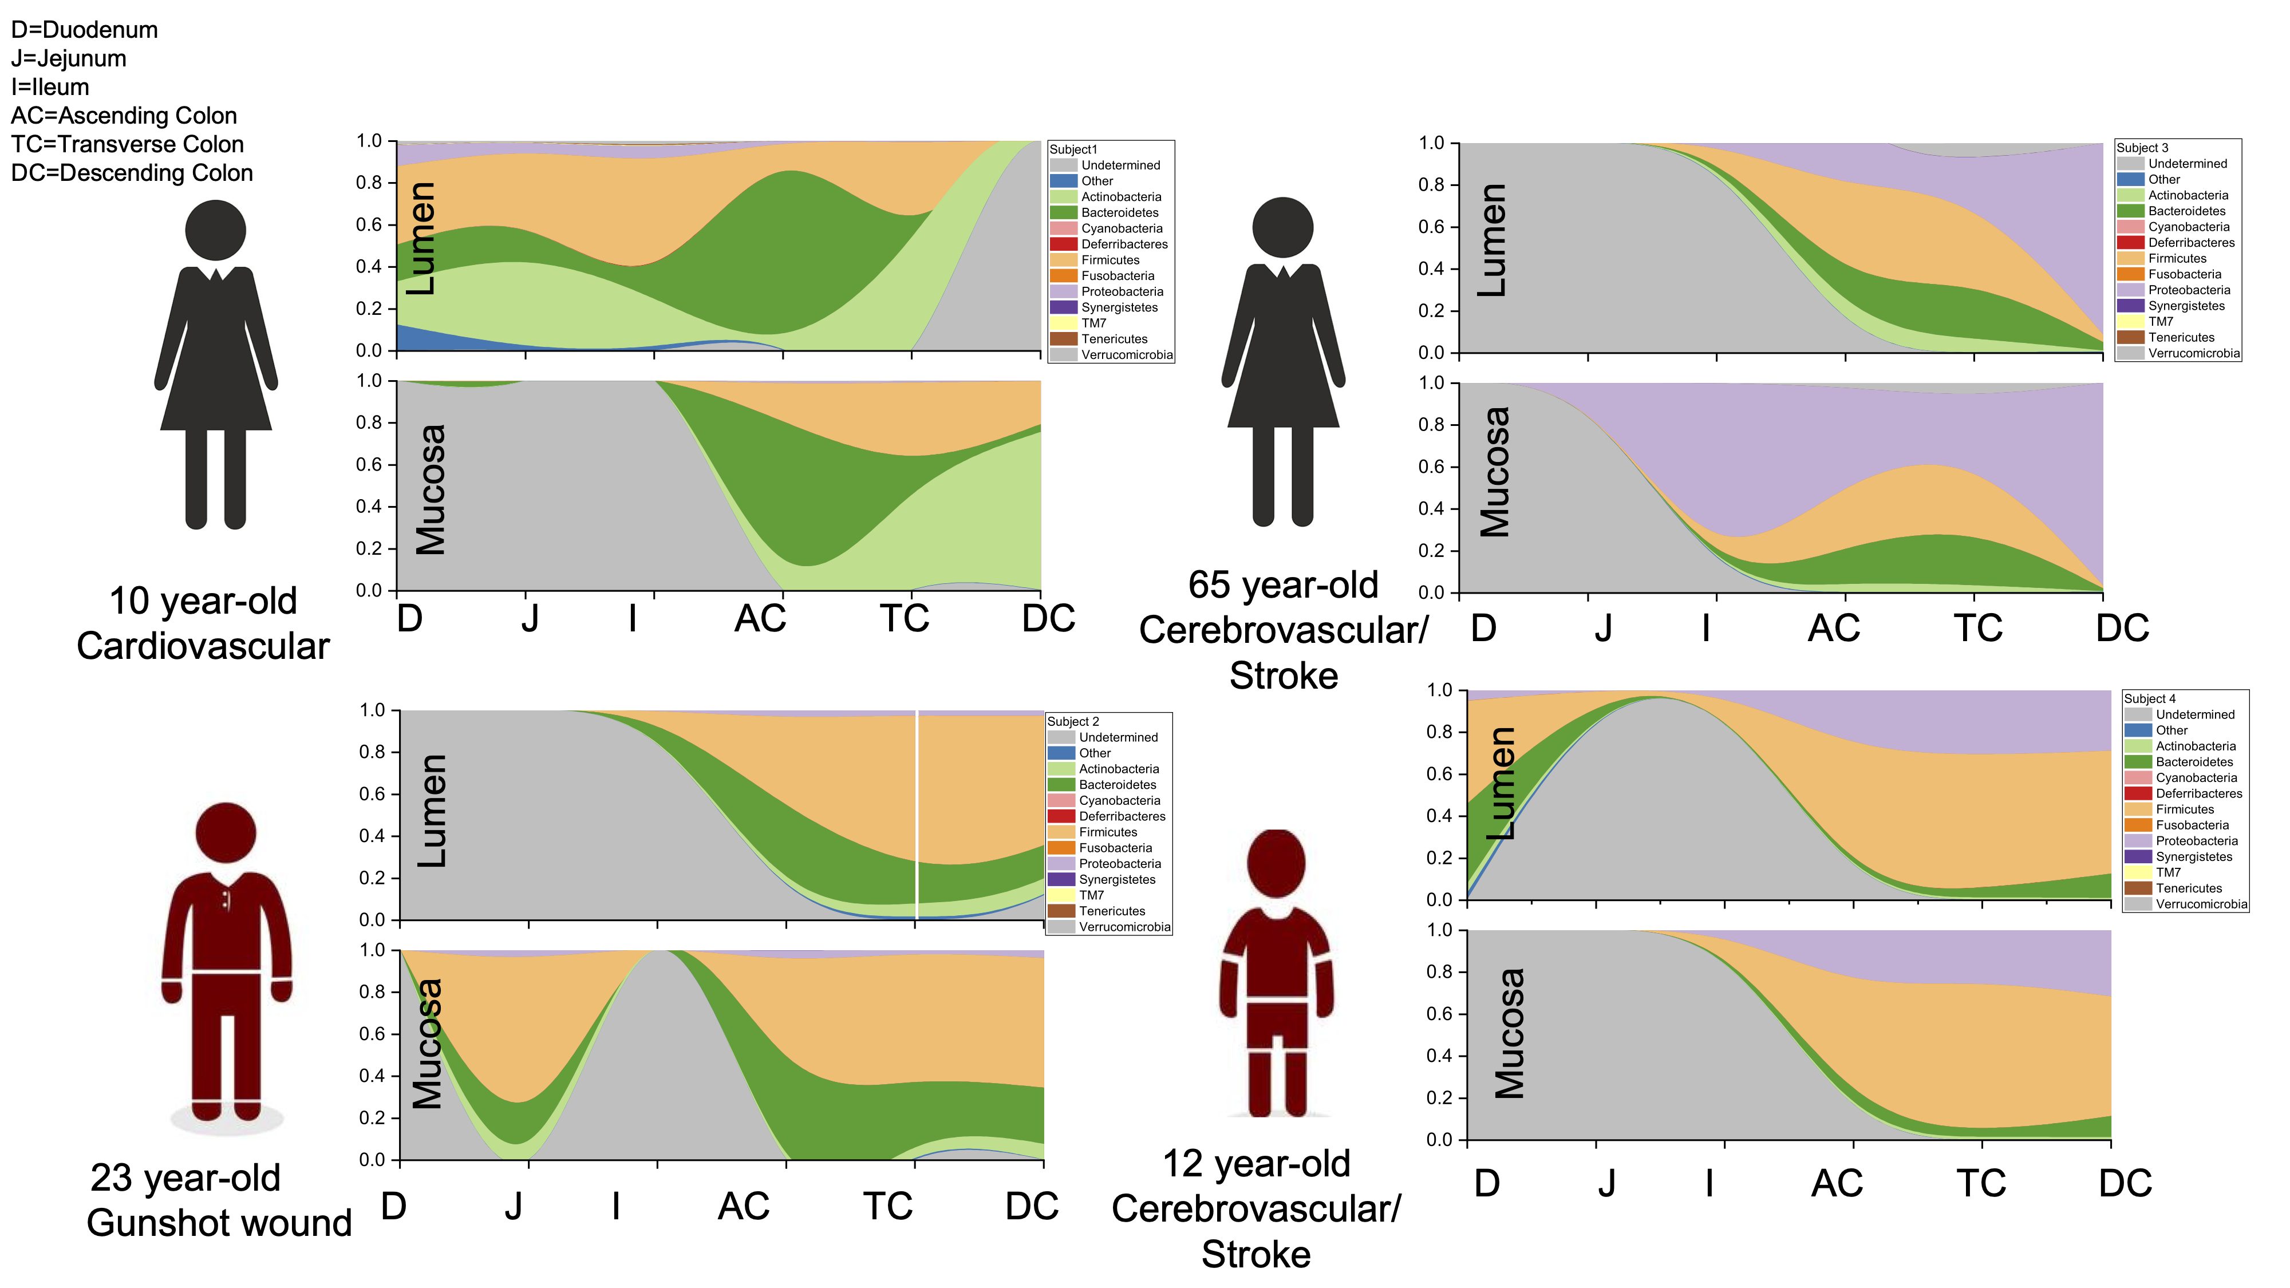
Figure S1
Figure S1. Phylum distribution by donor per intestinal section and region.

Slide 2
Figure S2
(c)
(d)
Figure S2. Distribution of the 427 bacterial strains isolated from donor 1 by intestinal section and region. Percentages represent total counts from the 3 media used: MRS, Rich Media and Thioglycolate.

Slide 3
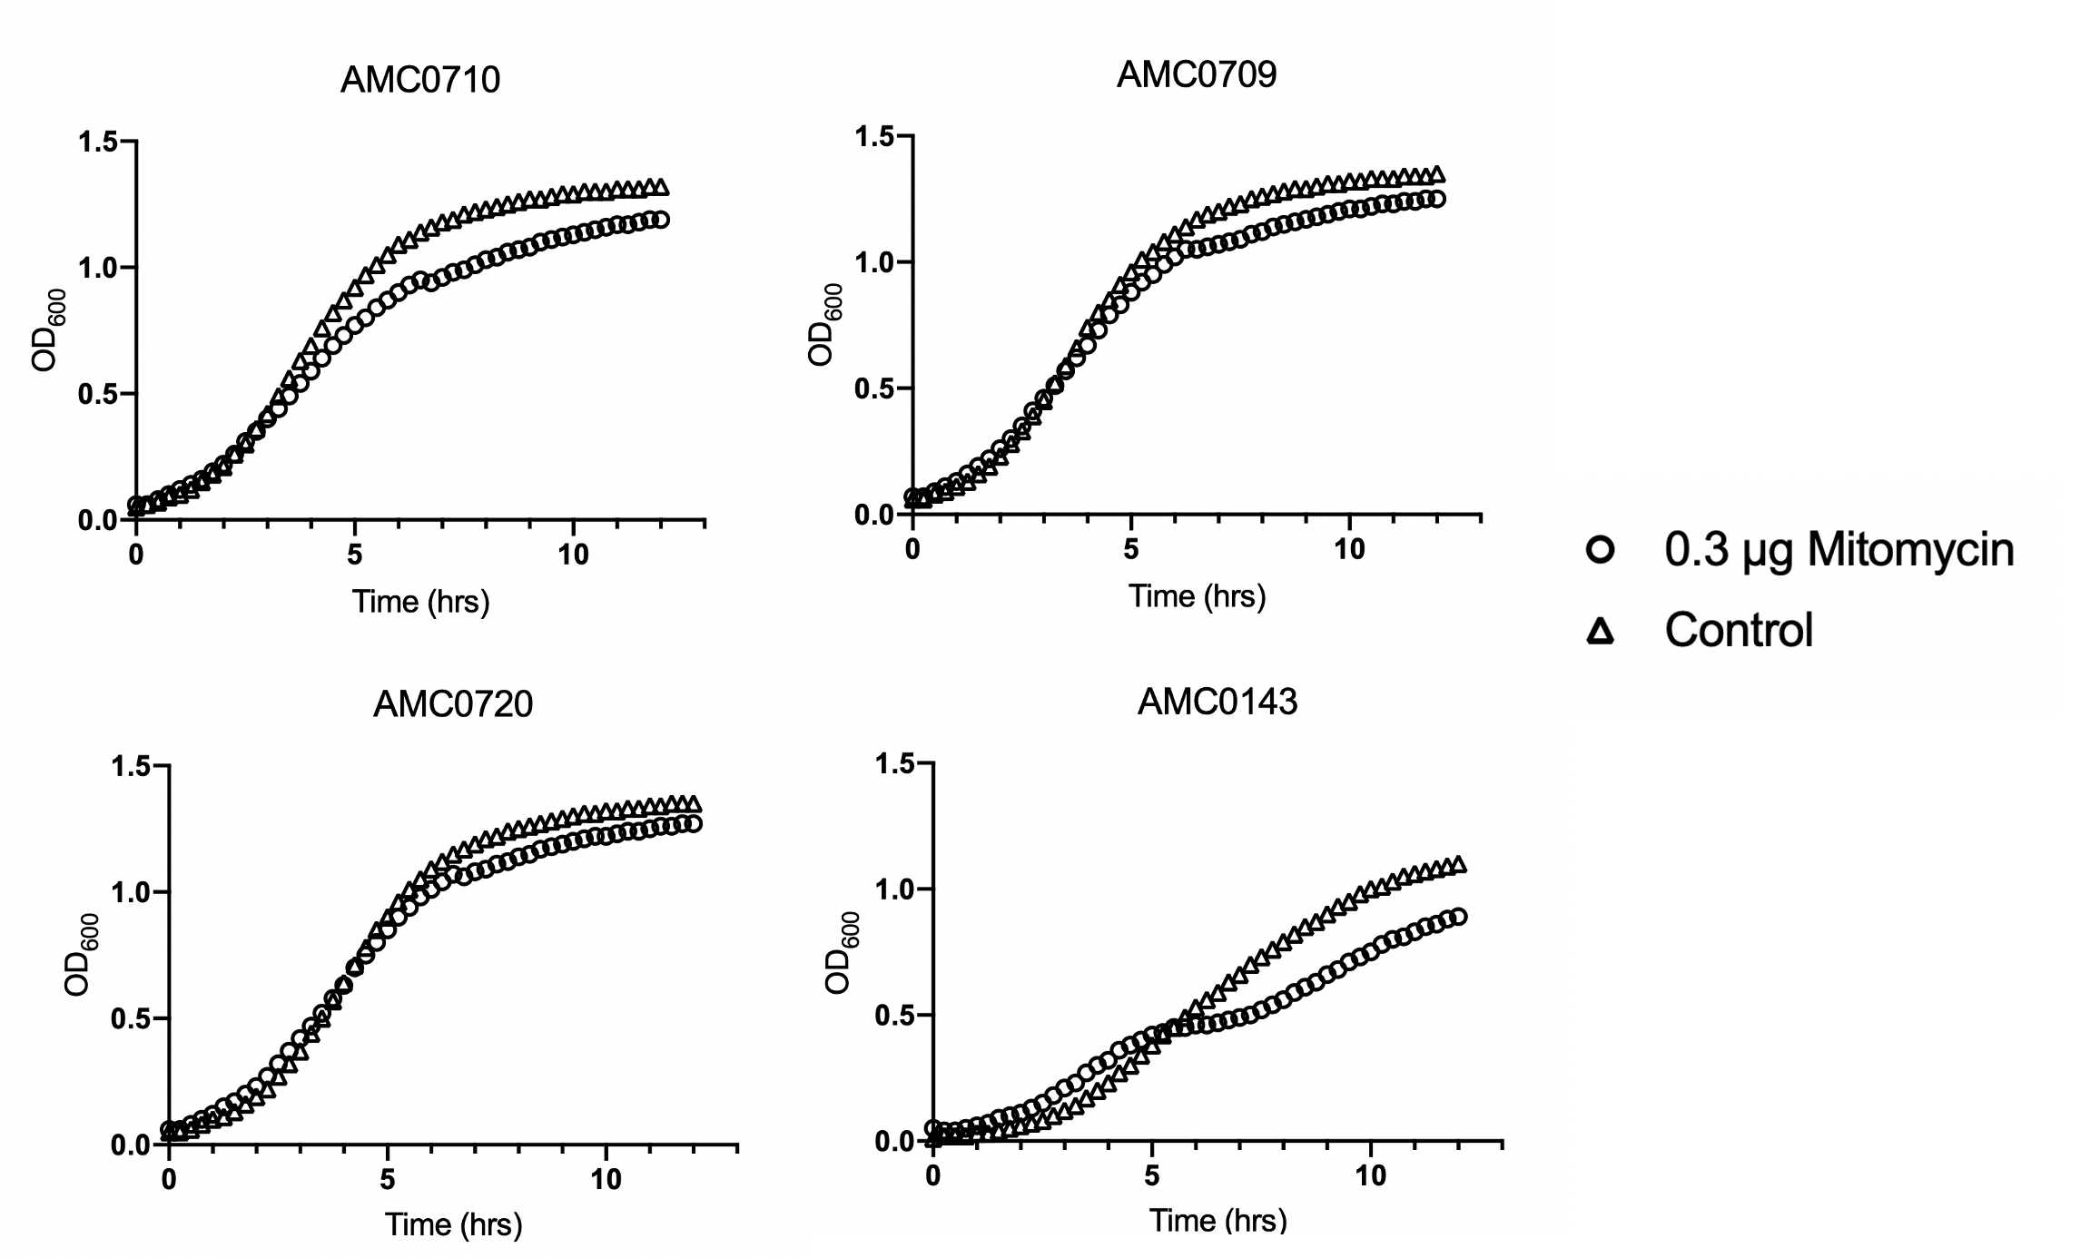
Figure S3
Figure S3. Induction of phage by addition of Mitomycin C in 3 intestinal isolates and AMC0143. There was no noticeable disturbance in the growth pattern of the remaining isolates.

Slide 4
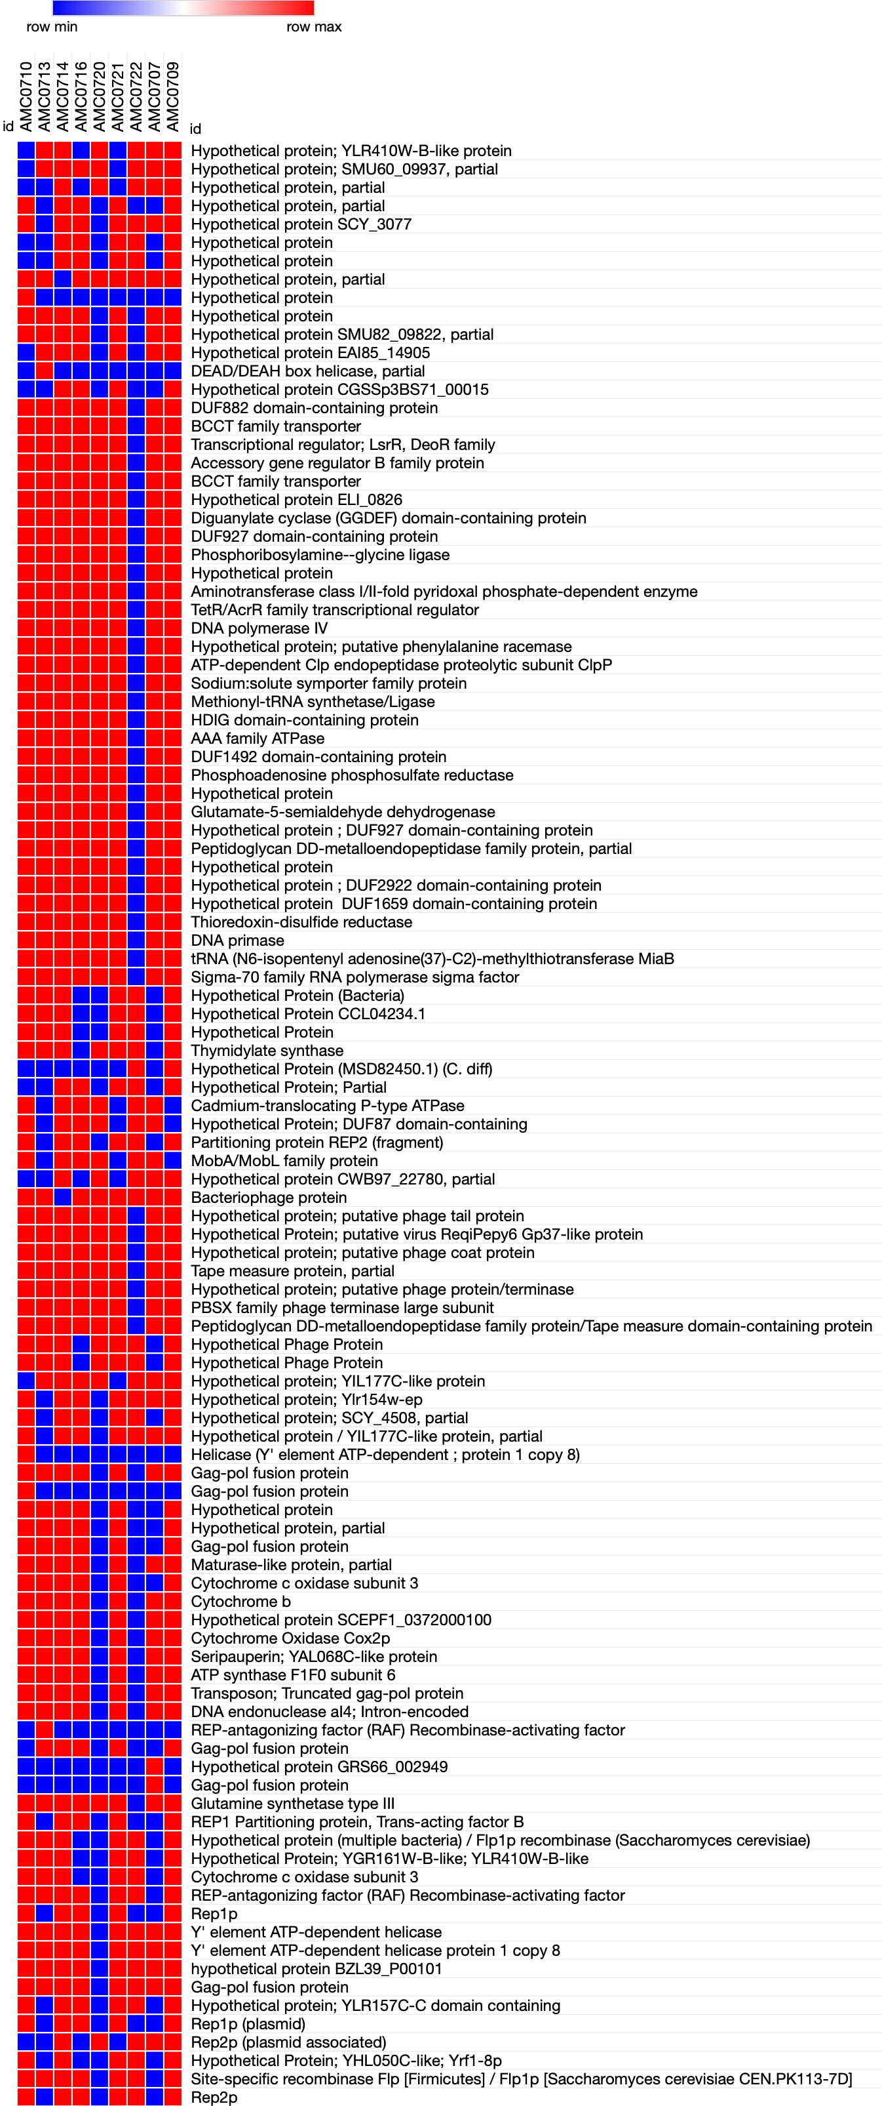
Figure S4
Bacteria
Phage
Figure S4. Heatmap showing the intra-cluster differences between L. rhamnosus strains in Cluster II. Blue represents the presence of a gene; Red denotes absence. Genes are grouped based on origin i.e. bacterial, phage or yeast.
Yeast

