Slide 1
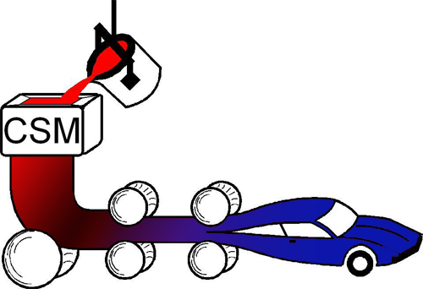
Supplementary Photograph – DIC Pattern
Manuscript Title: “Observing non-uniform, non-Lüders Yielding in a cold-rolled medium manganese steel with digital image correlation”
By: Bo H. Raadam and David K. Matlock
Advanced Steel Processing and Products Research Center*
Colorado School of Mines
Golden, Colorado 80401 USA
https://aspprc.mines.edu/
*An NSF Industry/University Cooperative
Research Center - Est. 1984

Slide 2
5 mm
Figure S1: Light optical photograph of the surface of a typical tensile sample showing the digital image correlation pattern used in this study.

