Slide 1
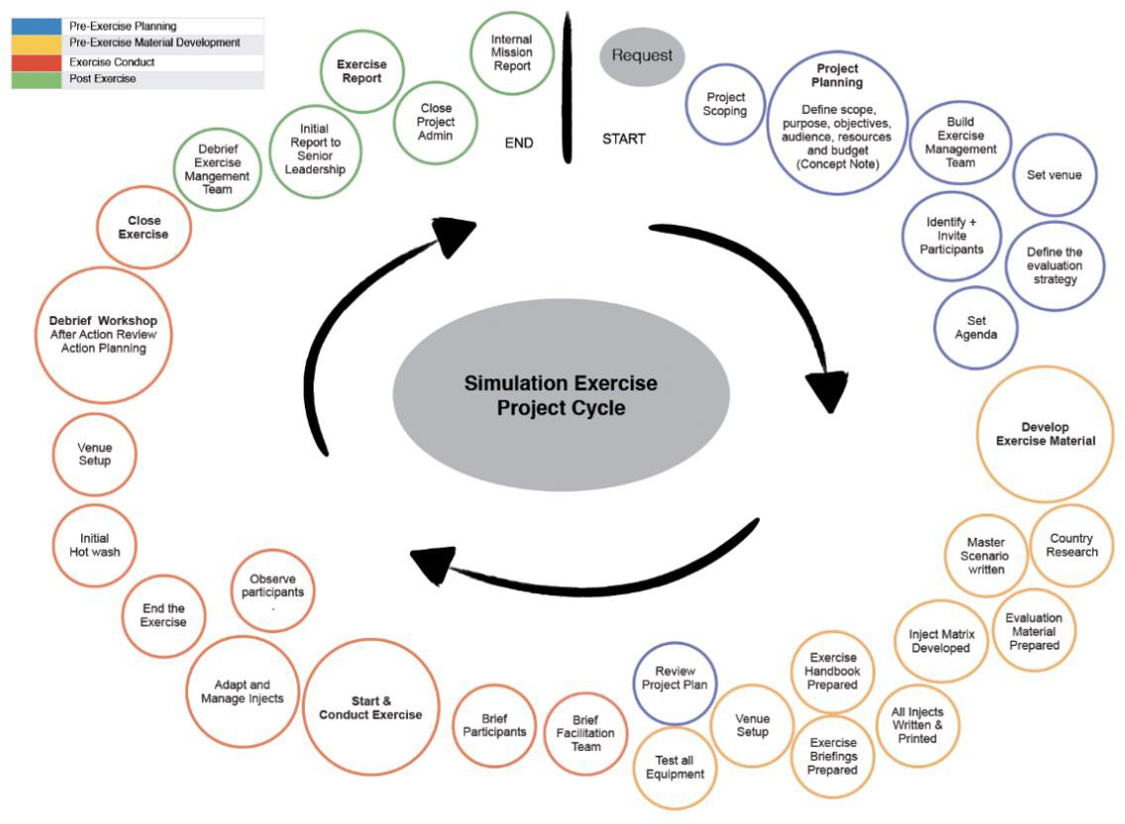
Supplemental Digital Content Figure 1. Example of an exercise project cycle for a functional exercise WHO Simulation Exercise Manual 2017³

