Slide 1
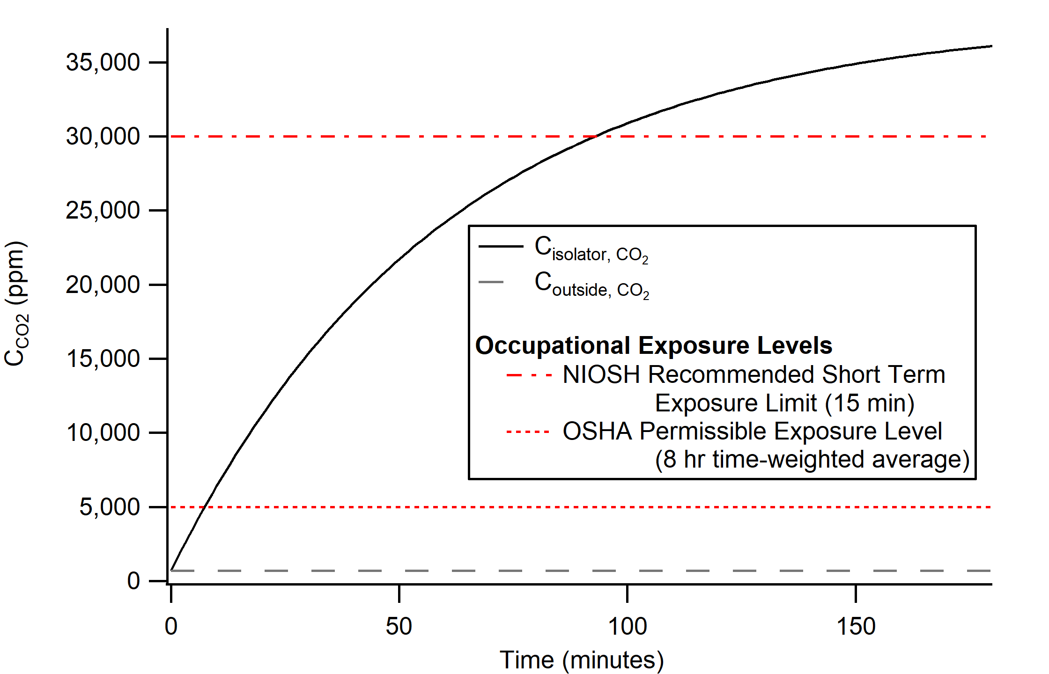
Supplemental Figure 1. Modeled CO₂ concentration over time following blower failure in comparison to the NIOSH recommended short term exposure limit (STEL) and OSHA permissible exposure level (PEL).¹⁴ Initial CO₂ concentrations within and outside the isolator were assumed to be 700 ppm.

