Slide 1

International Symposium on Disaster Medical and Public Health Management: review of the Hyogo Framework for Action
Comments in conclusion
Science and Technical Advisory Group
Professor Virginia Murray.
Vice-chair UNISDR Science and Technical Advisory Group
Consultant in Global Disaster Risk Reduction, Public Health England

Slide 2
UN Panelists
Dr Arturo Persigan, Technical Officer of the Humanitarian Action Unit of Western Pacific of WHO, WPRO/WHO
Terje Skavdal, Chief, Field Coordination Support Section UN OCHA
Dr Ciro Ugarte, Acting Director, Dept Emergency Preparedness and Disaster Relief, Pan American Health Organisation, PAHO/WHO

Slide 3
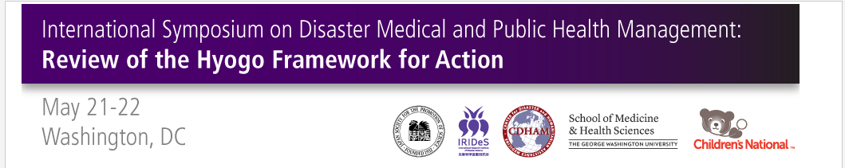
Japan Society for the Promotion of Science, Washington D.C.
The International Research Institute of Disaster Science, Tohoku University, Sendai, Japan
School of Medicine & Health Sciences at The George Washington University, Washington D.C.
Center for Disaster and Humanitarian Assistance Medicine at Uniformed Services University of the Health Sciences, Bethesda, Maryland
Children’s National Health System, Washington D.C.

Slide 4
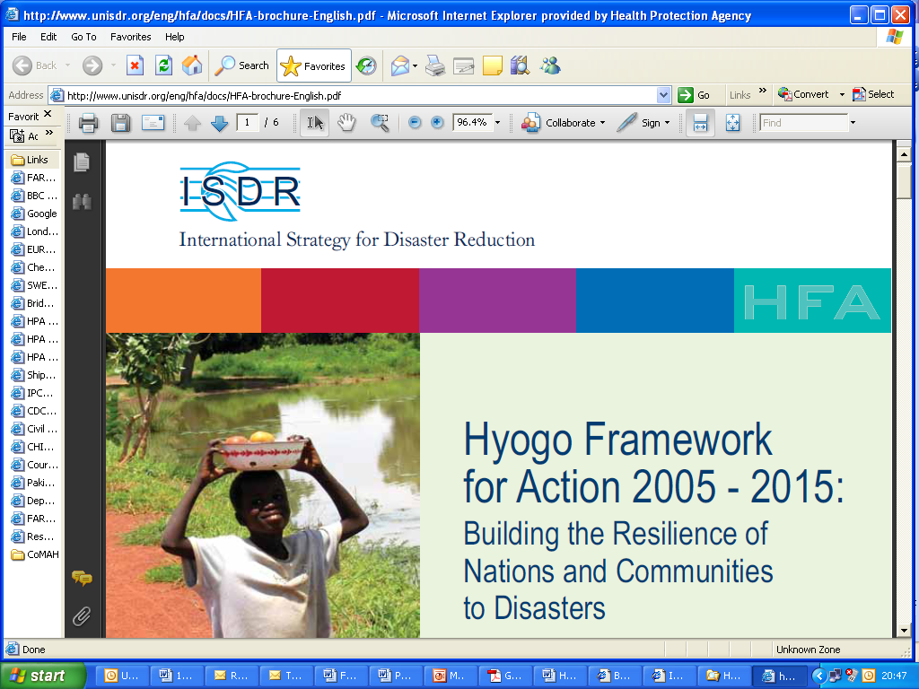
http://www.unisdr.org/eng/hfa/docs/HFA-brochure-English.pdf

Slide 5
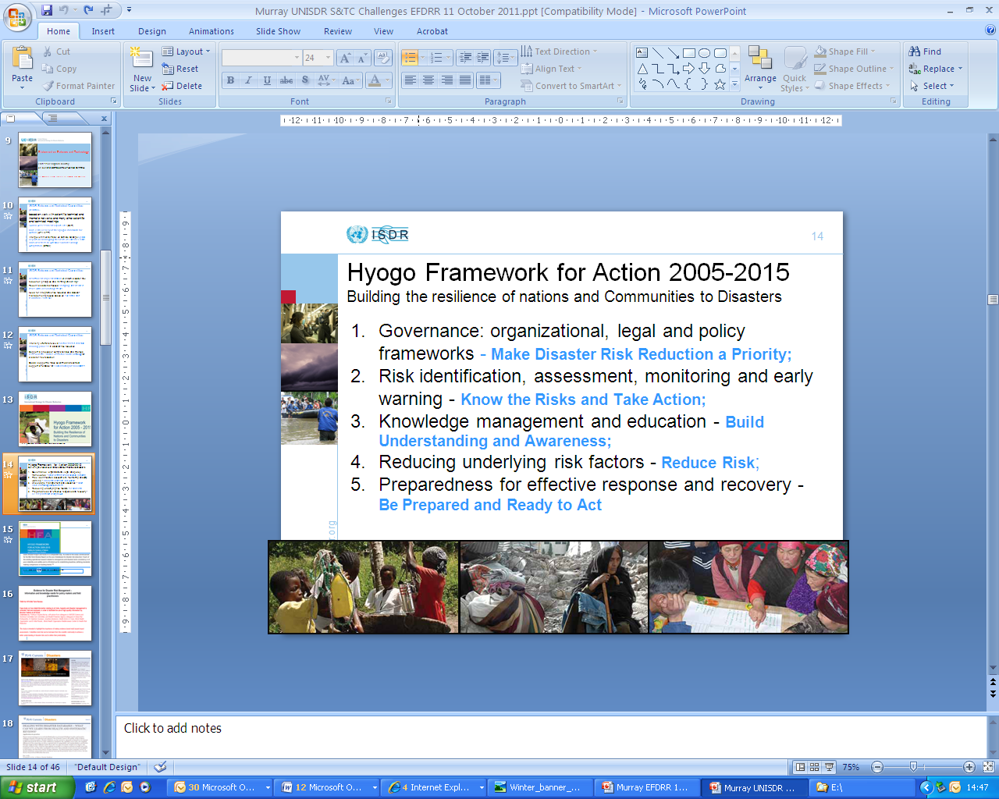

Slide 6
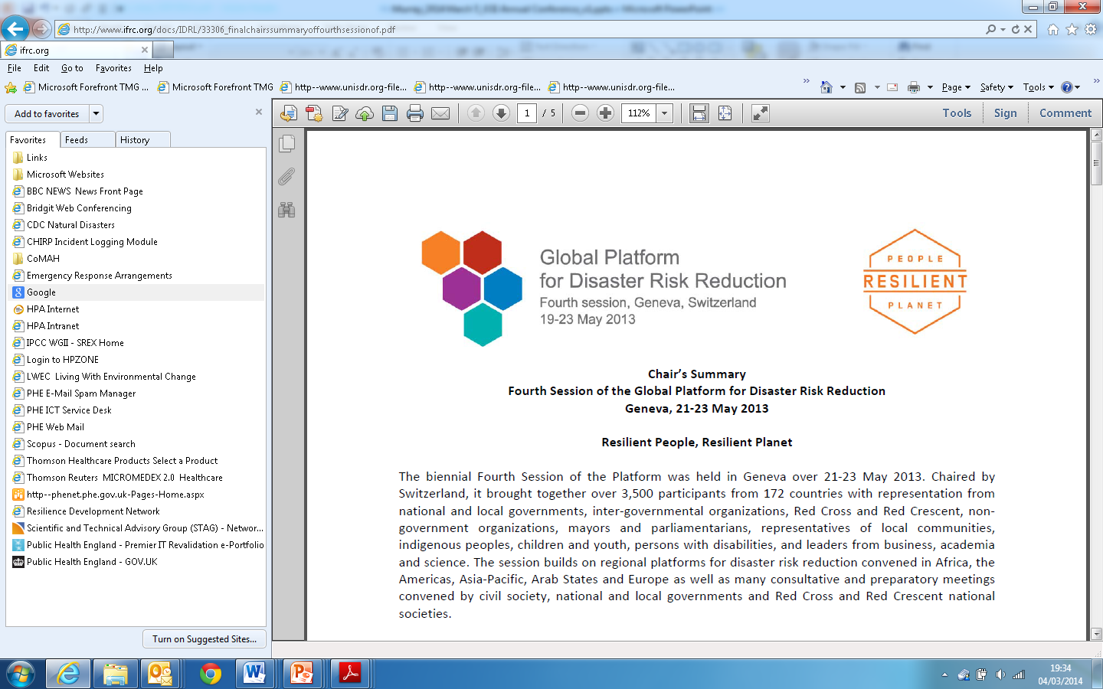
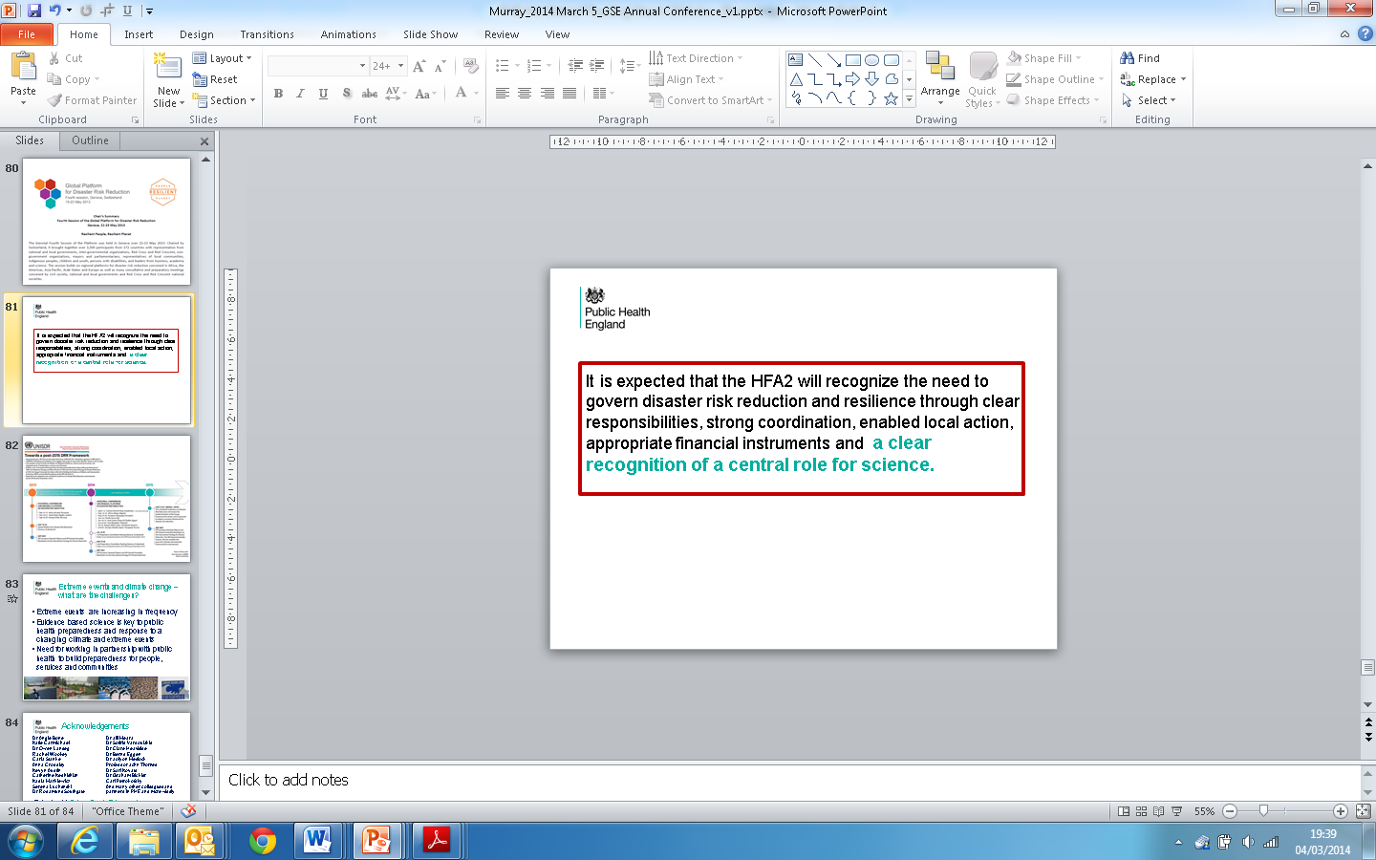

Slide 7
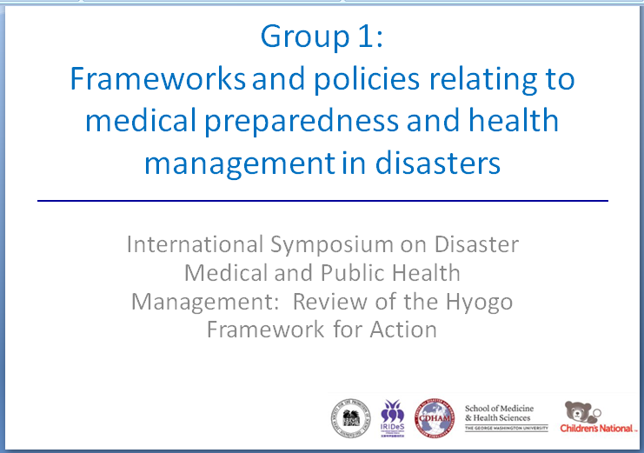

Slide 8
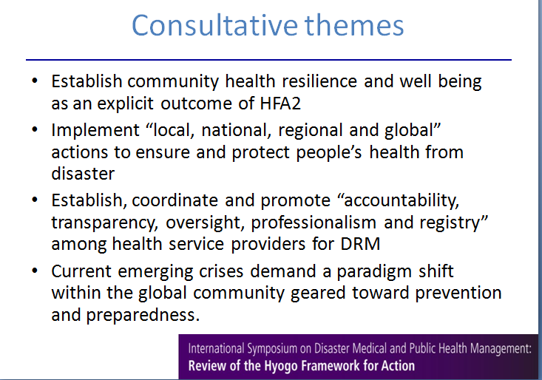

Slide 9
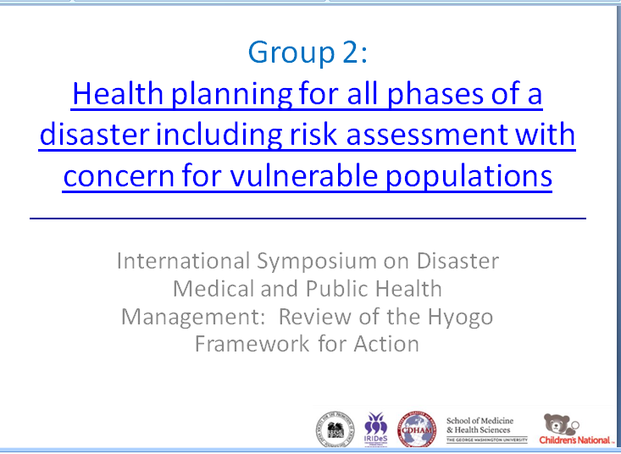

Slide 10
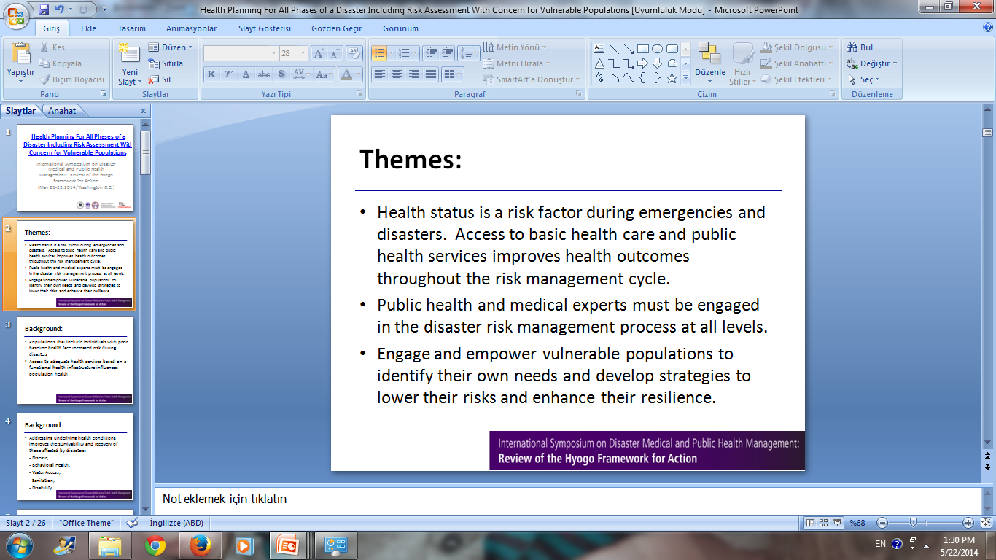

Slide 11
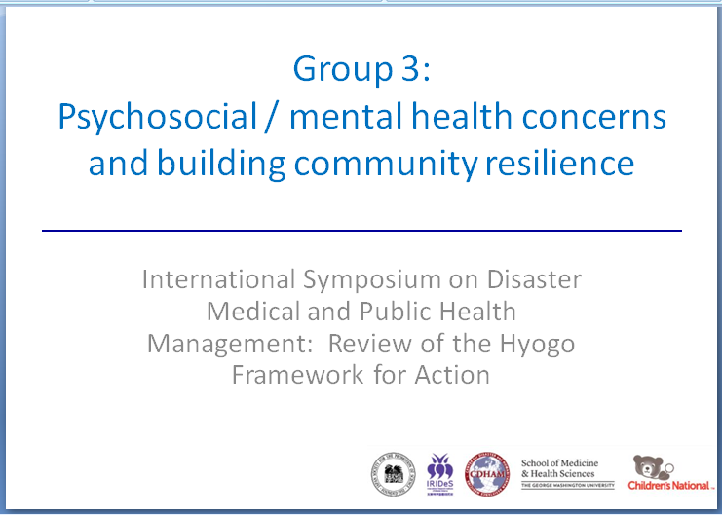

Slide 12
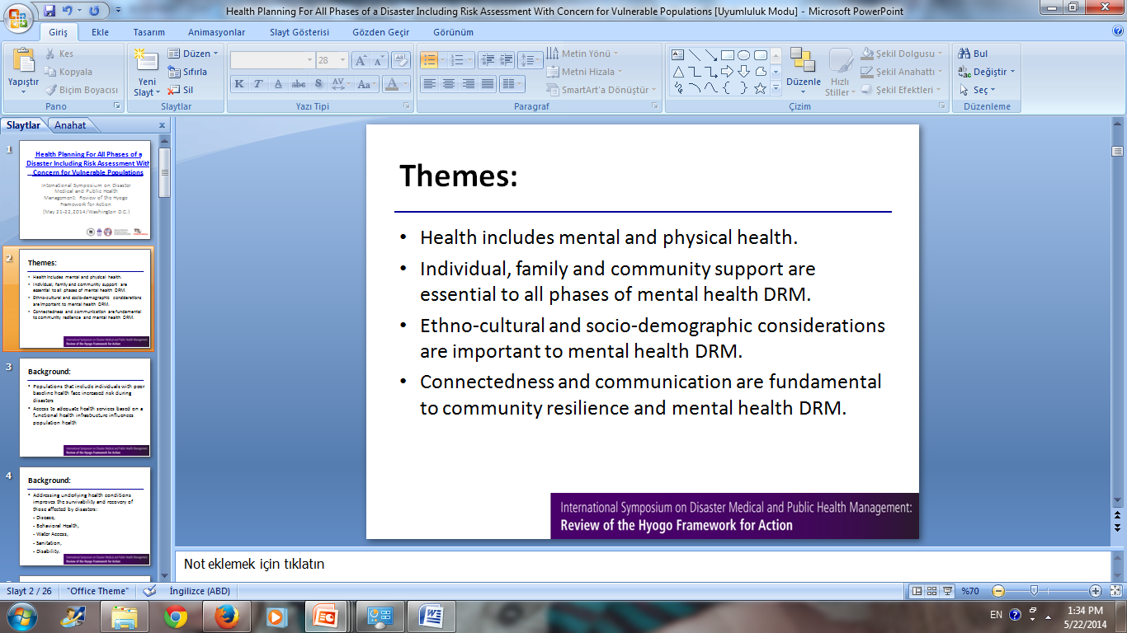

Slide 13
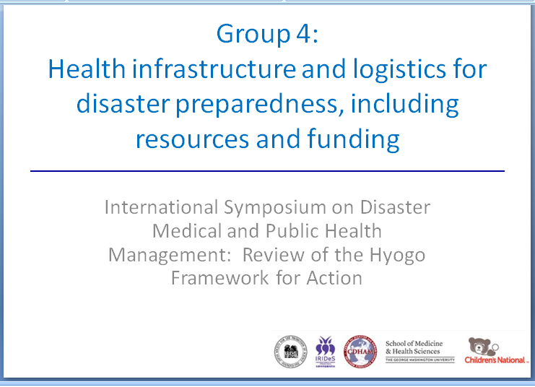

Slide 14
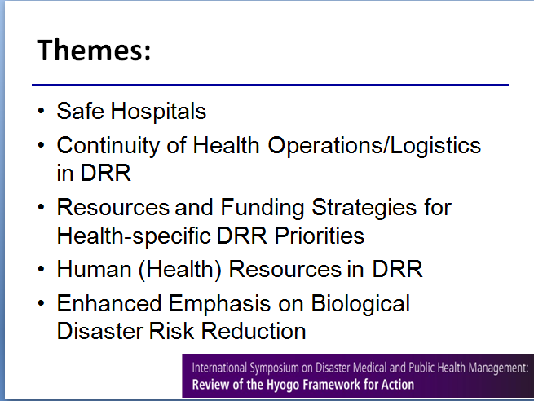

Slide 15
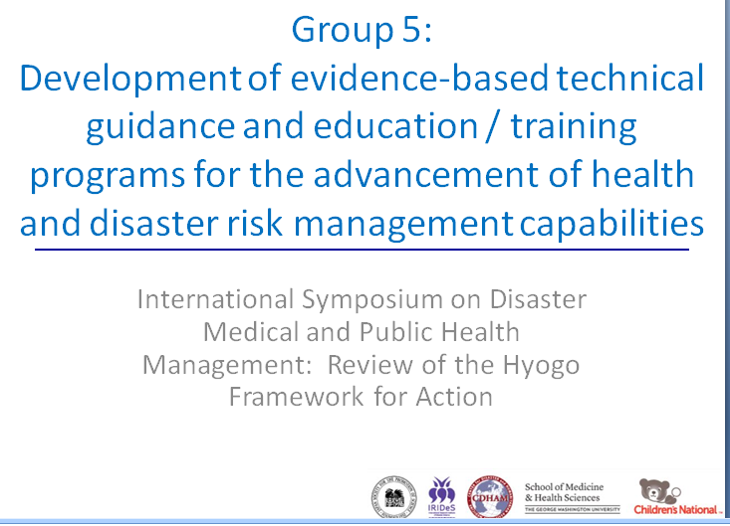

Slide 16
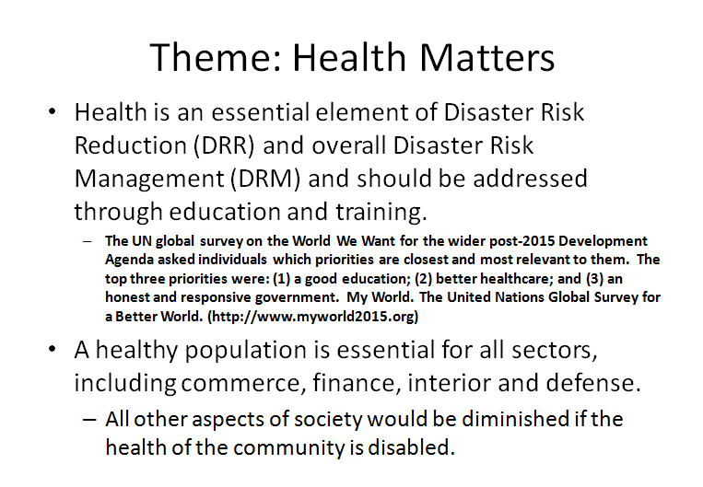

Slide 17
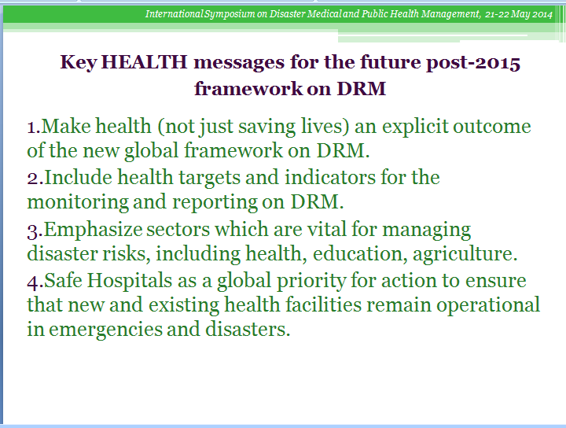

Slide 18
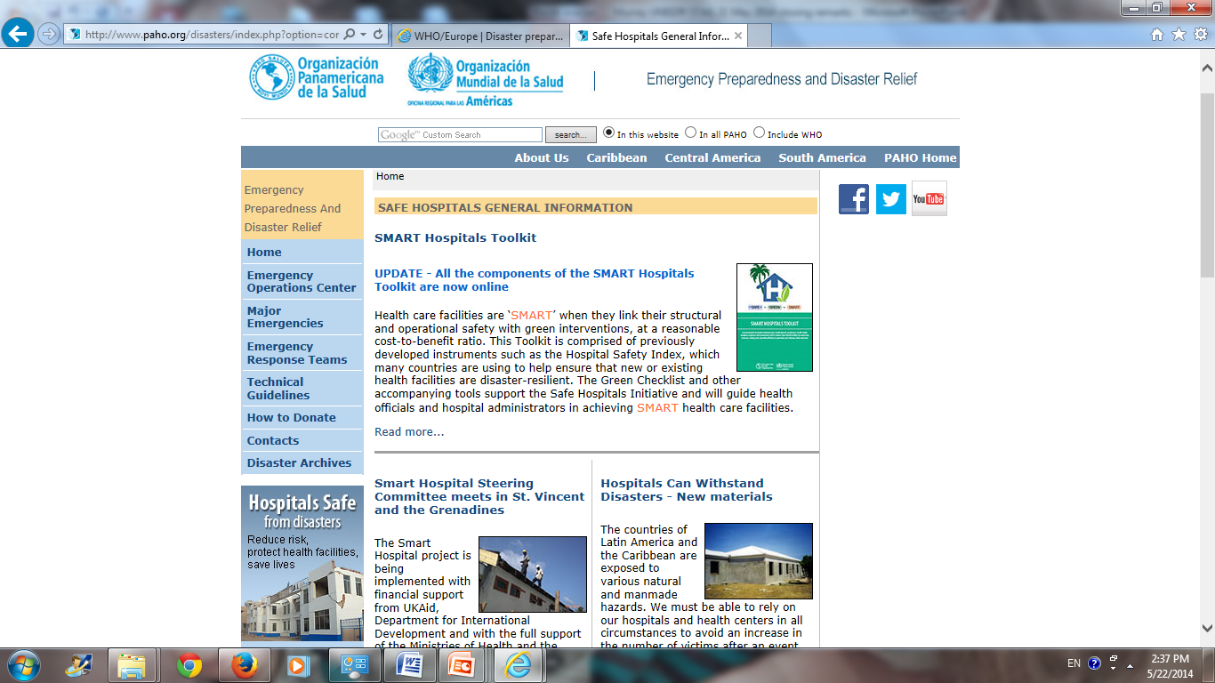

Slide 19
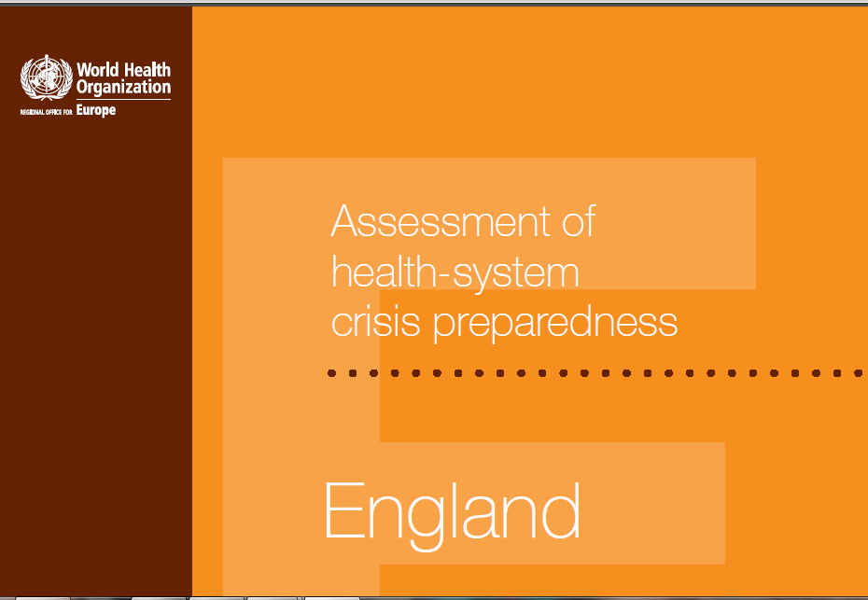
http://www.euro.who.int/en/health-topics/emergencies/disaster-preparedness-and-response/publications/2012/assessment-of-health-system-crisis-preparedness-england

Slide 20
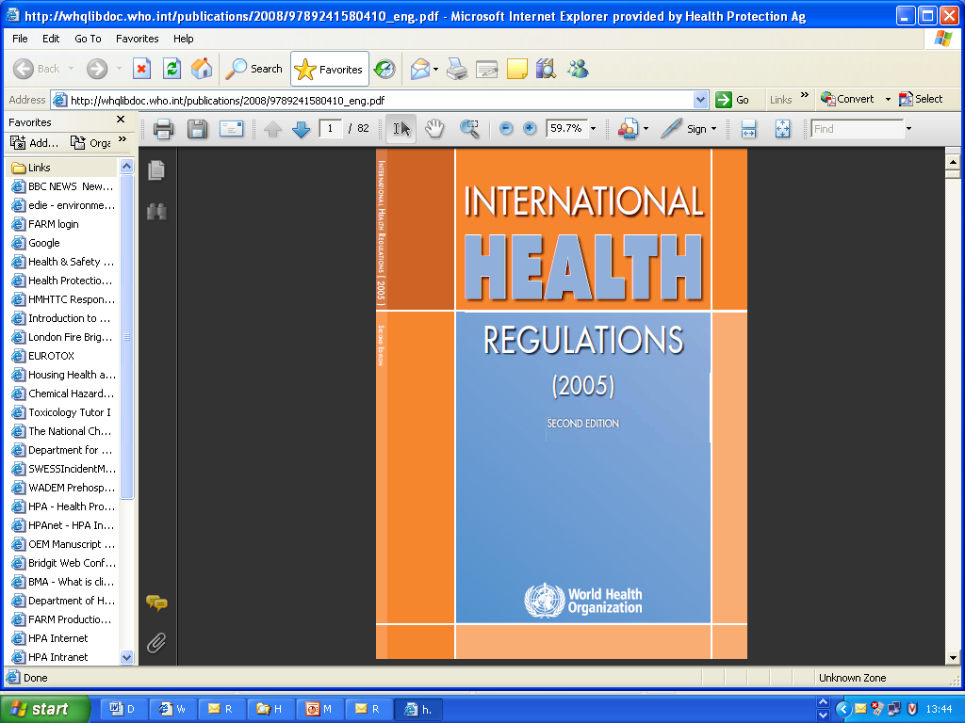
194 countries implement entered into force on
15 June 2007
http://www.who.int/ihr/9789241596664/en/index.html

Slide 21
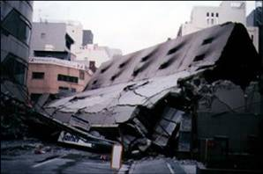
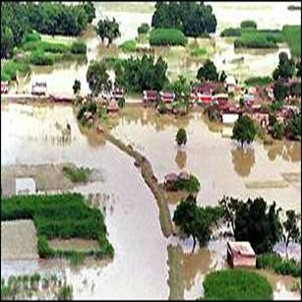
Some reflections
Impressive messages shared and important that these messages be shared via publication - Jim James and Disaster Medicine and Public Health Journal
Where possible include evidence base science to support breakout group summaries would be helpful
Important to share these messages with PAHO/WHO/UNISDR STAG/HFA2 Advisory Group and other partners
Some ideas on how to move forward

Slide 22
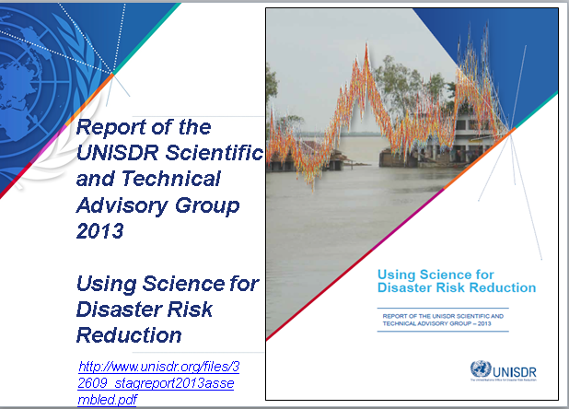

Slide 23
Case Studies: Objectives
The disaster risk reduction problem
The science
Application to policy and practice
Did it make a difference?
.

Slide 24
The Case Studies
Tsunami Warning and Mitigation for the Indian Ocean Region
Assessing Vulnerability to Improve Risk Reduction
Flood Early Warning in Bangladesh
An Earthquake Early Warning for Japanese Bullet Trains
Watching the Rains to Build Resilience in the African Sahel

Slide 25
The Case Studies
Flood Risk Reduction in the Netherlands
Health disaster risk reduction through Rubella vaccination
An Atlas of Hazards and Disaster Risks to Support Disaster Risk Reduction in China
Mathematical Models for Cambodia to Reduce the Risk of H5N1 Flu Outbreaks in Poultry
Building Resilience to Earthquakes in Chile

Slide 26
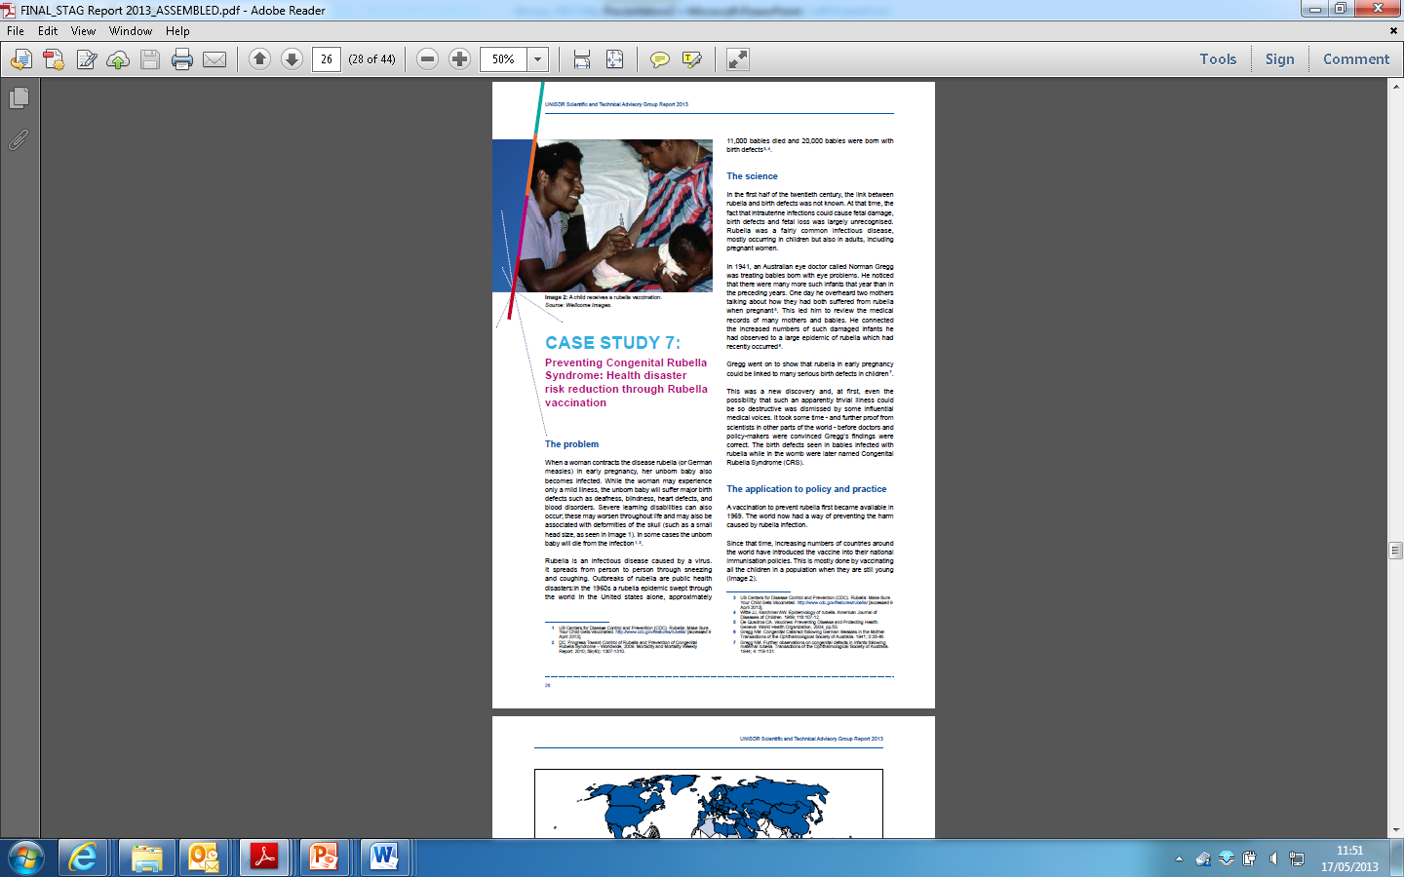
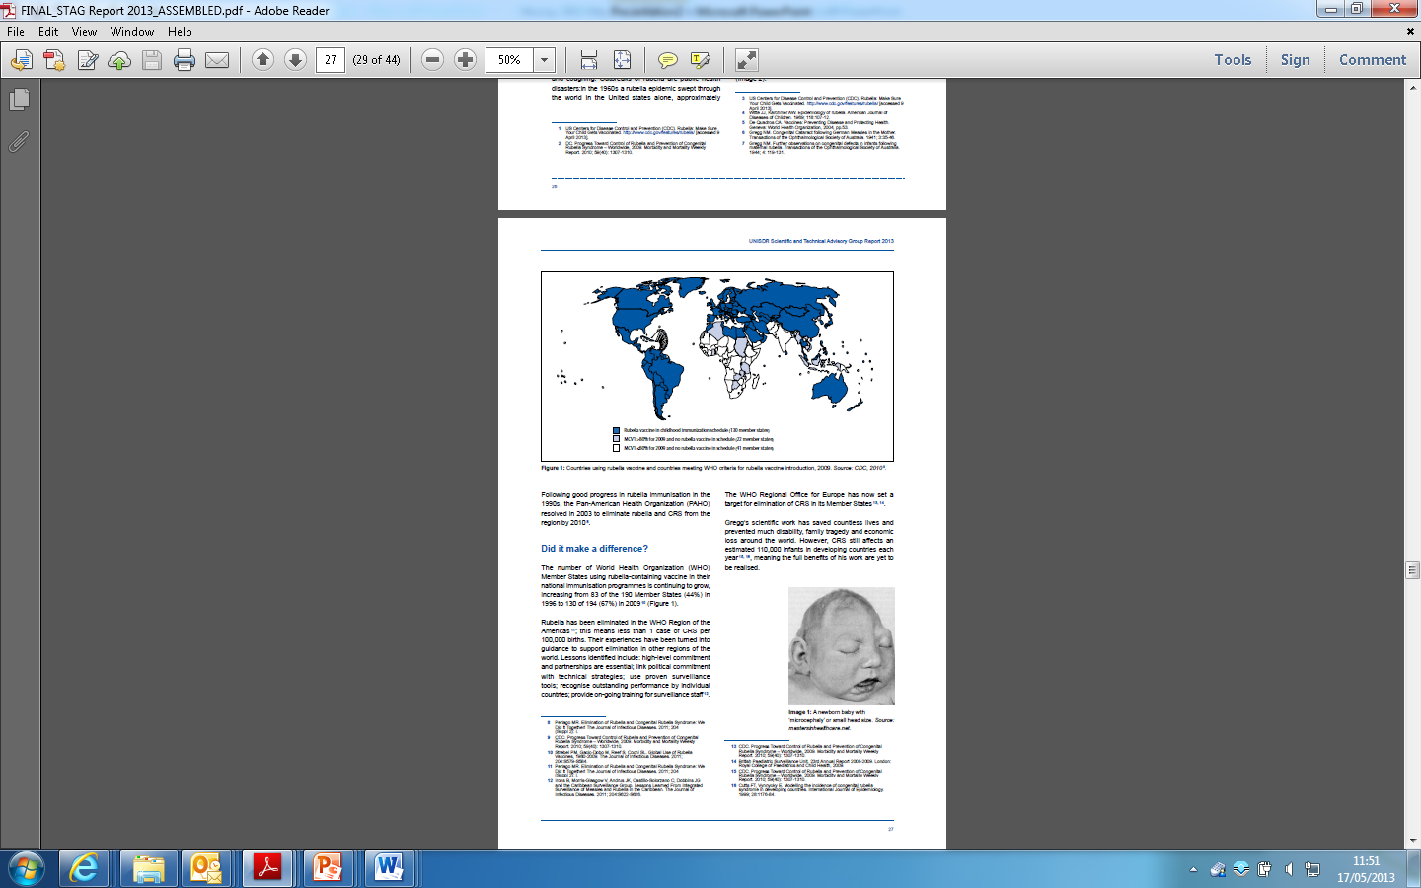

Slide 27
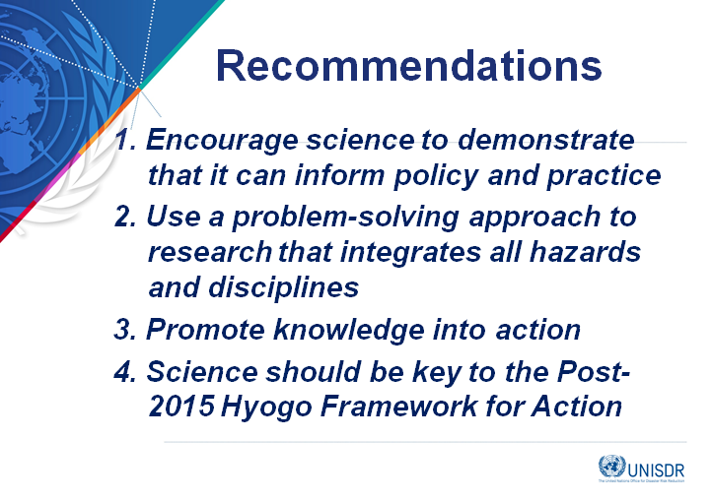
Recommendations
1. Encourage science to demonstrate that it can inform policy and practice
2. Use a problem-solving approach to research that integrates all hazards and disciplines
3. Promote knowledge into action
4. Science should be key to the Post-2015 Hyogo Framework for Action

Slide 28
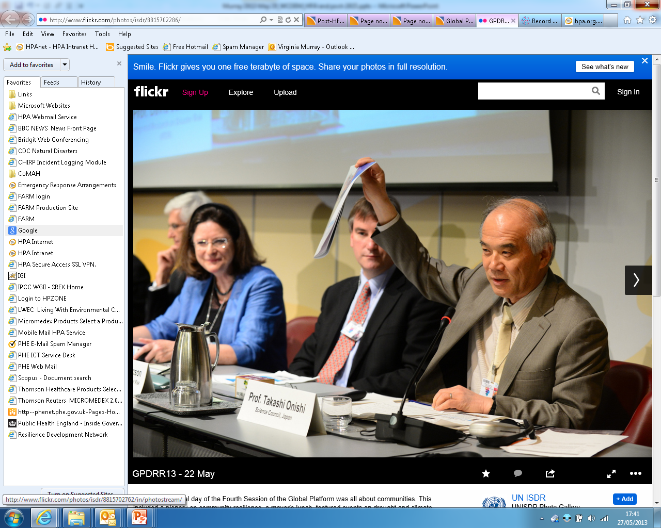

Slide 29
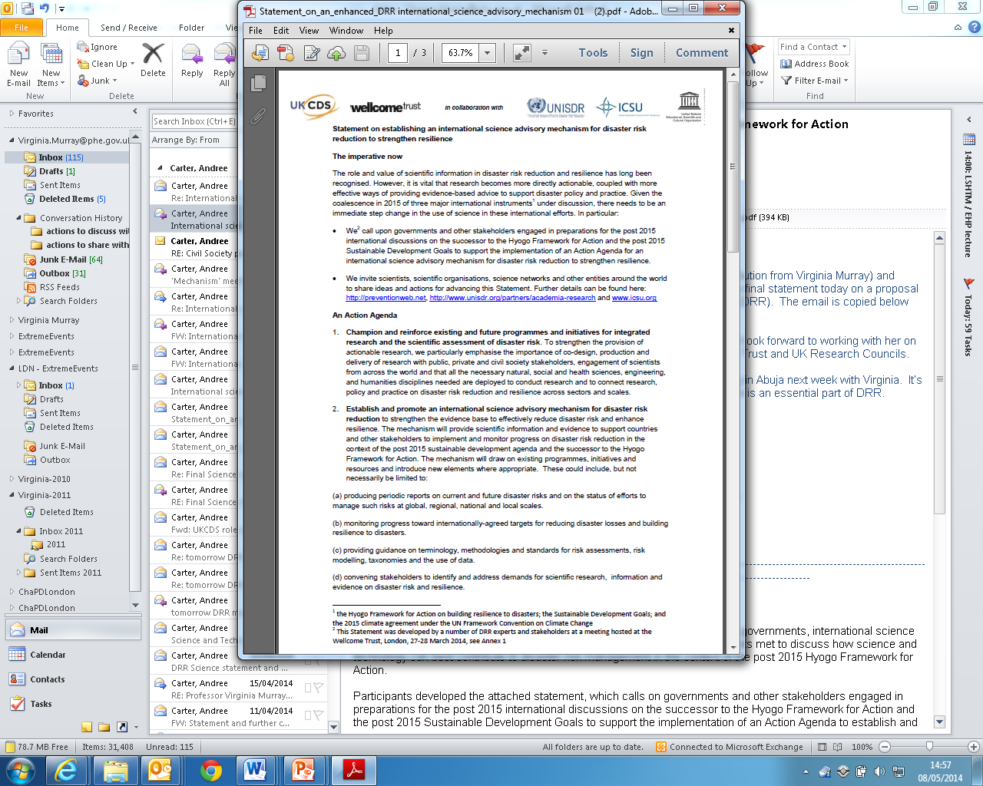

Slide 30
Statement on establishing an international science advisory mechanism for disaster risk reduction to strengthen resilience
producing periodic reports on current and future disaster risks and on the status of efforts to manage such risks at global, regional, national and local scales.

Slide 31
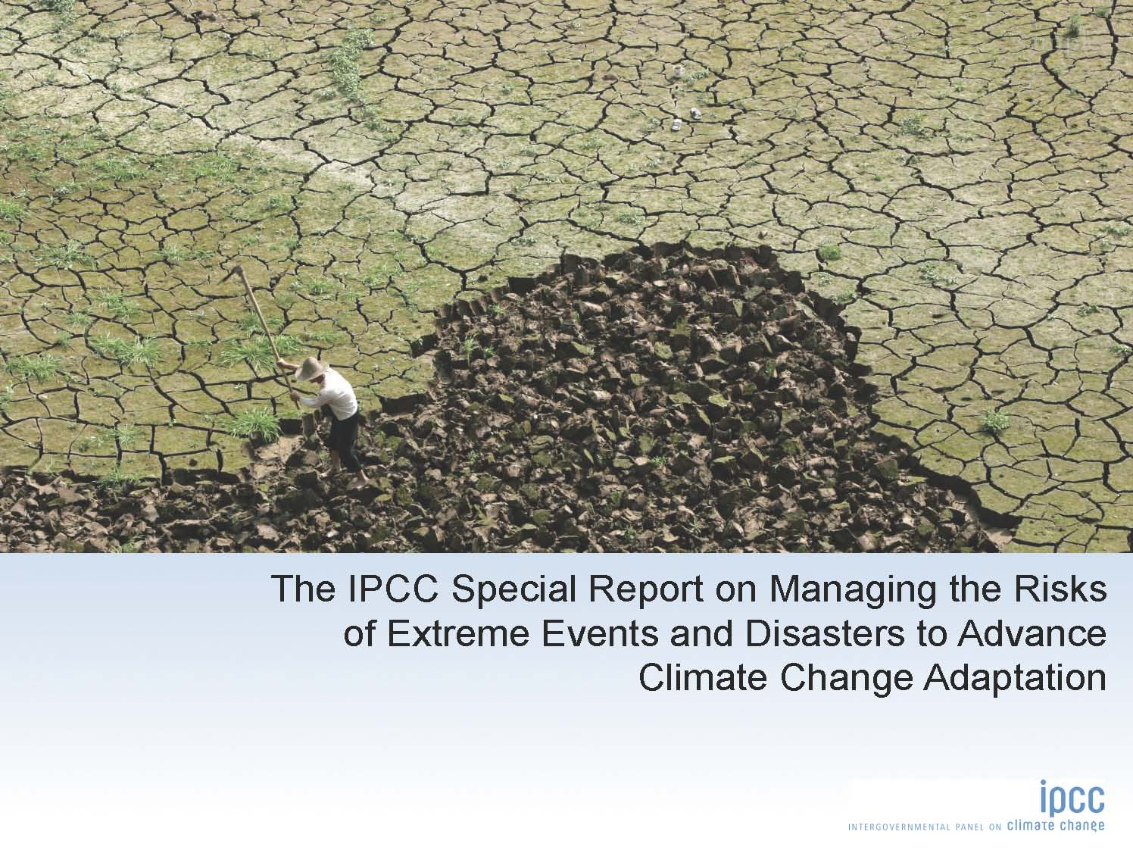

Slide 32
Statement on establishing an international science advisory mechanism for disaster risk reduction to strengthen resilience
producing periodic reports on current and future disaster risks and on the status of efforts to manage such risks at global, regional, national and local scales.
monitoring progress toward internationally-agreed targets for reducing disaster losses and building resilience to disasters.
.

Slide 33
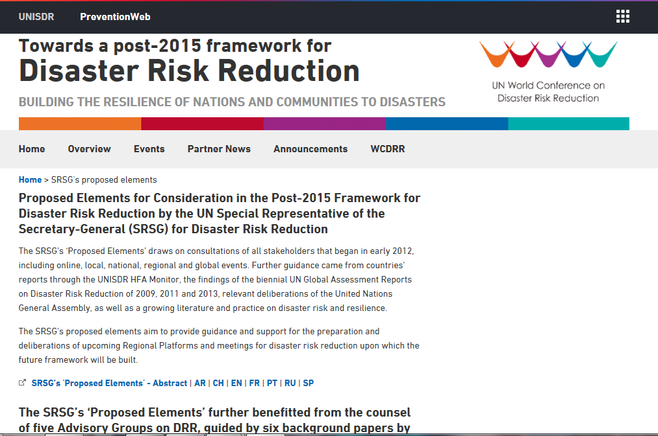

Slide 34
Statement on establishing an international science advisory mechanism for disaster risk reduction to strengthen resilience
producing periodic reports on current and future disaster risks and on the status of efforts to manage such risks at global, regional, national and local scales.
monitoring progress toward internationally-agreed targets for reducing disaster losses and building resilience to disasters.
providing guidance on terminology, methodologies and standards for risk assessments, risk modelling, taxonomies and the use of data. .

Slide 35
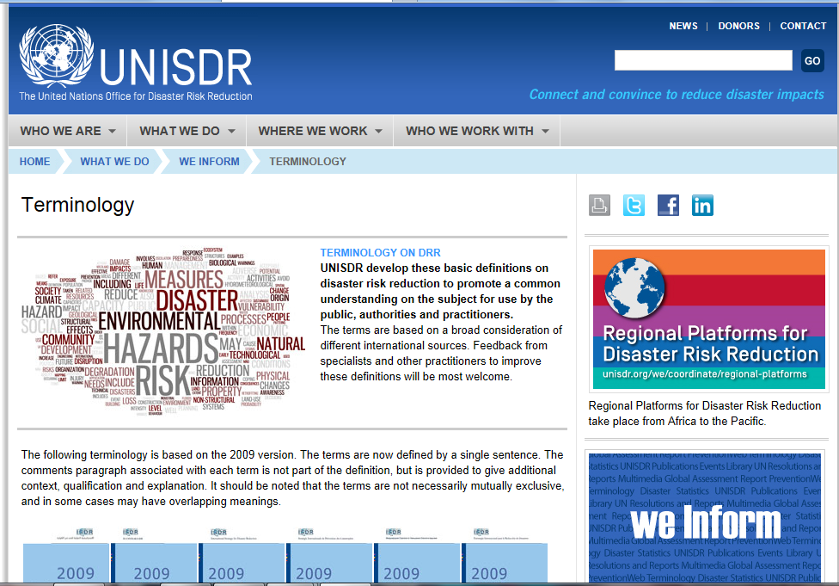

Slide 36
Statement on establishing an international science advisory mechanism for disaster risk reduction to strengthen resilience
convening stakeholders to identify and address demands for scientific research, information and evidence on disaster risk and resilience.
enhancing the communication of complex scientific information and evidence to support the decision-making of policy makers and other stakeholders.

Slide 37
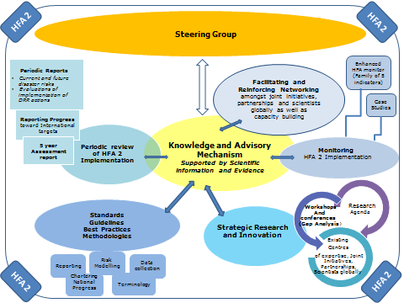

Slide 38
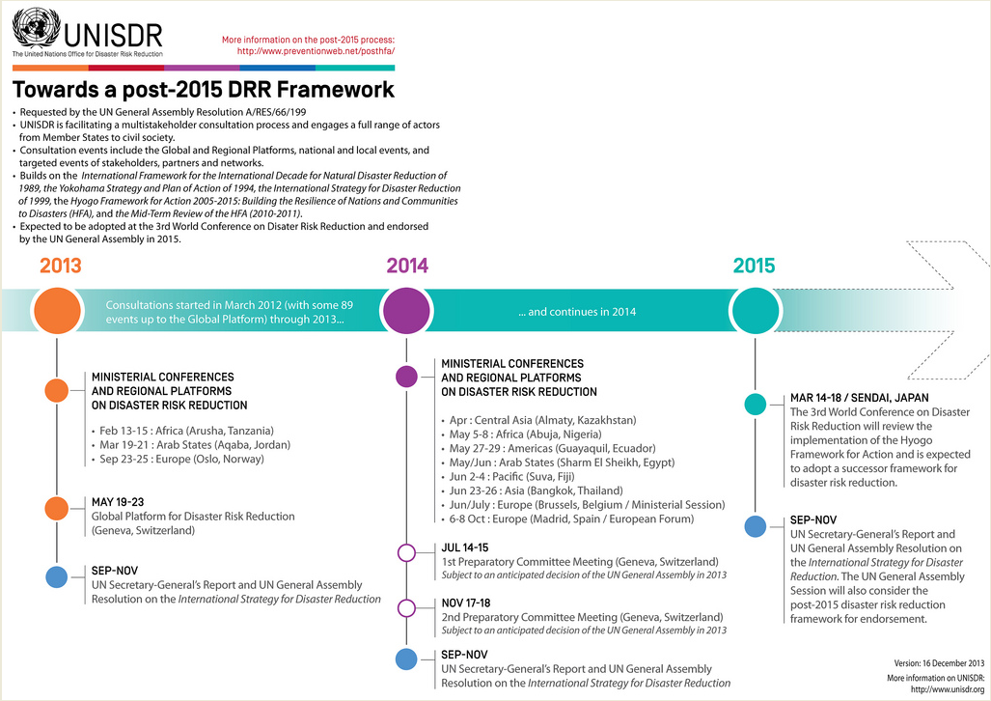
IV
I

