Slide 1
Reducing the Risk of
Disaster-related Mortality
Mark Keim, MD, MBA
National Center for Environmental Health
Agency for Toxic Substances and Disease Registry

Slide 2


A story of disaster risk reduction…

Slide 3
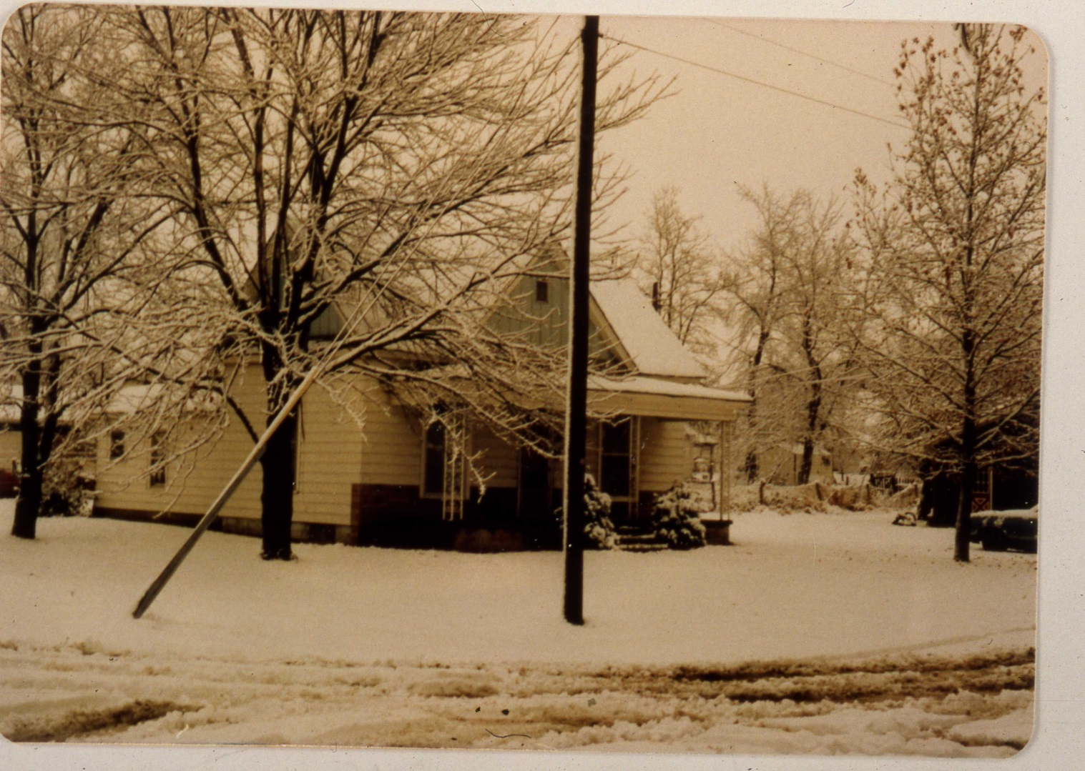
15 years later…
December 1981

Slide 4

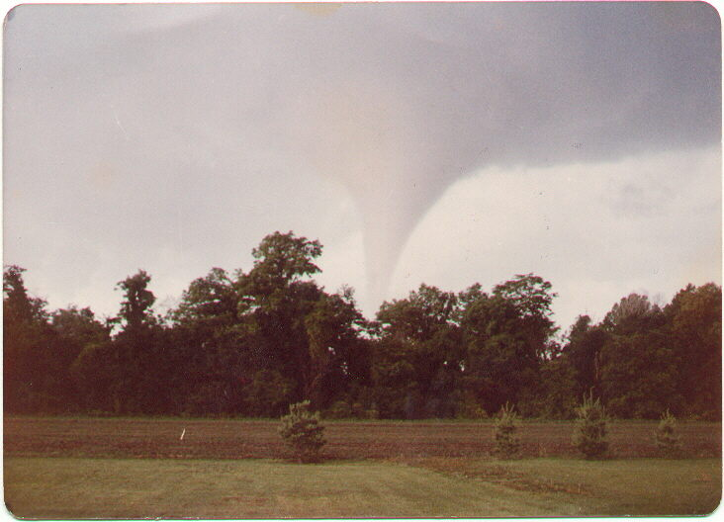
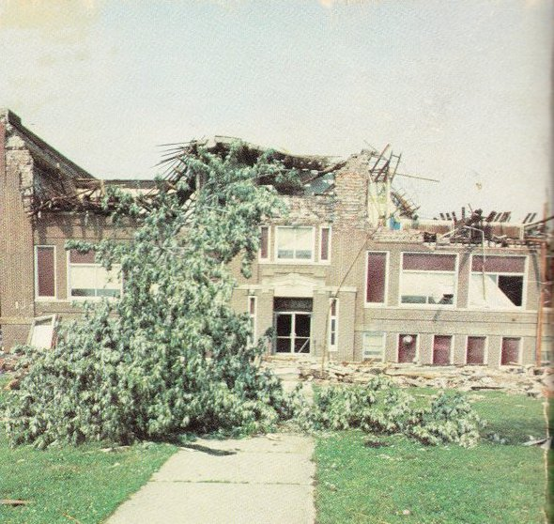
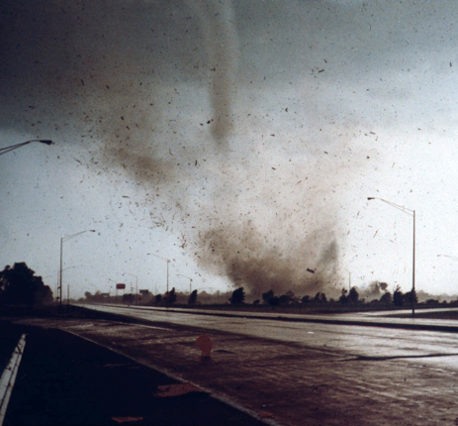
1982 Memorial Day holiday

Slide 5
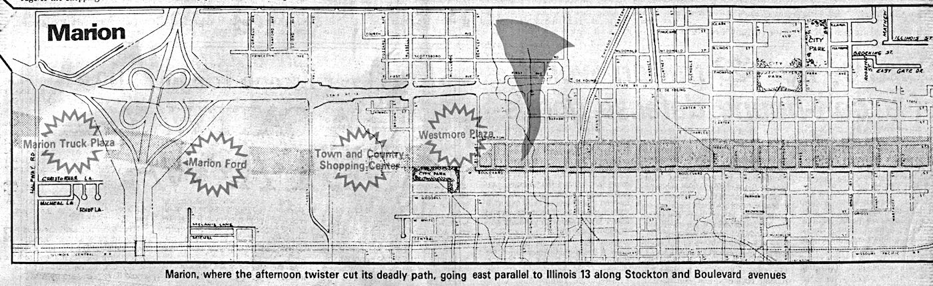
Evacuation path

Slide 6
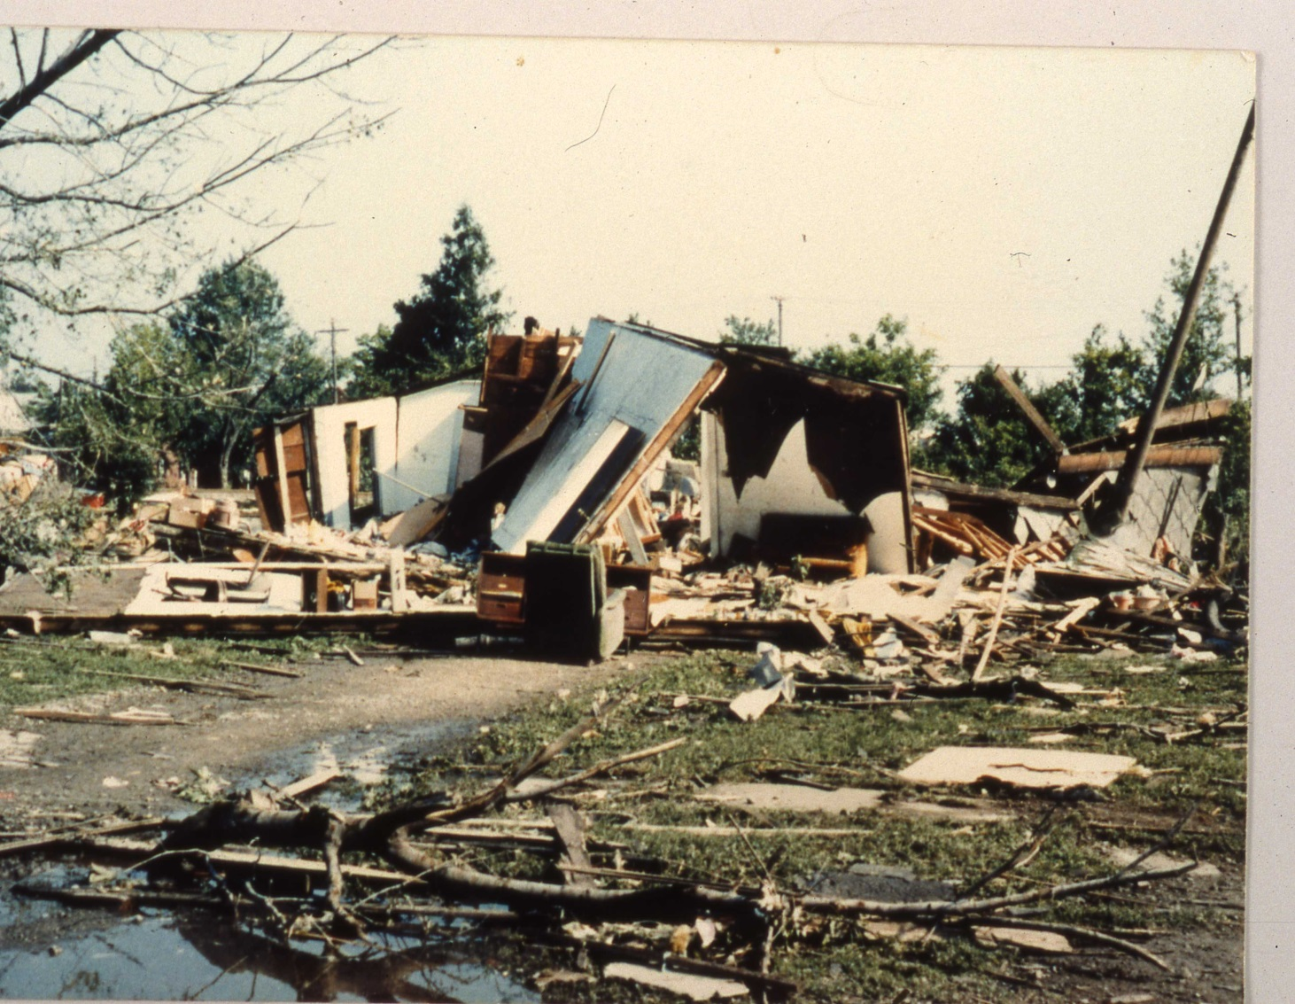
All deaths occurred during the impact phase
May 1982

Slide 7
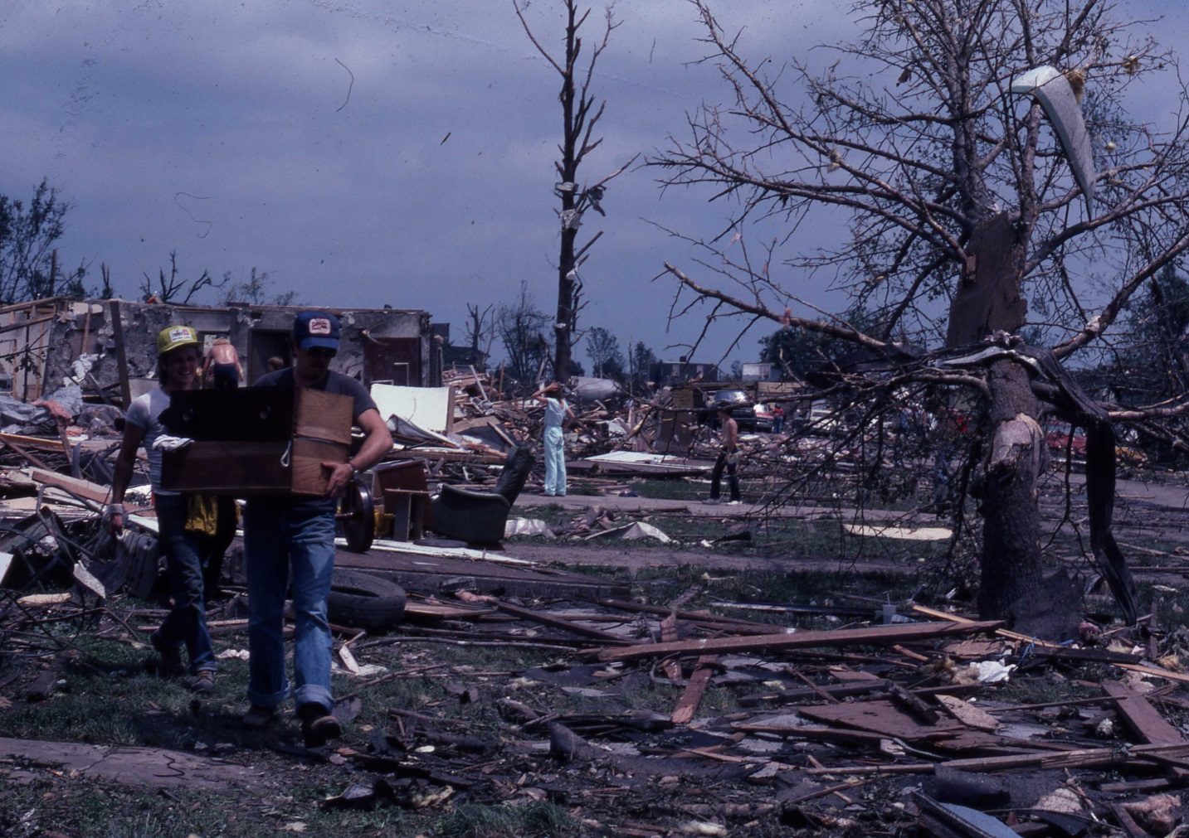
61% of injuries occurred during recovery phase
Duclos PJ, Ing RT. Injuries and risk factors for injuries from the 29 May 1982 tornado, Marion, Illinois. Int J Epidemiol. 1989 Mar;18(1):213-9.

Slide 8

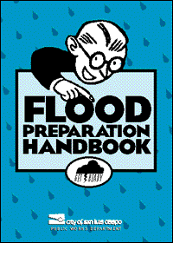
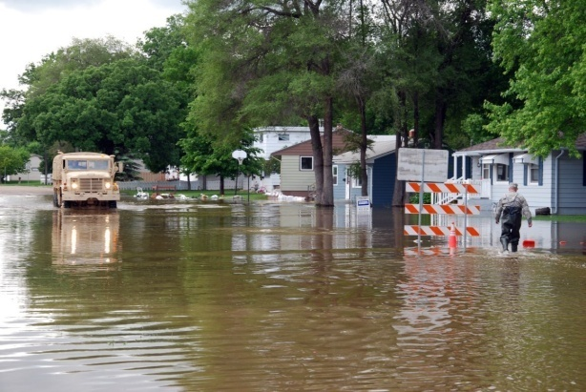
An evolution in approaches
Response
Preparedness
Risk Management

Slide 9
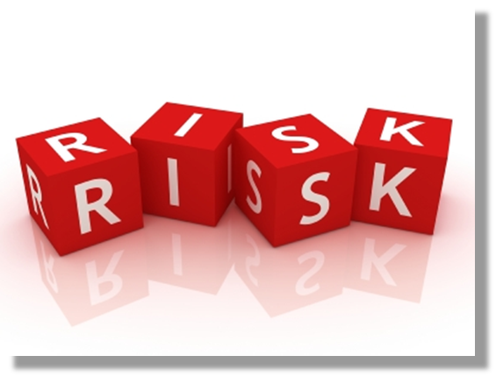
What is risk?
Risk is the probability that an event will occur.
In epidemiology, it is most often used to express the “probability that a particular outcome will occur following a particular exposure”
Last JM, ed. A dictionary of epidemiology. 4th edition. New York: Oxford University Press, 2001.

Slide 10
What is
Disaster Risk Management (DRM)?
Definition
  “The systematic process of using administrative directives, organizations, and operational skills and capacities to implement strategies, policies and improved coping capacities in order to lessen the adverse impacts of hazards and the possibility of disaster”.
Components
  Risk assessment
  Risk avoidance
  Risk reduction
  Risk transfer
  Risk retention
UNISDR 2009, http://www.unisdr.org/eng/terminology/terminology-2009-eng.html

Slide 11
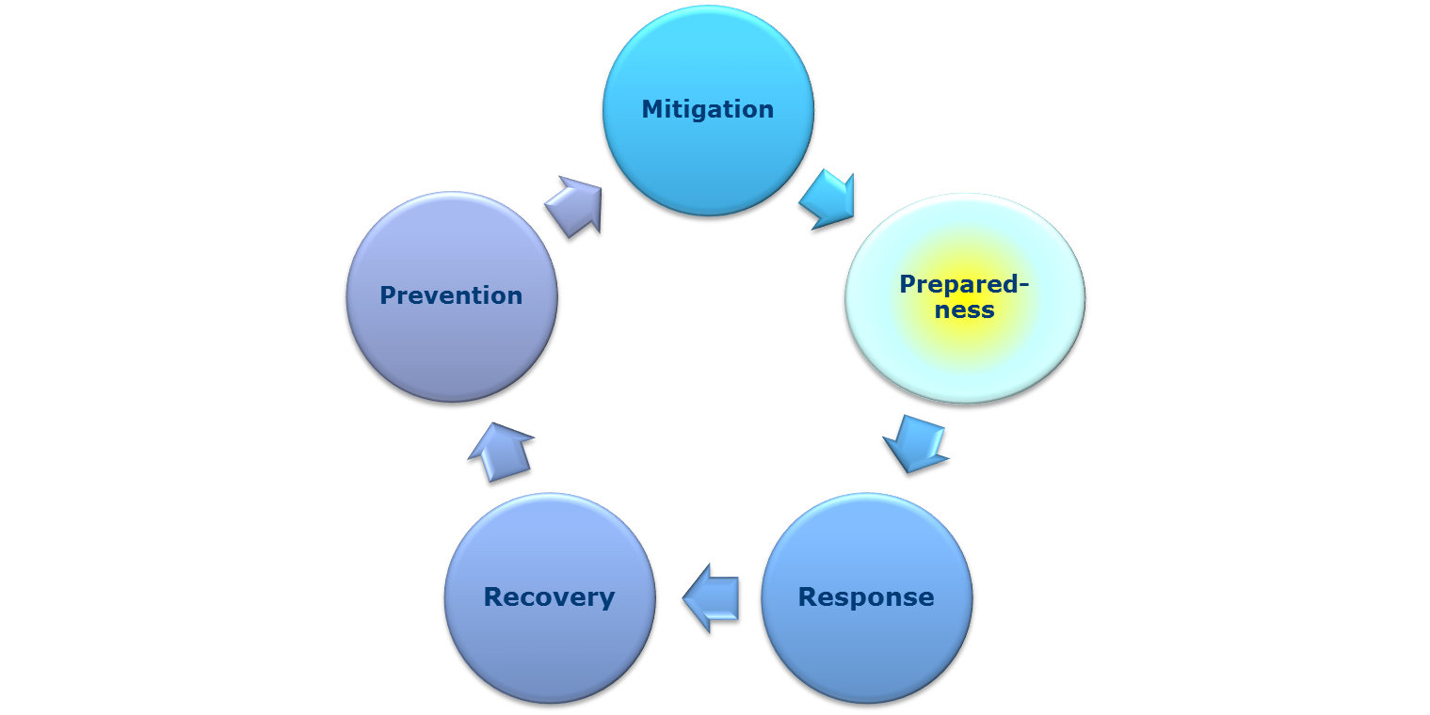
Risk reduction vs. risk retention
Risk reduction measures are
Delivered pre-impact
Most cost-effective
Community based
Sustainable
Pre-impact
Post -impact
Risk retention measures are
Delivered post-impact
Least cost-effective
Nationally and internationally based
Non-sustainable
From: Keim M. Building human resilience. Am J Prev Med 2008;35(5):508-516

Slide 12
Disaster Risk Reduction (DRR) for Health
What is DRR?
  Preventing disaster-related adverse health impact before it happens
  Deals with the root cause
Why DRR?
More effective in reducing costs
    $1 spent in DRR saves $4-7 in response costs
More effective in reducing mortality
    >90% of disaster deaths occur during impact phase

Slide 13
Health-related disaster risk occurs as the result of convergence of 4 key factors:
The presence of a health hazard associated with the occurrence of natural or man-made danger
The degree of exposure to the hazard sustained by the person (or population)
The degree of vulnerability of the person (or population) to that particular health hazard
The degree of capacity of the person (or population) in order to avoid or lessen harm
From: Keim M. Disaster Risk Management for Health. In Ed., David S. Textbook of Emergency Medicine. Lippincott) New Dehli 2012

Slide 14
Factors affecting disaster risk
Hazard/ Exposure
Vulner-ability
Capacity
RISK

Slide 15
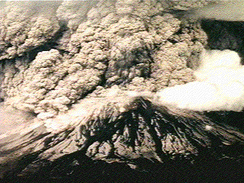
What is a hazard?
Definition of a hazard
  “A dangerous phenomenon, substance, human activity or condition that may cause loss of life, injury or other health impacts, property damage, loss of livelihoods and services, social and economic disruption, or environmental damage”
UNISDR 2009, http://www.unisdr.org/eng/terminology/terminology-2009-eng.html

Slide 16


Examples of hazards
Floods
Earthquakes
Radiation
Typhoons
Outbreaks
Tornadoes

Slide 17
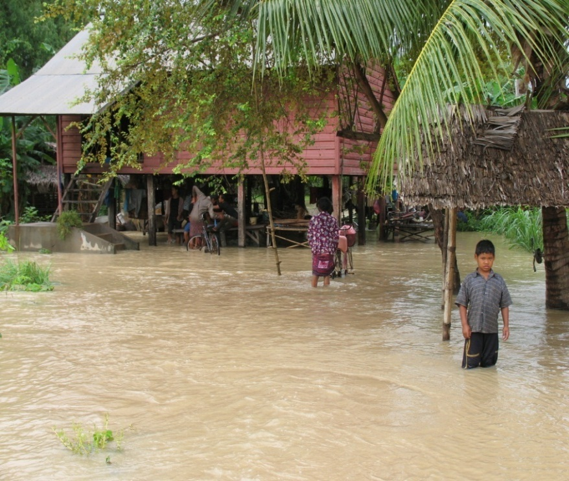
What is exposure?
Exposure
  “People, property, systems, or other elements present in hazard zones that are thereby subject to potential losses”
Example of exposure
  Living in an area that floods
UNISDR 2009, http://www.unisdr.org/eng/terminology/terminology-2009-eng.html

Slide 18
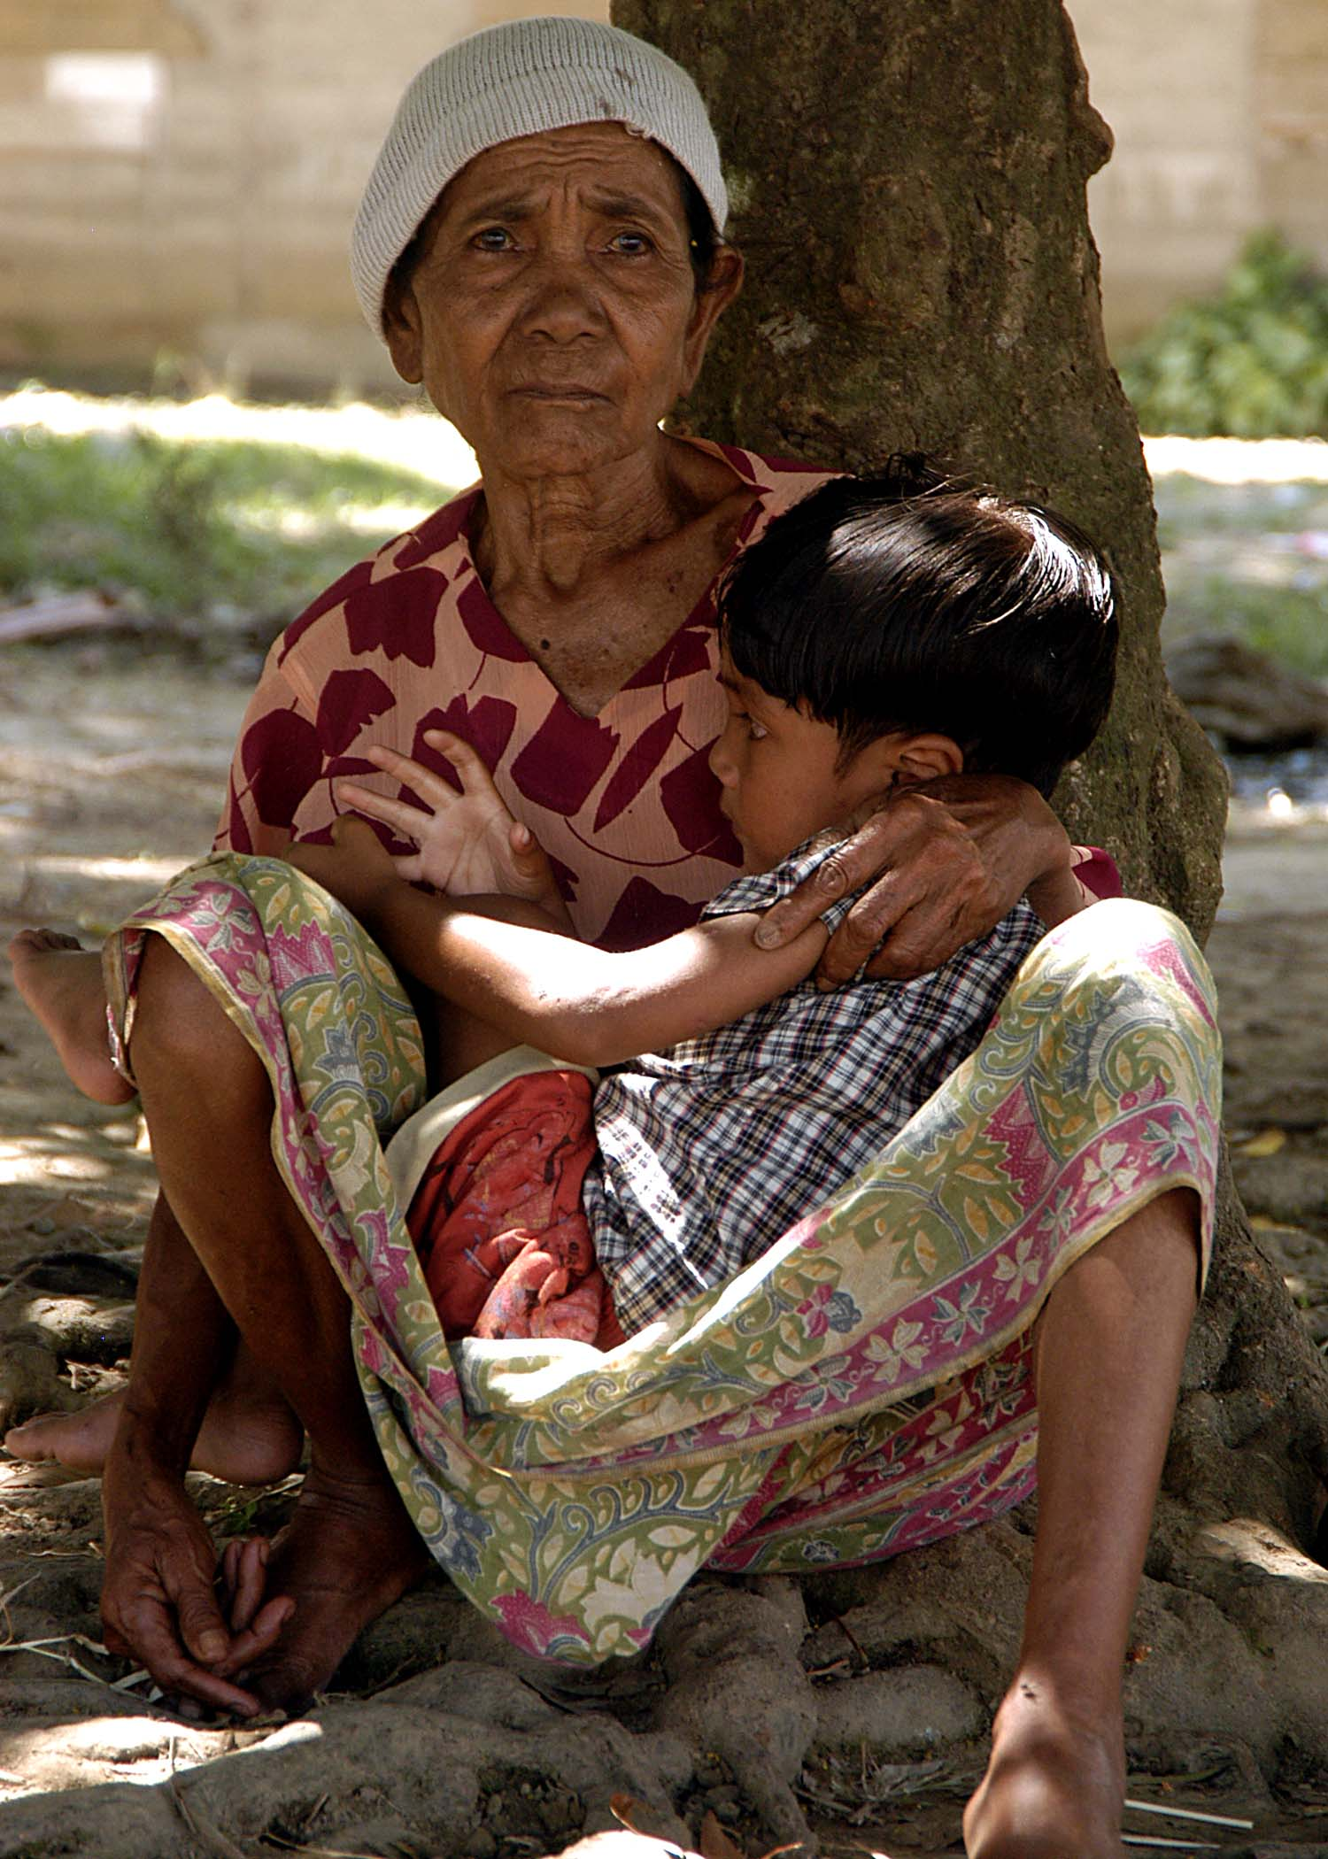
What is vulnerability?
“The characteristics and circumstances of a community, system or asset that make it susceptible to the damaging effect of a hazard” UNISDR 2009
Or simply put…
Likely to incur physical or emotional illness or injury
UNISDR 2009, http://www.unisdr.org/eng/terminology/terminology-2009-eng.html

Slide 19

Public health vulnerability
Certain populations are more vulnerable to disaster-related morbidity and mortality

Slide 20


What is capacity?
Definition
What is the difference between capacity vs. capability?
  “The combination of all the strengths, attributes and resources available within a community, society or organization that can be used to achieve agreed goals” ‡
Also known as absorptive capacity ‡‡
‡ UNISDR 2009, http://www.unisdr.org/eng/terminology/terminology-2009-eng.html
‡‡ Sundnes K, Birnbaum M, Birnbaum E, eds. Health Disaster Management Guidelines for Evaluation and Research in the Utstein Style. USA: Prehospital and Disaster Medicine; 2003

Slide 21
Countering disaster risk
Increase Risk
Decreases Risk
Capacity
Hazard /
Exposure
and
Vulnerability

Slide 22
Causes Effects
Mortality
Displace-ment
Morbidity
Loss of livelihood
Hazard
Exposure
Vulnerability
Prevention
Mitigation
Preparedness, Response
& Recovery

Slide 23
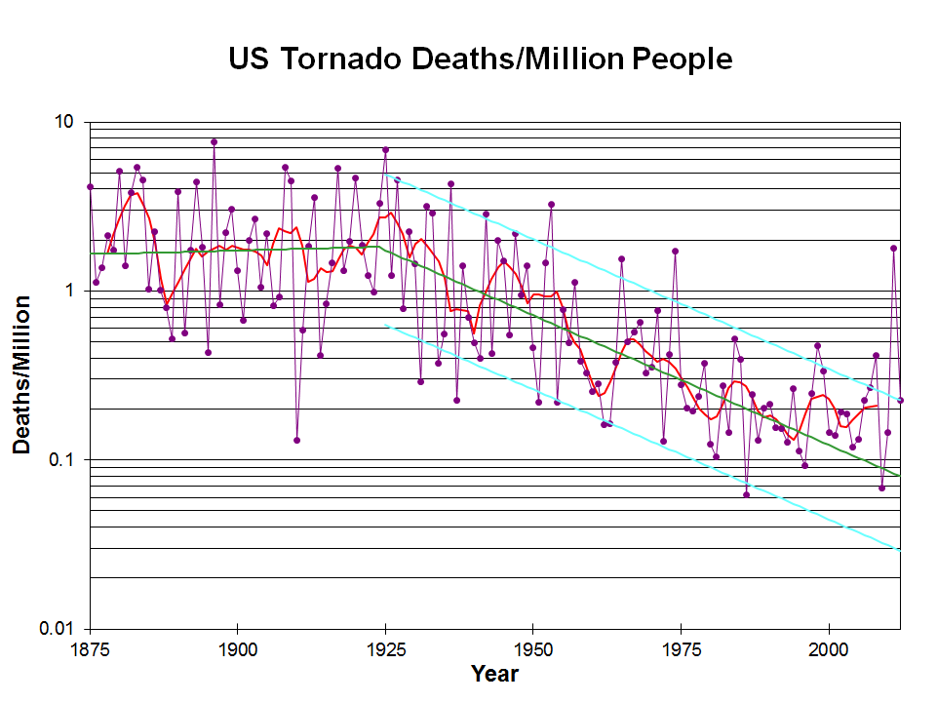
One DRR success story:
Tornado death rates are decreasing in the US
Why?
  Improved forecasting and early warning
  Improved communication
  Changes in construction
  (Note …that it’s not because of healthcare)
Brooks H, Doswell C. Deaths in the May 1999 OK City Tornado from a Historical perspective. Weather and forecasting. 2002;17: 354-61

Slide 24
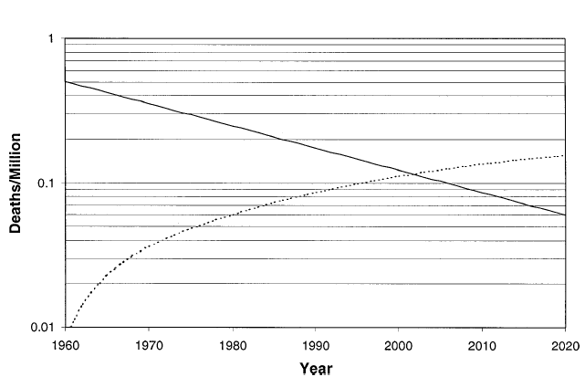
Long term trends in tornado death rates extrapolated to 2020
PERMANENT HOMES
MOBILE HOMES
Brooks H, Doswell C. Deaths in the May 1999 OK City Tornado from a Historical perspective. Weather and forecasting. 2002;17: 354-61

Slide 25
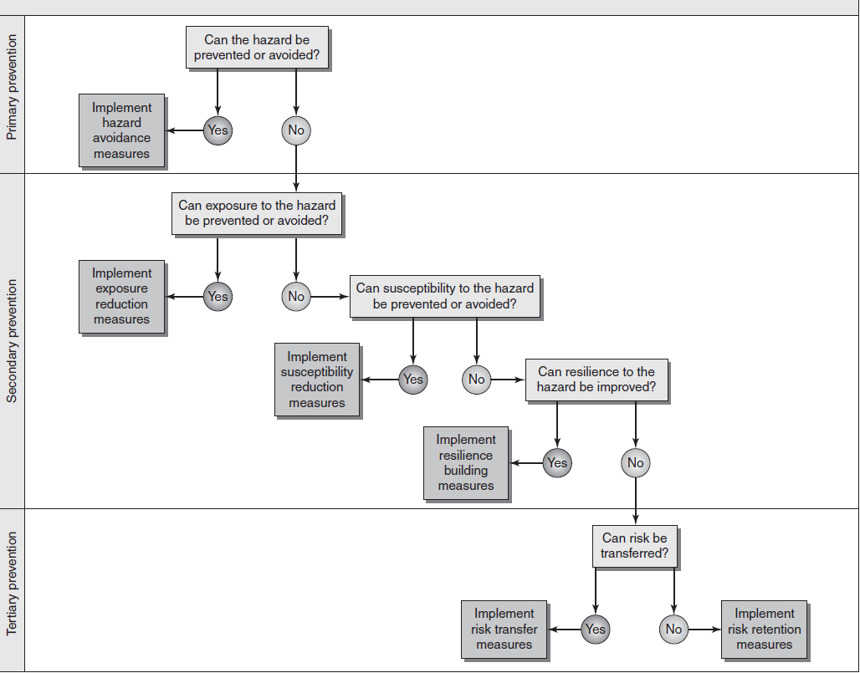
DRM Decision Algorithm
From: Keim M. Disaster Risk Management for Health. In Ed., David S. Textbook of Emergency Medicine. Lippincott) New Dehli 2012

Slide 26
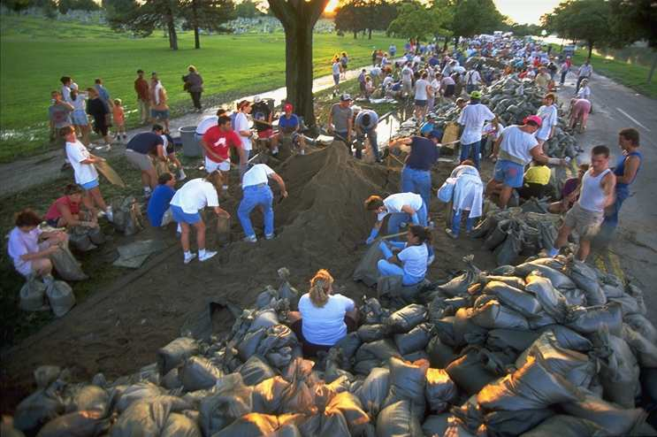
How can we reduce health risk for disasters?
Disaster reduction occurs at the community level ⁸
Community health sectors can play an active role in reducing disaster health risk
  Reducing vulnerability
    “Health people” ⁹
  Reducing exposure
    “Healthy homes” ⁹
  Increasing resilience
    “Healthy communities” ⁹
8 Schipper L, Pelling M 2006, Disaster risk, climate change and international development. Disasters, vol. 30, no. 1, pp. 19-38.
9 Srinivasan S, Creating healthy communities, healthy homes and healthy people. Am J Public Health 2003;93:1446-50.

Slide 27


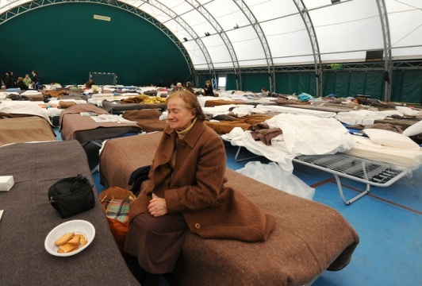
Disaster risk reduction: reducing exposures
Floodplain management
Forecasting and early warning
Population protection measures
Building codes
Land use regulation
  urban planning and zoning
  sustainable development

Slide 28

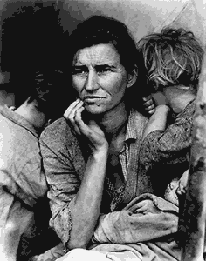
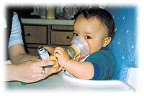

Disaster risk reduction: reducing vulnerability
Health promotion
Health care
Poverty reduction
Community planning
Public services
Community cohesion

Slide 29
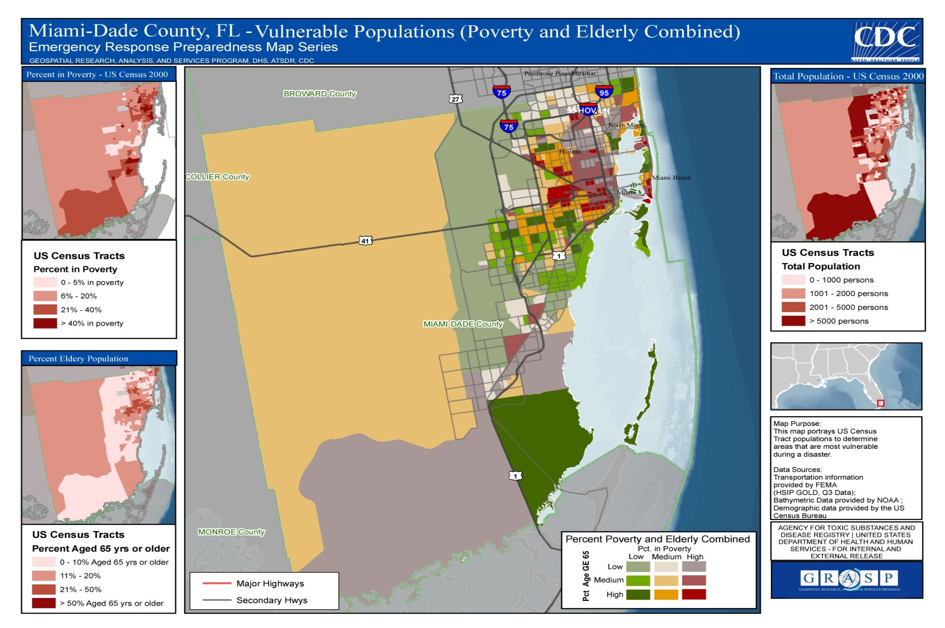
Mapping human vulnerability

Slide 30

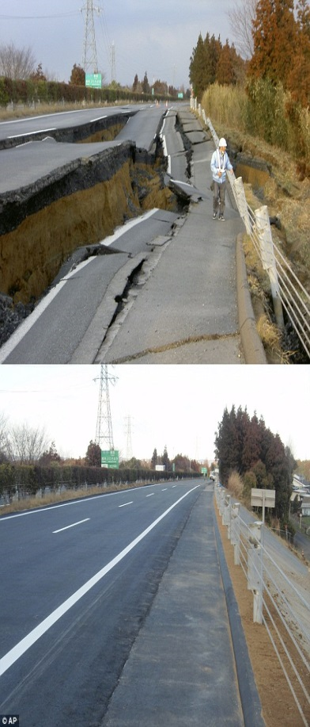

Disaster risk reduction: building capacity
We build capacity by improving:
  Preparedness
  Response
  Recovery
Societal actions that build emergency health capacity
Public health & safety
Healthcare
Education
Poverty reduction

Slide 31
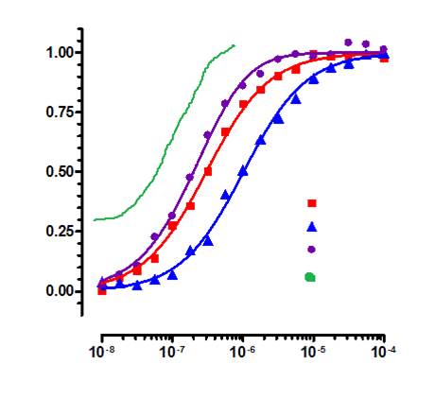
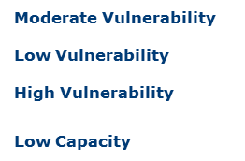


Modeling risk, vulnerability and capacity
R
I
SK
DOSE

Slide 32



Email
  mjk9@cdc.gov
LinkedIn.com:
  www.linkedin.com/in/disasterdoc/
  Disaster Risk Reduction for Health
Discussion Group
National Center for Environmental Health
Agency for Toxic Substances and Disease Registry

