Slide 1
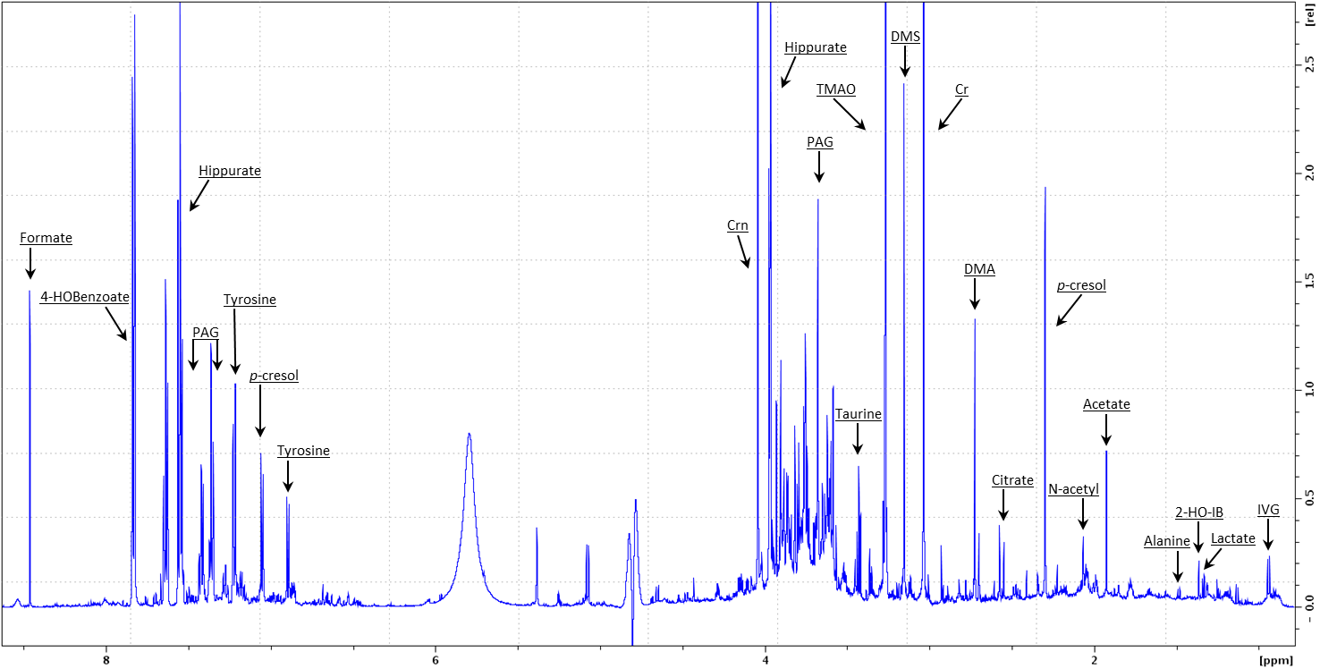
Animal journal. Salivary and urinary metabolome analysis for pre-puberty-related biomarkers identification in porcine.
Ghylène Goudet, Lydie Nadal-Desbarats, Cécile Douet, Jonathan Savoie, Christophe Staub, Eric Venturi, Stéphane Ferchaud, Sylviane Boulot, Armelle Prunier
Supplementary Figure S1 : Representative ¹H-Nuclear Magnetic Resonance spectra of porcine urinary samples. PAG: phenylacetylglycine, Crn: creatinine, TMAO: trimethylamine-oxide, DMS: dimethylsulfone, Cr: creatine, DMA: Dimethylamine, IB: isobutyrate, IVG: isovalerylglycine.

Slide 2
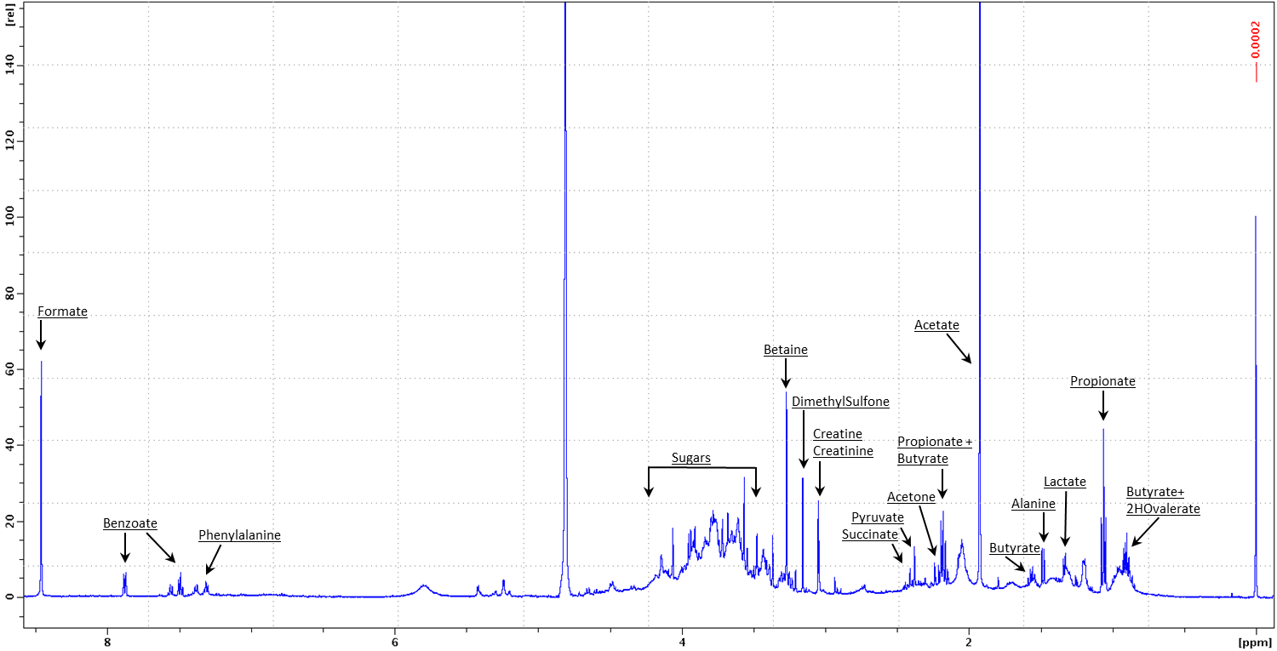
Animal journal. Salivary and urinary metabolome analysis for pre-puberty-related biomarkers identification in porcine.
Ghylène Goudet, Lydie Nadal-Desbarats, Cécile Douet, Jonathan Savoie, Christophe Staub, Eric Venturi, Stéphane Ferchaud, Sylviane Boulot, Armelle Prunier
Supplementary Figure S2 : Representative ¹H-Nuclear Magnetic Resonance spectra of porcine salivary samples

