Slide 1
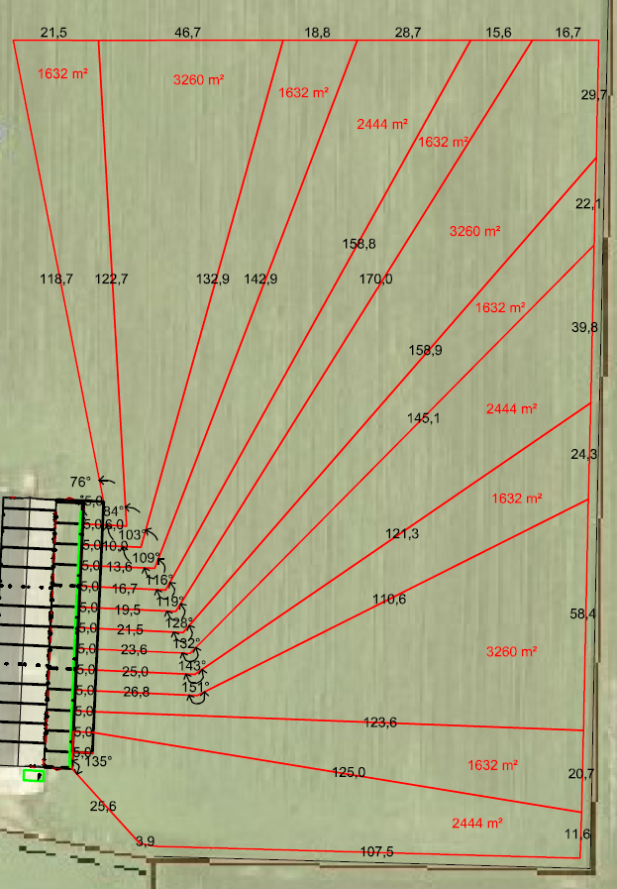
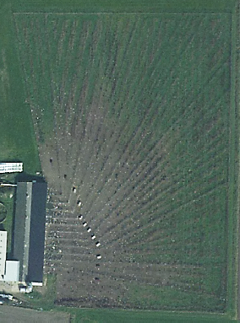
a)
b)
Supplementary Figure S2. a) Diagram and b) aerial photo of the outdoor areas. In order to achieve 4 m² outdoor area per hen for all group sizes, the shape of the areas differed between rooms, but all outdoor areas had at least 5 m in front of the veranda before the shape changed. In the aerial photo shelters placed 25 m from the veranda in the second year can be seen, together with dots of white hens.

