Slide 1
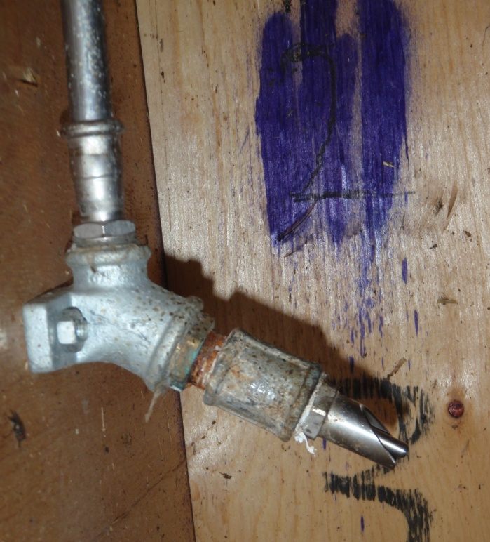
Supplementary Figure S2. The nipple drinker was mounted 0.53 m above floor level with a 15° downward angel against the horizontal plan.

