Slide 1
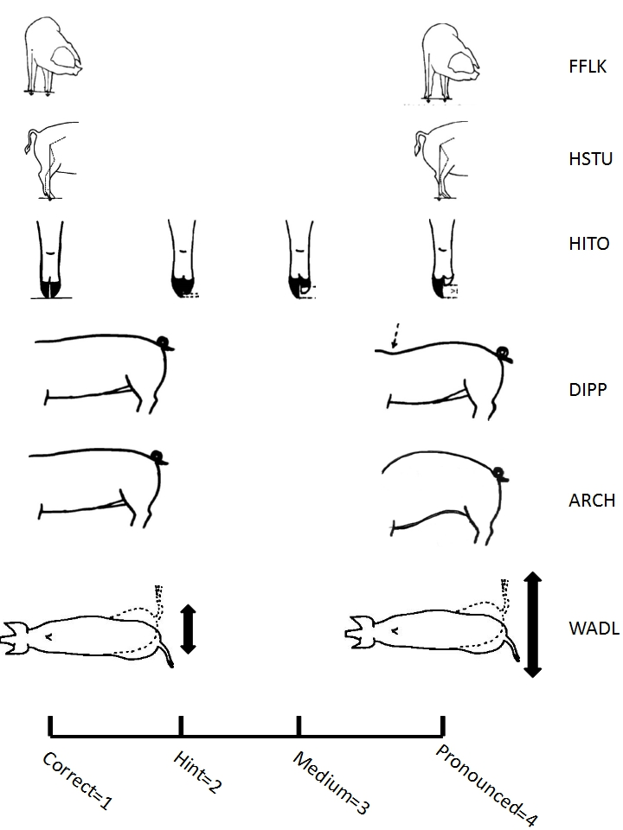
Supplementary Figure S2: Conformation traits assessed on a 4-point scale. The traits scored are front leg pastern front view (FFLK), hind leg sideway standing under (HSTU), hind leg small inner toe (HITO), dipped back (DIPP), arched back (ARCH) and waddling hind quarters (WADL).

