Slide 1
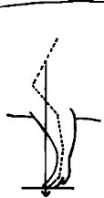
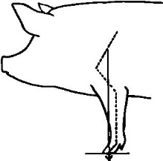
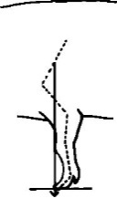
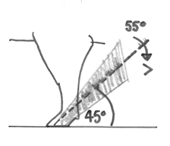
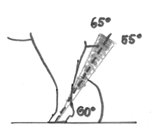
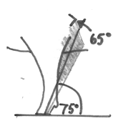
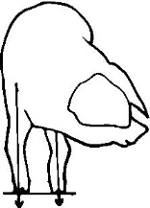
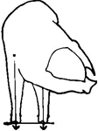
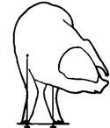
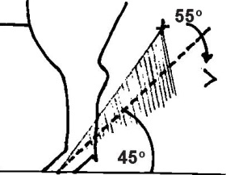
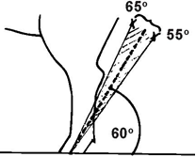
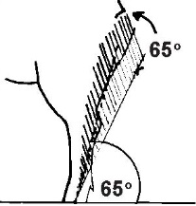
FKNE
FPAS
FSTA
HSTA
HPAS
Pronounced=1
Medium=2
Hint=3
Correct=4
Hint=5
Medium=5
Pronounced=7
Supplementary Figure S1: Conformation traits assessed on a 7-point scale. The traits scored are front leg knee side view (FKNE), front leg pastern side view (FPAS), front leg knee front view (FSTA), hind leg hock rear view (HSTA) and hind leg pastern side view (HPAS).

