Slide 1
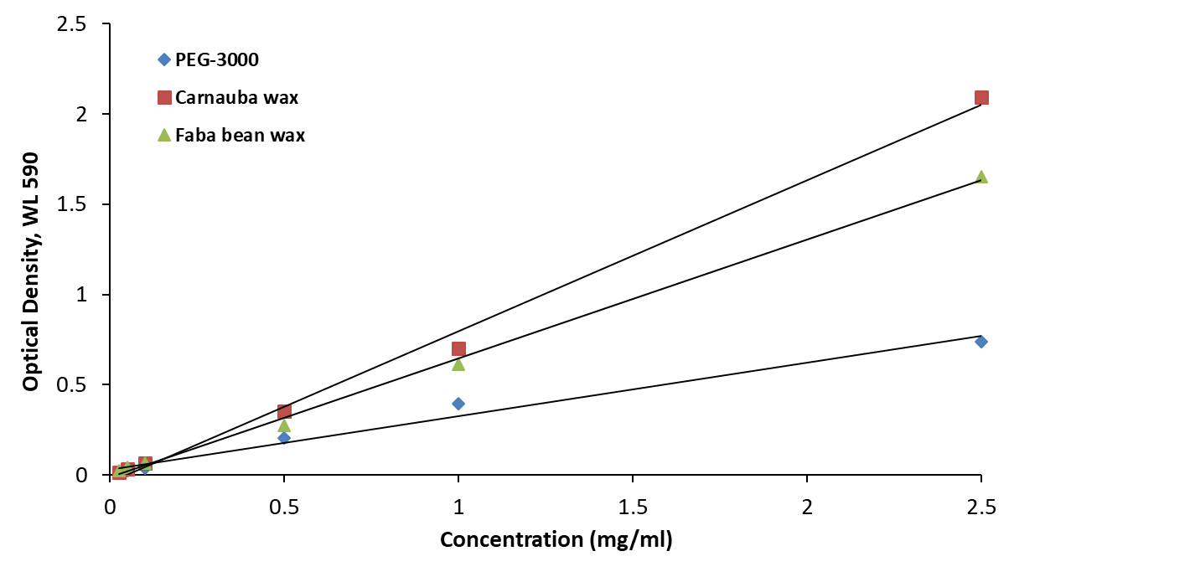
Figure S1. Standard curves for Carnauba wax (y = 0.8350x – 0.0374, R² = 0.9955), faba bean wax (y = 0.8337x – 0.0399, R² = 0.9972), and PEG-3000 (y = 0.2962x + 0.0283, R² = 0.9801).

