Slide 1
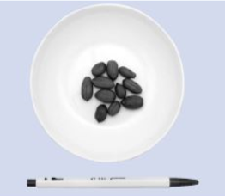
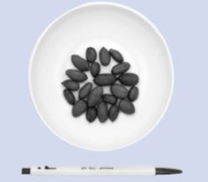
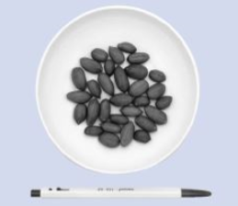
(a) Half serving size (7.5 g)
(b) One serving size (15 g)
(c) One and half serving size (22.5 g)
Supplementary Figure 1) Photo of peanuts equivalent to half (a), one (b) and one and half (c) serving size of peanuts
One serving size of peanuts was 15 gram. A pen presented to compare the sizes of the plates.

