Slide 1
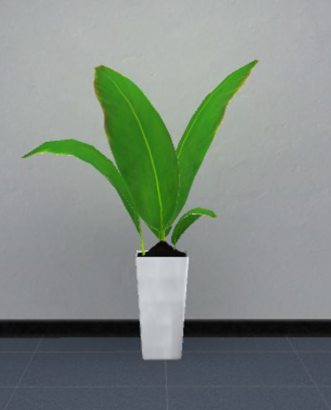
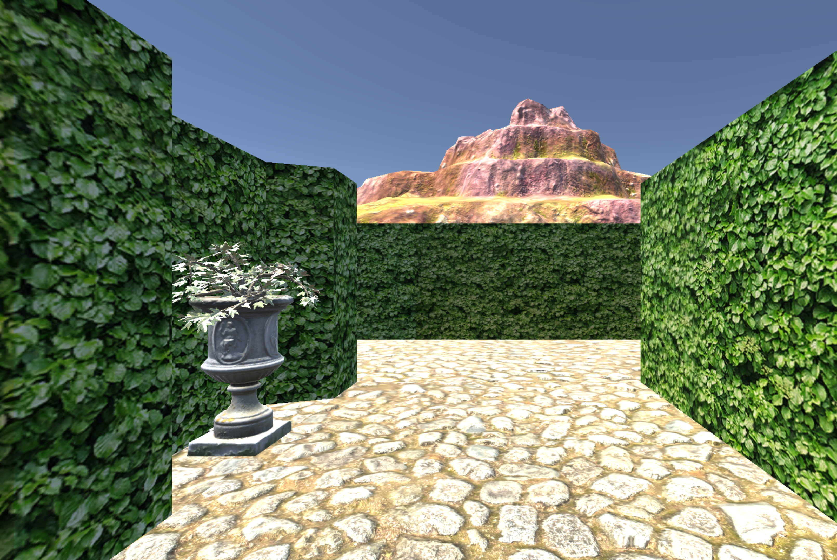
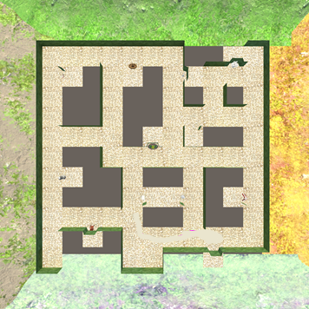
A
B
LEARNING
TEST
LEARNING
TEST
C
TEST
LEARNING
S
T
S: Starting Location
T: Target Location
Original Path
Shortcut Path

