Slide 1
Isle of Ted: Climate Change

Slide 2
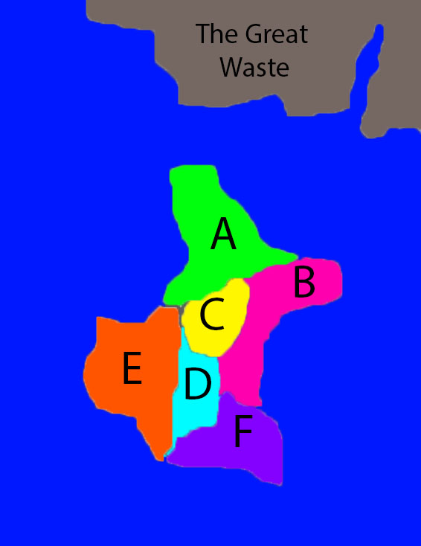
Welcome to the Isle of Ted
Map modified from Thomas, G. Dale. 2002. “The Isle of Ted Simulation: Teaching Collective Action in International Relations and Organization.” PS: Political Science & Politics 35 (3): 555–559.

Slide 3
How do we play the game?
Six groups: Alpha, Beta, Cain, Delta, Eagle, or Frost. Each group starts with 10 resource points.
You can use your points to build an island road network, provide for defense of the whole island, or send out fishing boats for your group.
You can get more points by trading on the roads or fishing.
You can protect your points by fending off pirate raids.
There is no limit to the number of points your group can amass, but no group can go below 0 points.
We will play up to 10 rounds— —I’ll tell you when it’s the last round!

Slide 4
How do you get more points? Trade!
If a road network exists on the Isle, each group will gain points for trade each turn.
Alpha and Eagle get +2 resource points for trading; all other groups get +1 resource points. Groups get points whether or not they helped build or maintain the road.
How do you build a road? The road costs 8 points to build. The cost of building can be shared among groups.
Every turn, the road must be maintained with 1 point. Without maintenance, the road collapses and 8 points are necessary to rebuild.

Slide 5
How do you get more points? Fish!
Each turn, your group can send between 1–4 fishing boats out to sea.
Each boat costs 1 point. The more fish you catch, the more points you get!
Points for fishing accrue only to the group(s) who sent the boats.

Slide 6
How do you lose points?
Between 1 and 4 pirates attack the Isle of Ted every turn!
The pirates only attack one of the coastal groups (Alpha, Beta, Eagle, or Frost)
To defeat the pirates, the Isle must have defense strength equal to or greater than the pirates. Each point spent on defense counts for the Isle as a whole.
If the pirates are stronger, they will take 1–4 points from the attacked group
Cain and Delta can only be attacked if the pirates attack a coastal group that is out of points

Slide 7
Game play: (up to) 10 rounds
First round: 3 minutes of discussion within your group (no outside negotiation!)
At the end of each turn, each group hands in their action sheet
The professor adds up the points, announce the Isle results (road, fish, defense), roll the pirate attack, and return the sheets to the groups with total points
Beginning the second turn, 3 minutes of negotiation are allowed between groups
I’ll tell you when it’s the last round
All actions are kept secret from the others. Deception may be a useful technique!

