Slide 1
Mind the (Gender) Gap
Gender gap in public policy

Slide 2
Copyright Information
Mind the (Gender) Gap by Dr. Amy L. Atchison is licensed under a Creative Commons Attribution-NonCommercial 4.0 International License.
​Amy L. Atchison, PhD
Department of Political Science and International Relations
Valparaiso University
1400 Chapel Dr., Arts & Sciences Building, Office 323
Valparaiso, IN 46383
219-464-5348
Amy.Atchison@Valpo.edu

Slide 3
Mind the (Gender) Gap Instructions
I use Turning Point ‘s Power Point clicker polling functionality to complete this exercise. It could be done with an app like Poll Anywhere, but I forbid all cell phone use in my classes. I do the polling in three rounds: all students, students who primarily identify as female, and students who primarily identify as male. The disadvantage to clickers is that one cannot separate responses by gender, so each question has to be polled three times, which is why the Power Point contains each question three times and a slide for the comparison results.
Students who are gender fluid are free to participate in either gender round, or may choose not to participate at all. Clickers are completely anonymous, so students can gender identify however they feel comfortable, whether they are “out” to their classmates or not.

Slide 4
Mind the (Gender) Gap
So, this will be a little different than our typical clicker exercises…
We’re going to do this in 3 rounds & you WILL NOT be able to see the results until both rounds are complete.
In alphabetical order:
Round 1: everyone’s round
Round 2: if you primarily identify as female, this is your round
Round 3: if you primarily identify as male, this is your round

Slide 5
Mind the gap
Only vote in the first round and in YOUR gender round, please
We’ll be using clicker channel 80
To activate your clicker, press
CH, 80, CH

Slide 6
Politically, would you say you are:
ALL ANSWER
Right
Center-right
Center
Center-left
Left
Unsure

Slide 7
Politically, would you say you are:
FEMALES ANSWER
Right
Center-right
Center
Center-left
Left
Unsure

Slide 8
Politically, would you say you are:
MALES ANSWER
Right
Center-right
Center
Center-left
Left
Unsure

Slide 9
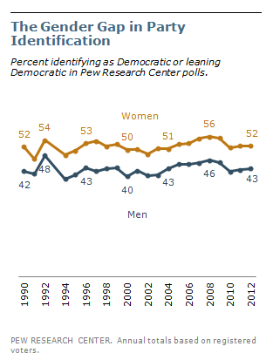
Politically, would you say you are:
GENERAL POPULATION (US)
Right
Center-right
Center
Center-left
Left
Unsure
Notes:
Note: Many students reject party labels, so I chose to ask about where they fall on the spectrum rather than party ID.

Slide 10
Are you in favor of the death penalty for a person convicted of murder?
ALL ANSWER
Yes
No
No opinion

Slide 11
Are you in favor of the death penalty for a person convicted of murder?
FEMALES ANSWER
Yes
No
No opinion

Slide 12
Are you in favor of the death penalty for a person convicted of murder?
MALES ANSWER
Yes
No
No opinion

Slide 13
Are you in favor of the death penalty for a person convicted of murder?
GENERAL POPULATION (US)

Slide 14
Government does ________ for wealthy people.
ALL ANSWER
Not enough
Too much
Right amount
Not sure

Slide 15
Government does ________ for wealthy people.
FEMALES ANSWER
Not enough
Too much
Right amount
Not sure

Slide 16
Government does ________ for wealthy people.
MALES ANSWER
Not enough
Too much
Right amount
Not sure

Slide 17
Government does ________ for wealthy people.
GENERAL POPULATION (US)

Slide 18
In general, do you think the courts deal too harshly or not harshly enough with criminals?
ALL ANSWER
Too harshly
About right
Not harsh enough

Slide 19
In general, do you think the courts deal too harshly or not harshly enough with criminals?
FEMALES ANSWER
Too harshly
About right
Not harsh enough

Slide 20
In general, do you think the courts deal too harshly or not harshly enough with criminals?
MALES ANSWER
Too harshly
About right
Not harsh enough

Slide 21
In general, do you think the courts deal too harshly or not harshly enough with criminals?
GENERAL POPULATION (US)

Slide 22
Government should invest in/promote the use of nuclear power to address the energy supply.
ALL ANSWER
Yes
No

Slide 23
Government should invest in/promote the use of nuclear power to address the energy supply.
FEMALES ANSWER
Yes
No

Slide 24
Government should invest in/promote the use of nuclear power to address the energy supply.
MALES ANSWER
Yes
No

Slide 25
Government should invest in/promote the use of nuclear power to address the energy supply.
GENERAL POPULATION (US)

Slide 26
Government does ________ for poor people.
ALL ANSWER
Not enough
Too much
Right amount
Not sure

Slide 27
Government does ________ for poor people.
FEMALES ANSWER
Not enough
Too much
Right amount
Not sure

Slide 28
Government does ________ for poor people.
MALES ANSWER
Not enough
Too much
Right amount
Not sure

Slide 29
Government does ________ for poor people.
GENERAL POPULATION (US)

Slide 30
The main emphasis of prisons should be:
ALL ANSWER
Punishment
Protection of society
Rehabilitation
Not sure

Slide 31
The main emphasis of prisons should be:
FEMALES ANSWER
Punishment
Protection of society
Rehabilitation
Not sure

Slide 32
The main emphasis of prisons should be:
MALES ANSWER
Punishment
Protection of society
Rehabilitation
Not sure

Slide 33
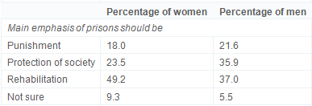
The main emphasis of prisons should be:
GENERAL POPULATION (US)

Slide 34
Government does ________ for the elderly.
ALL ANSWER
Not enough
Too much
Right amount
Not sure

Slide 35
Government does ________ for the elderly.
FEMALES ANSWER
Not enough
Too much
Right amount
Not sure

Slide 36
Government does ________ for the elderly.
MALES ANSWER
Not enough
Too much
Right amount
Not sure

Slide 37
Government does ________ for the elderly.
GENERAL POPULATION (US)

Slide 38
The best way to ensure peace is through:
ALL ANSWER
Good diplomacy
Military strength
Neither
Both
Unsure

Slide 39
The best way to ensure peace is through:
FEMALES ANSWER
Good diplomacy
Military strength
Neither
Both
Unsure

Slide 40
The best way to ensure peace is through:
MALES ANSWER
Good diplomacy
Military strength
Neither
Both
Unsure

Slide 41
Government does ________ for the elderly.
GENERAL POPULATION (US)

Slide 42
Abortion should be legal in all/most cases
ALL ANSWER
Yes
No

Slide 43
Abortion should be legal in all/most cases
FEMALES ANSWER
Yes
No

Slide 44
Abortion should be legal in all/most cases
MALES ANSWER
Yes
No

Slide 45
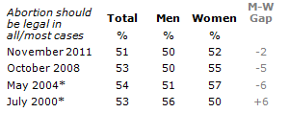
Abortion should be legal in all/most cases
GENERAL POPULATION (US)

Slide 46
Government does ________ for children.
ALL ANSWER
Not enough
Too much
Right amount
Not sure

Slide 47
Government does ________ for children.
FEMALES ANSWER
Not enough
Too much
Right amount
Not sure

Slide 48
Government does ________ for children.
MALES ANSWER
Not enough
Too much
Right amount
Not sure

Slide 49
Government does ________ for children.
GENERAL POPULATION (US)

Slide 50
Favor allowing gays/lesbians to marry legally.
ALL ANSWER
Yes
No

Slide 51
Favor allowing gays/lesbians to marry legally.
FEMALES ANSWER
Yes
No

Slide 52
Favor allowing gays/lesbians to marry legally.
MALES ANSWER
Yes
No

Slide 53
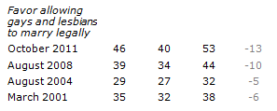
Favor allowing gays/lesbians to marry legally.
GENERAL POPULATION (US)

Slide 54
Stats Citations:
Crime & punishment questions and stats from:
Applegate, Brandon K., Francis T. Cullen, and Bonnie S. Fisher. "Public views toward crime and correctional policies: Is there a gender gap?." Journal of Criminal Justice 30.2 (2002): 89-100.
All other questions and from:
Pew Research Center. “The Gender Gap: Three Decades Old, as Wide as Ever.” March 29, 2012. http://www.people-press.org/2012/03/29/the-gender-gap-three-decades-old-as-wide-as-ever/ Retrieved 08/31/2015

