Slide 1
EPIDEMIOLOGY AND INFECTION
Co-circulation and co-infections of all dengue virus serotypes in Hyderabad, India 2014
Kishore Vaddadi¹, Chaitanya Gandikota¹, Pratul Kumar Jain¹, V S V Prasad² and Musturi Venkataramana^{1*}
¹Department of Biotechnology and Bioinformatics, School of Life Sciences, University of Hyderabad, Hyderabad, Telangana State, India.
²Lotus Children’s hospital, Lakdikapul, Hyderabad, Telangana State, India.
SUPPLEMENTARY DATA

Slide 2
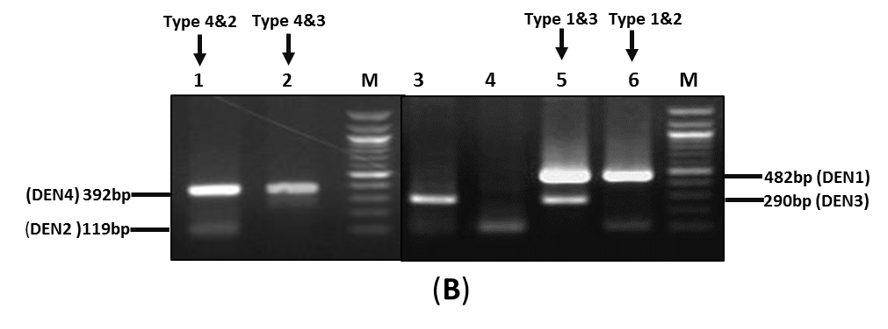
Supplementary figure S1: Representative agarose gel of amplified products for serotyping
(A)
(B)

Slide 3
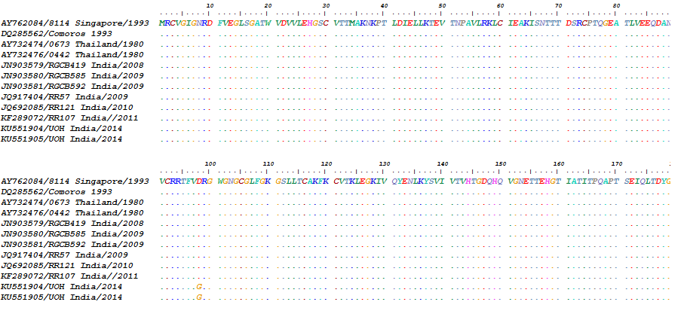
Supplementary figure S2: Comparative amino acid sequence analysis of the Envelope region of Den-1 strains
Genotype-III
Genotype-III
Genotype-III

Slide 4
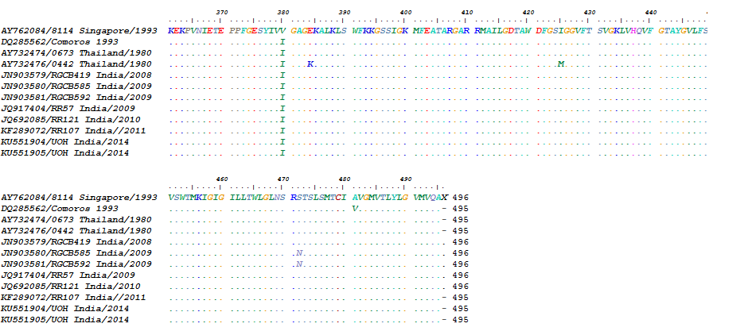
Genotype-III
Genotype-III
Genotype-III

Slide 5
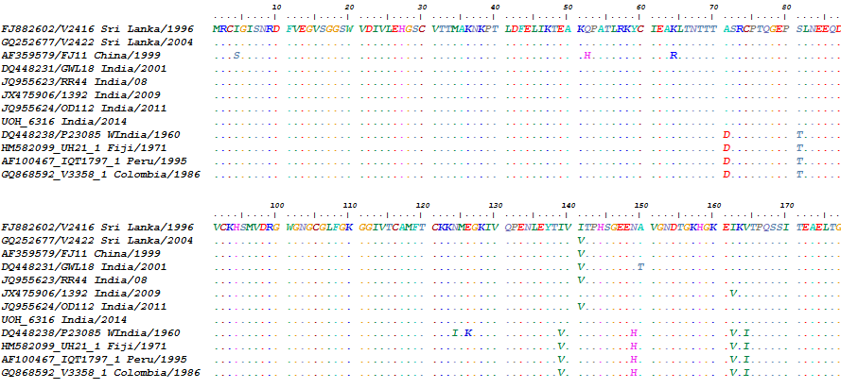
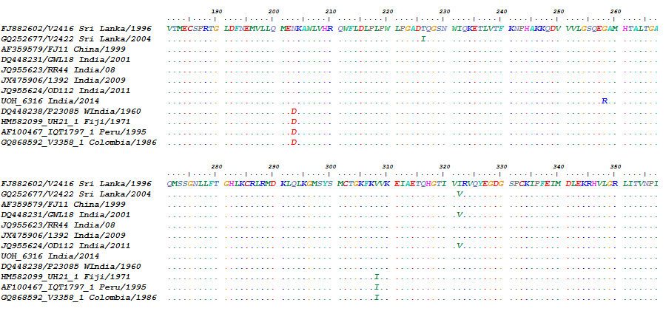
Supplementary figure S3: Comparative amino acid sequence analysis of the Envelope region of Den-2 strains
GT-IV/
Cosmopolitan
GT-V/
American
GT-IV/
Cosmopolitan
GT-V/
American
GT-IV/
Cosmopolitan
GT-V/
American

Slide 6
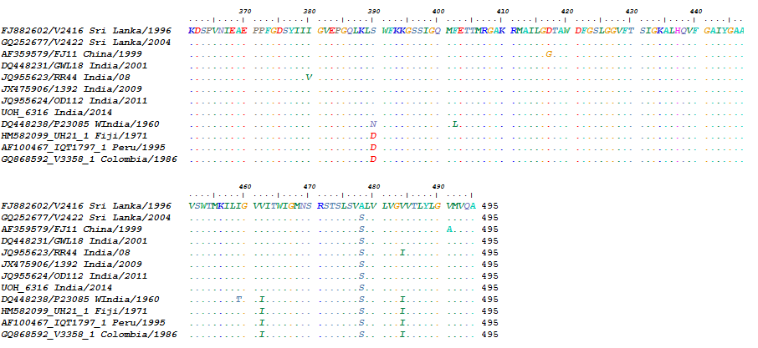
GT-IV/
Cosmopolitan
GT-V/
American
GT-IV/
Cosmopolitan
GT-V/
American
GT-IV/
Cosmopolitan
GT-V/
American

Slide 7
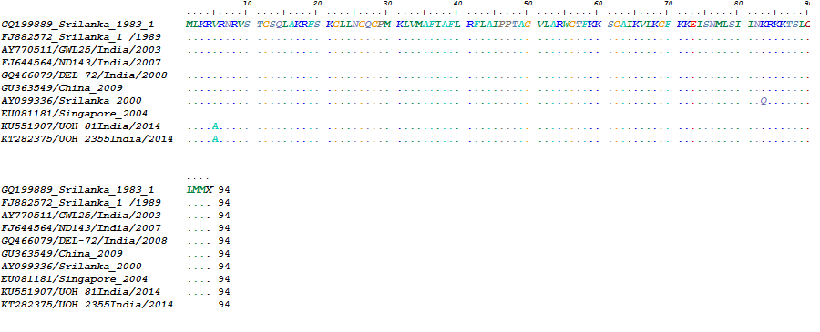
Supplementary figure S4: Comparative amino acid sequence analysis of the CprM region of Den-3 strains
Genotype-III
Genotype-III

Slide 8
Supplementary figure S5: Comparative amino acid sequence analysis of the Envelope region of Den-4 strains
Genotype-I
Genotype-I
Genotype-I

Slide 9
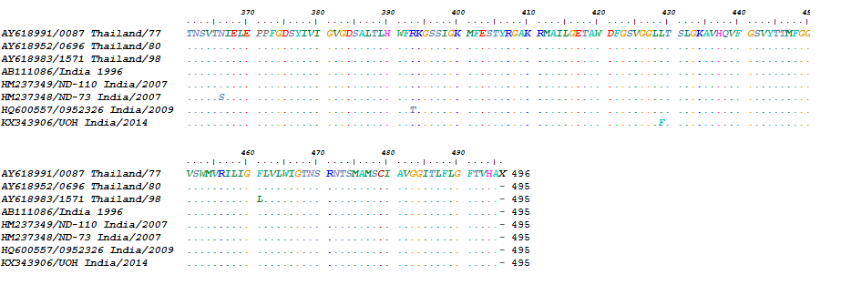
Genotype-I
Genotype-I
Genotype-I

