Slide 1
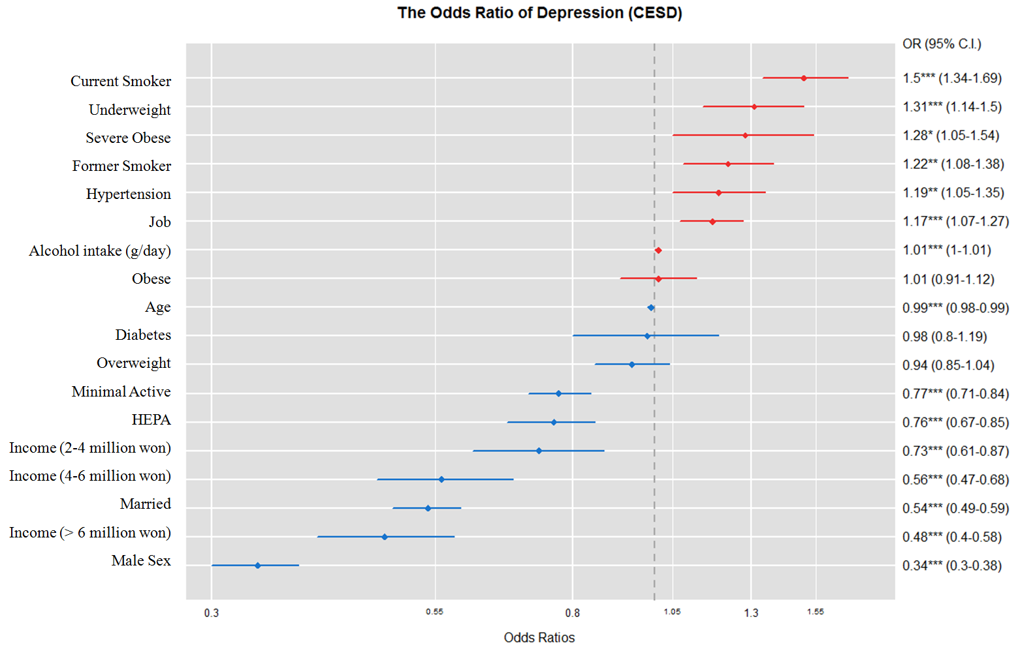
Supplementary figure 1a. The Odds Ratio of Depression (CES-D≥25) in all study participants.
The normal body weight, never smoker, monthly income < 2 million won, inactive physical activity is a reference group.
The increased OR presented in red and decreased OR presented in blue. (* P<0.05, ** P<0.01, *** P < 0.001)

Slide 2
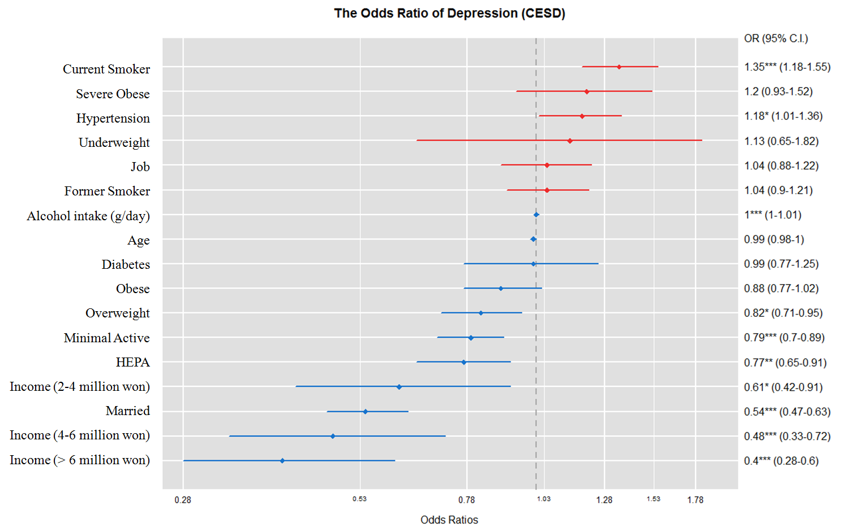
Supplementary figure 1b. The Odds Ratio of Depression (CES-D≥25) in male subgroup.
The normal body weight, never smoker, monthly income < 2 million won, inactive physical activity is a reference group.
The increased OR presented in red and decreased OR presented in blue. (* P<0.05, ** P<0.01, *** P < 0.001)

Slide 3
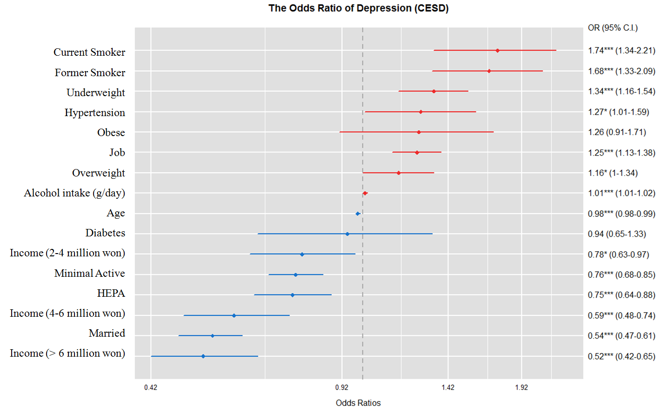
Supplementary figure 1c. The Odds Ratio of Depression (CES-D≥25) in female subgroup.
The normal body weight, never smoker, monthly income < 2 million won, inactive physical activity is a reference group.
The increased OR presented in red and decreased OR presented in blue. (* P<0.05, ** P<0.01, *** P < 0.001)

