Slide 1
ELECTRONIC SUPPLEMENTARY FILE (ESF)
Role of T and B lymphocyte cannabinoid type 1 and 2 receptors in major depression and suicidal behaviors: effects of in vitro cannabidiol administration.
(1,2,3,4,5) Michael Maes, (1) Muanpetch Rachayon; (1,6) Ketsupar Jirakran; (1) Atapol Sughondhabirom, (1,7) Abbas F. Almulla, (8) Pimpayao Sodsai.
(1) Department of Psychiatry, Faculty of Medicine, Chulalongkorn University and King Chulalongkorn Memorial Hospital, the Thai Red Cross Society, Bangkok, Thailand
2) Cognitive Fitness and Technology Research Unit, Faculty of Medicine, Chulalongkorn University, Bangkok, Thailand
3) Department of Psychiatry, Medical University of Plovdiv, Plovdiv, Bulgaria
4) Research Institute, Medical University Plovdiv, Plovdiv, Bulgaria
5) Kyung Hee University, 26 Kyungheedae-ro, Dongdaemun-gu, Seoul 02447, Korea
(6) Maximizing Thai Children's Developmental Potential Research Unit, Department of Pediatrics, Faculty of Medicine, Chulalongkorn University, Bangkok, Thailand
(7) Medical Laboratory Technology Department, College of Medical Technology, The Islamic University, Najaf, Iraq.
(8) Center of Excellence in Immunology and Immune-Mediated Diseases, Department of Immunology, Faculty of Medicine, Chulalongkorn University and King Chulalongkorn Memorial Hospital, Bangkok, Thailand.

Slide 2
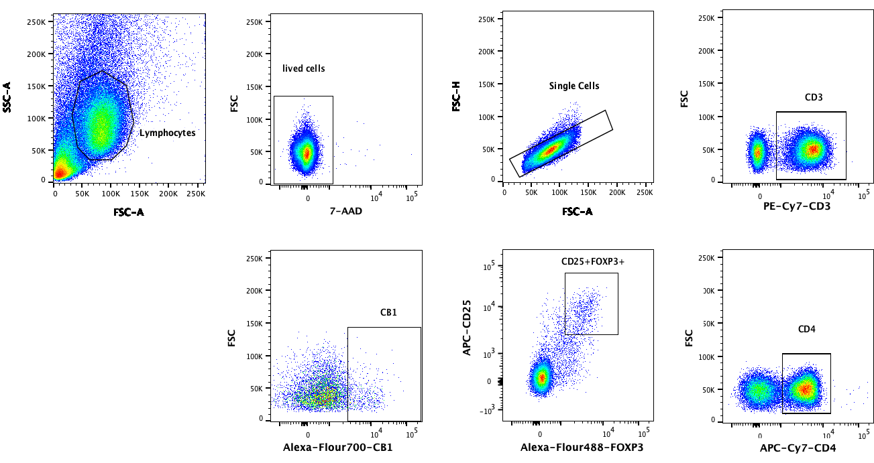

Slide 3
ESF, Figure 1. Gating strategy to assess FoxP3+CB1+ cells

Slide 4
CD8+
CD4+

Slide 5
ESF, Figure 1. Gating strategy to assess CD4+/CD8+/CD20+ CB2+ cells

Slide 6
ESF Table 1. Description of the immune profiles used in this study
Immune Profile | Members
M1 macrophage | IL-1β, sIL-1RA, IL-6, TNF-α, CXCL8, CCL3
T helper-1 | IL-2, IFN-γ, IL-12
T helper-17 | IL-6, IL-17
IRS | IL-1β, IL-6, TNF-α, CXCL8, CCL3, IL-2, IFN-γ, IL-12, IL-17, IL-15, G-CSF, GM-CSF, CXCL10, CCL5, CCL2
T cell growth | IL-4, IL-9, IL-12, GM-CSF, IL-15
IRS: immune-inflammatory response system; CIRS: compensatory immunoregulatory system

Slide 7
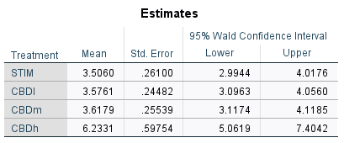
ESF, Table 2 Effects of three concentrations of CBD on the anti-CD3/CD28 stimulated FoxP3+CB1+ cells (percentage).
Stim: stimulated with anti-CD3/CD28 beads, CBD (cannabidiol): all stimulated with anti-CD3/CD28 and 0.1 µg/dL CBD (CBDl), 1.0 µg/dL (CBDm) or 10.0 µg/dL (CBDh).

