Slide 1
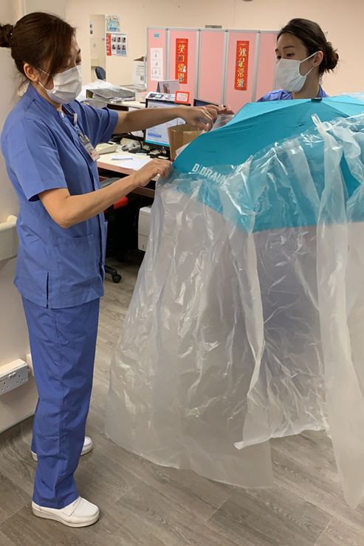
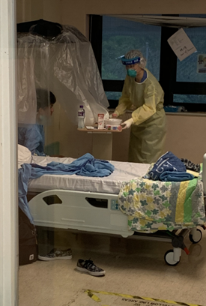
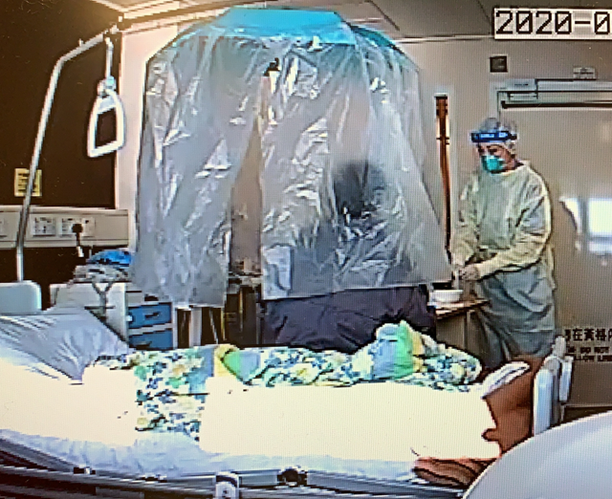
Fig 1b
Fig 1d
Fig 1a
An umbrella with plastic curtain to cover patient during collection of air samples
Fig 1c

