Slide 1
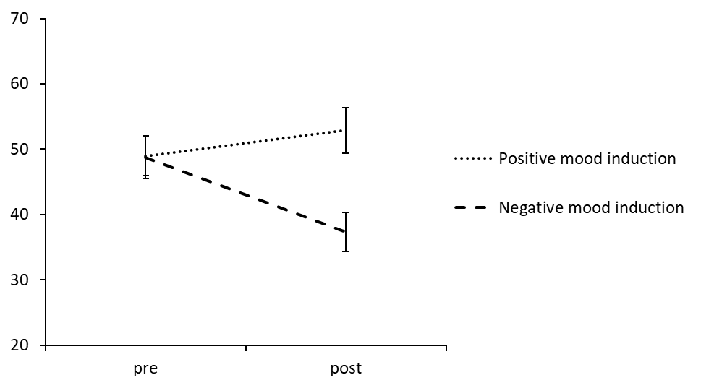
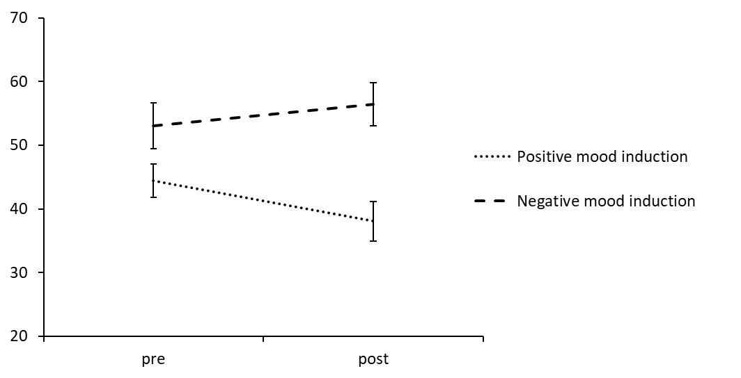
Manipulation Check from Study 2
a) Change in positive affect
b) Change in negative affect
Change in positive affect (post-pre)
Change in negative affect (post-pre)

