Slide 1
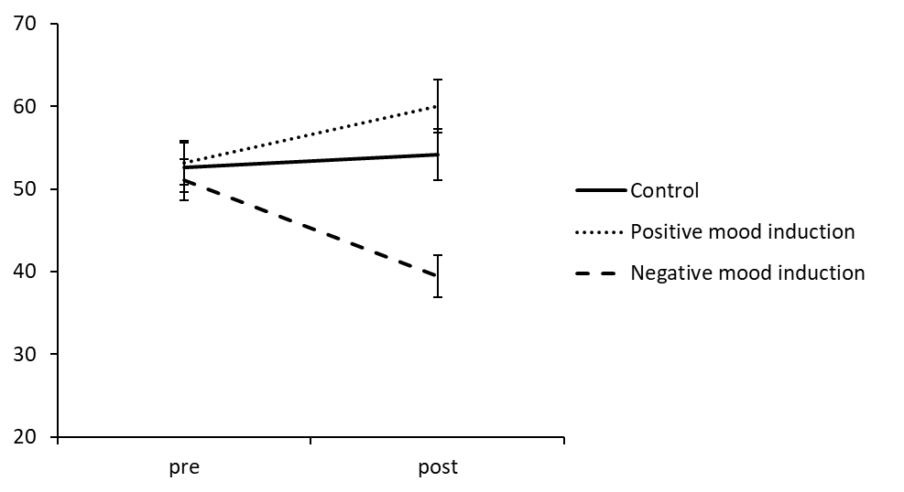
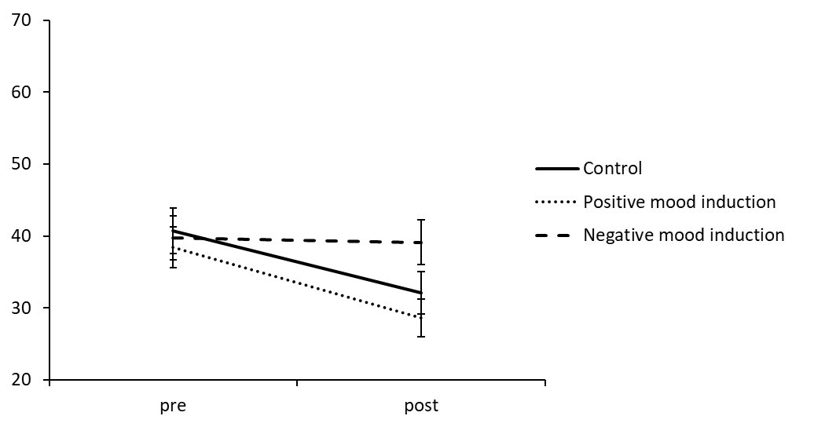
Manipulation Check from Study 1
a) Changes in positive affect
b) Changes in negative affect
Positive affect
Negative affect

