Slide 1
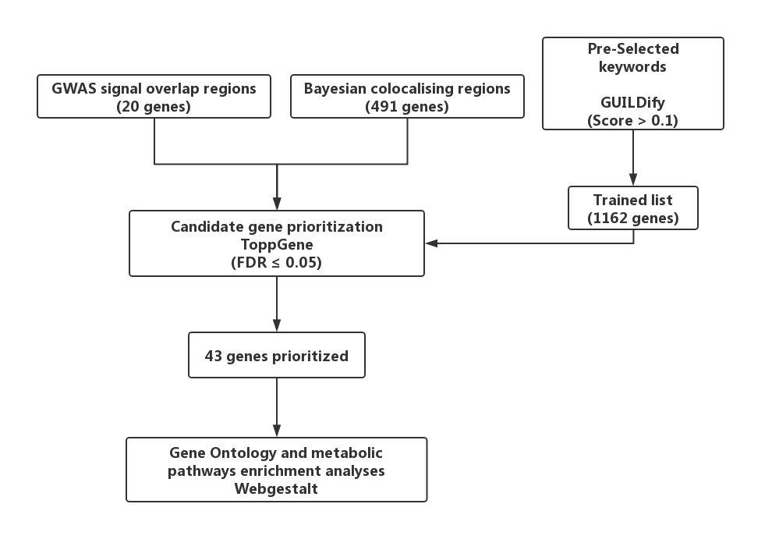
Supplementary Figure 1. Workflow of gene prioritization on the colocalization analysis

Slide 2
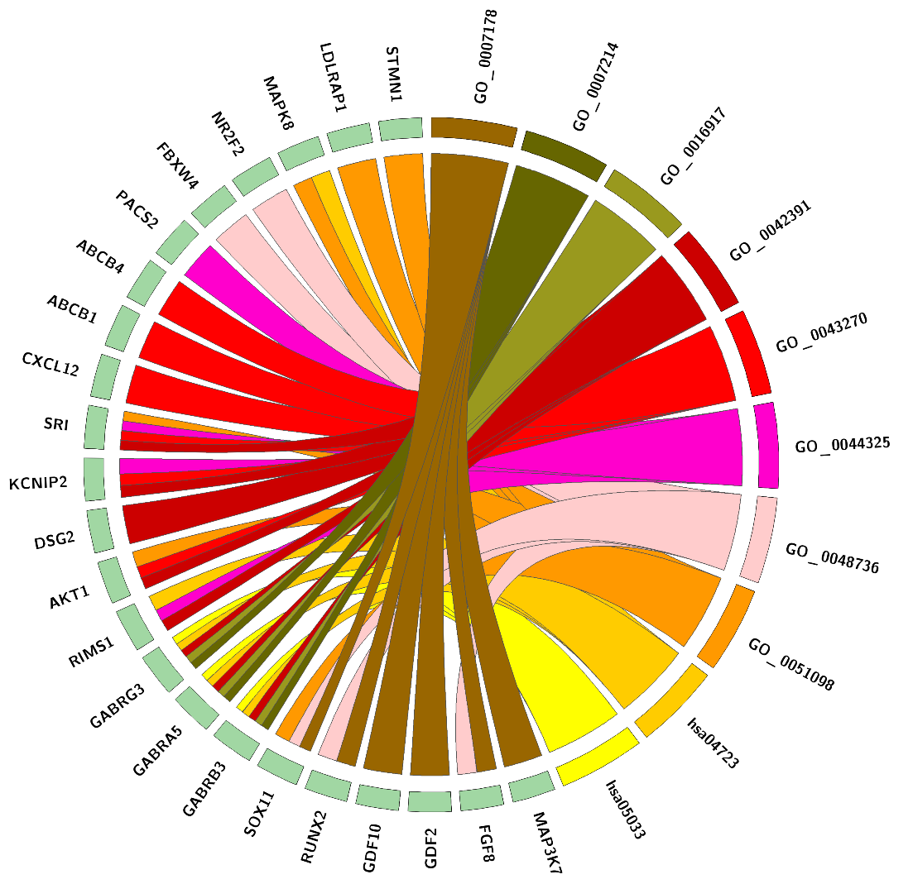
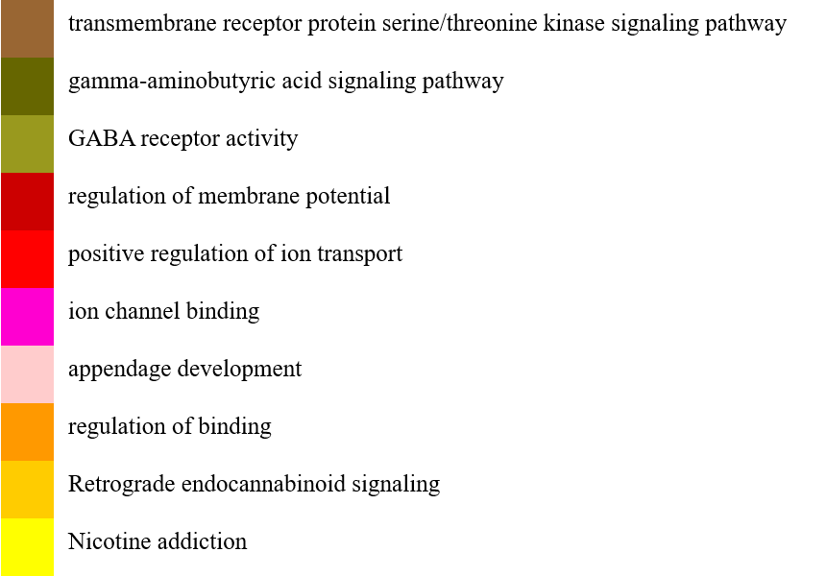
Supplementary figure 2. Chord plot displaying the relationship between the prioritized genes and the most functionally relevant GO enriched terms and KEGG pathways.

Slide 3
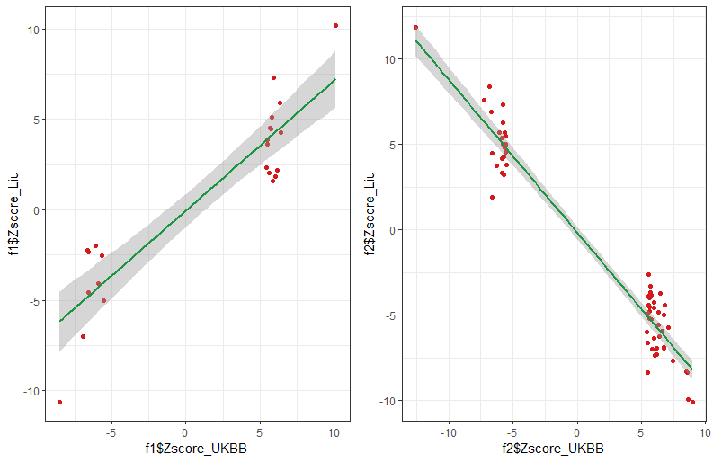
r=0.91, P=1.05e-9
r=-0.97, P=2.2e-16
Z-score
Liu’s smkCes
Z-score
Liu’s smkInt
Z-score
UKBB cur tob smk
Z-score
UKBB past tob smk
Supplementary figure 3. Comparison of the GWAS SNPs Z statistics between data from current study and Liu’s findings.

