Slide 1
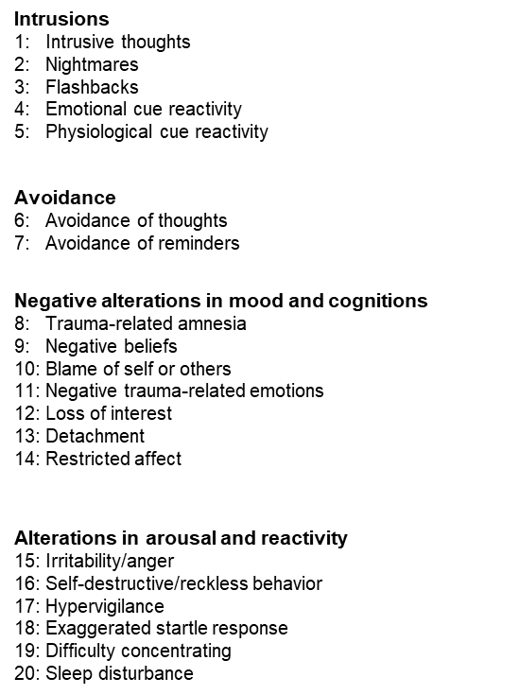
Between-persons PTSD symptoms network based on participant mean edge weight scores

