Slide 1
Supplementary Table 1. Amount of endotoxin determined in DNA samples from T. vaginalis and E. coli. The nucleic acid from the parasite was isolated using two different purification methods.
Endotoxin level assay
Sample | EU/mL*
Isolated TvDNA | 0.125
Isolated and Purified TvDNA | 0.111
Isolated E. coli DNA | 2.290
*1EU= 0.1ng of pyrogens.

Slide 2
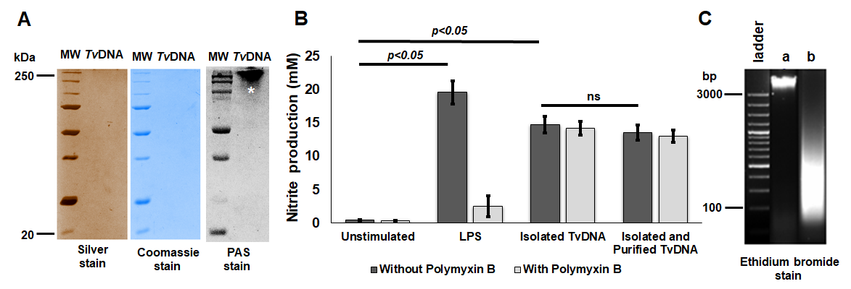
Supplementary figure 1. Non-degraded and purified Trichomonas vaginalis DNA induces NO production in RAW26.7 cells. A) 50μg/mL of TvDNA were used for differential staining on polyacrylamide gels. Silver and Coomassie stain do not show protein contamination while PAS stain shows saccharides present in TvDNA (*). B) Nitrite production from RAW264.7 cells stimulated with isolated or isolated and purified TvDNA. Data are representative of three independent experiments expressed as the mean±SD. C) Ethidium bromide stain shows non-degraded TvDNA (a) and degraded TvDNA after DNase I treatment (b) Significance was determined by Kruskal-Wallis analysis and Dunn´s test (n=18,*P<0.05). ns= non-significant.

Slide 3
Supplementary Table 2. List of primers used in the semi quantitative RT-PCR assays
Gene | Primer 5´ 3´
TNF-a | F GAACTGGCAGAAGAGGCACT
 | R AGGGTCTGGGCCATAGAACT
IL-6 | F AGTTGCCTTCTTGGGACTGA
 | R TCCACGATTTCCCAGAGAAC
IL-12p40 | F GCACCCTCAGGATAGATGA
 | R TAACACCAGGGCAACACAAA
IL-10 | F CTGCTGTTGGAAACGGACATC
 | R GGTGGGAAGAACATTCGCCT
IL-13 | F TCCAATTGCAATGCCATCTA
 | R GCTAGCAGGAGTGGGTTCAG
GAPDH | F TCCCTCAAGATTGTCAGCAA
 | R AGATCCACAACGGTAACATT

