Slide 1
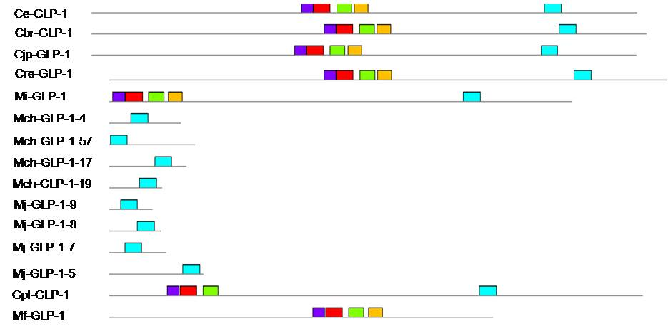
Fig. S2. Protein motifs of Notch receptor members using the MEME tool. The motifs belonging to C. elegans, C. briggsae, C. japonica, C. remanei, M. incognita, M. chitwoodi, M. javanica, M. floridensis and G. pallida GLP-1 protein are compared.

Slide 2
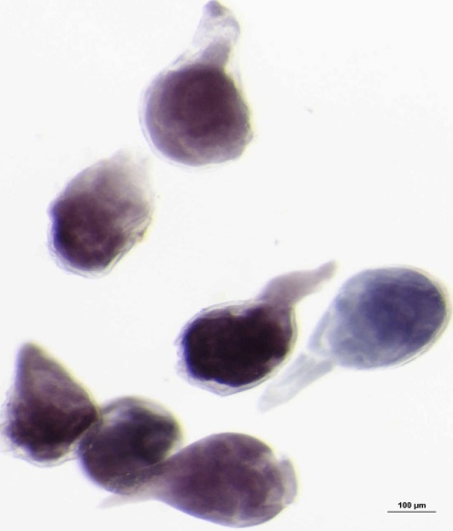
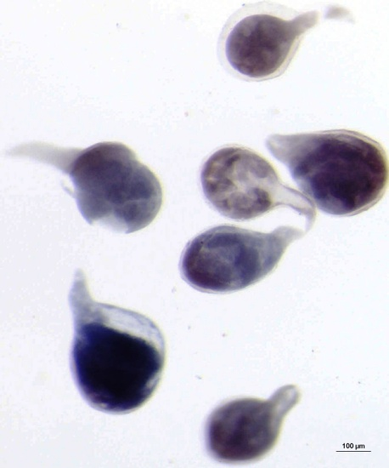
Control
Transgenic
Fig. S3. Females isolated from wild-type and RNAi transgenic plants were stained with acid fuchsin.

Slide 3
A
B
Fig. S4. Stylet and pharynx phenotypes of J2s descended from M. incognita females that fed on wild-type (control) (a) and RNAi line (b) plants. Size measurements were performed using a Zeiss Axio Imager microscope.

Slide 4
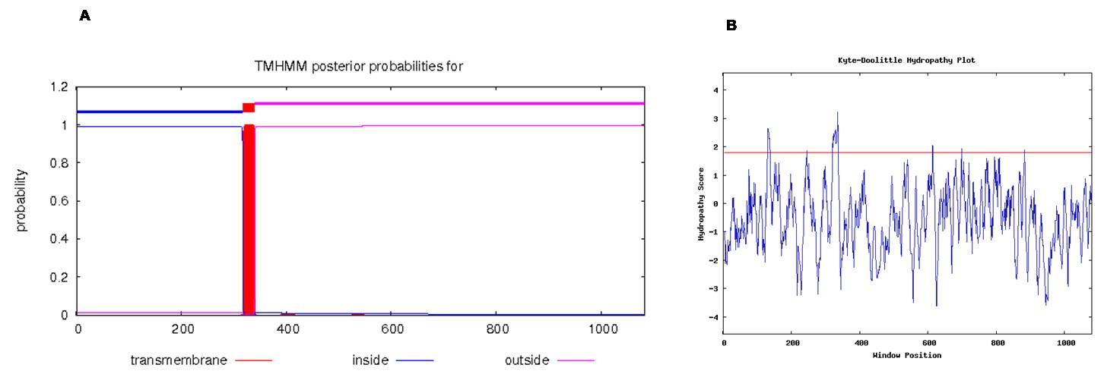
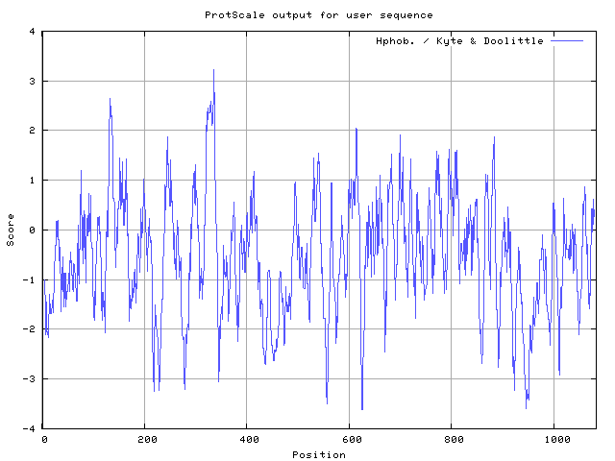
Fig. S5A. The predicted transmembrane domains in M. incognita GLP-1 protein. Three different software programs were used for the prediction, and all provided similar results. (a) TMHMM software; (b) Kd software; (c) Protscale.

Slide 5
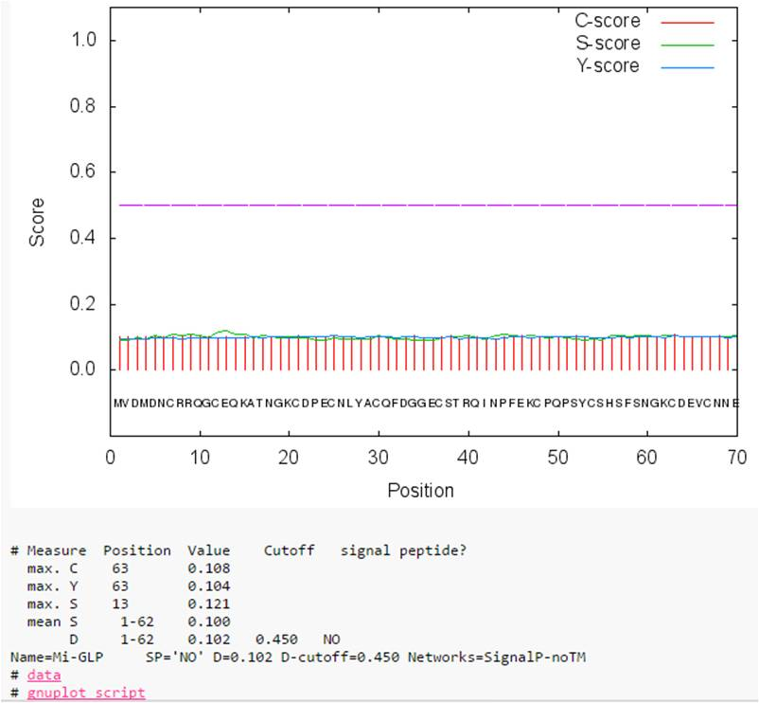
Fig. S5B. Prediction of a signal peptide in Mi-GLP-1 using Signal P.4 software. No signal peptide was found.

