Slide 1
Marine mammal sightings around Oil and Gas installations, offshore Denmark

Slide 2
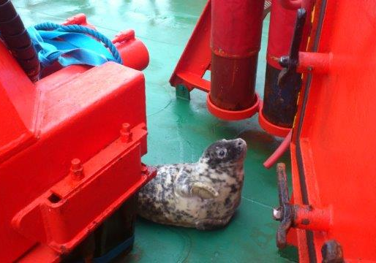
Siri
Grey Seal
28th Dec. 2012
Photo: Esvagt Preventer
K. Enevoldsen

Slide 3
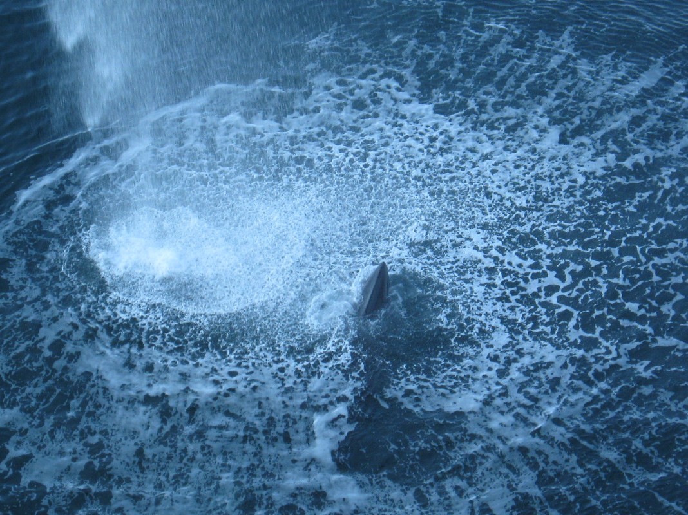
Siri
Minke whale
26th May 2012
Photo: M. Sand-Jensen
(Firewater deluge test)

Slide 4
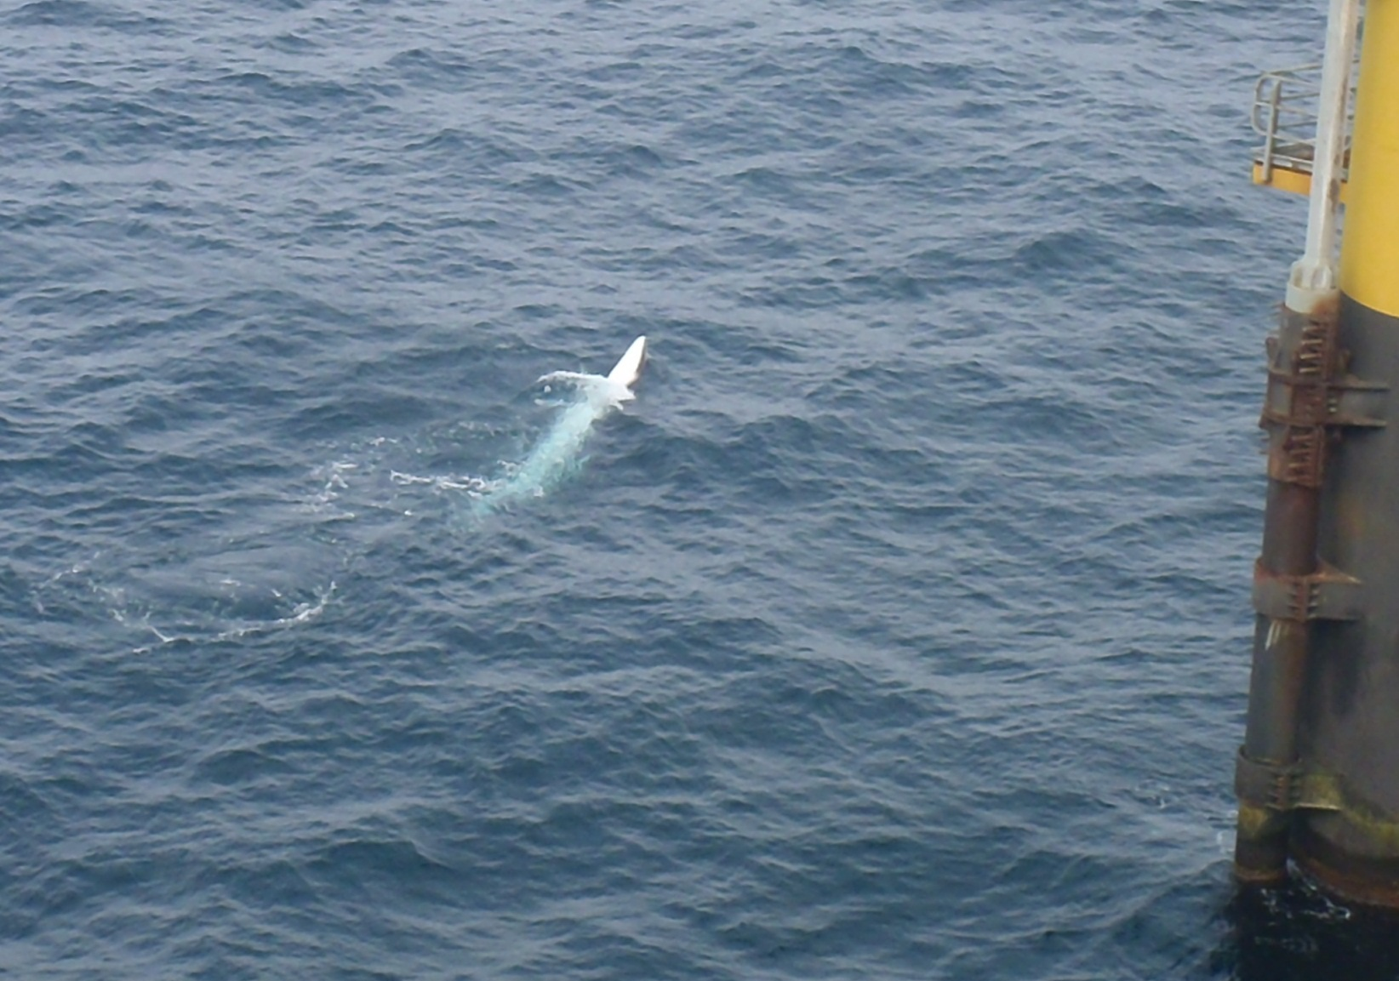
Skjold
Minke whale
12th June 2013
Photo: R. Skiver

Slide 5
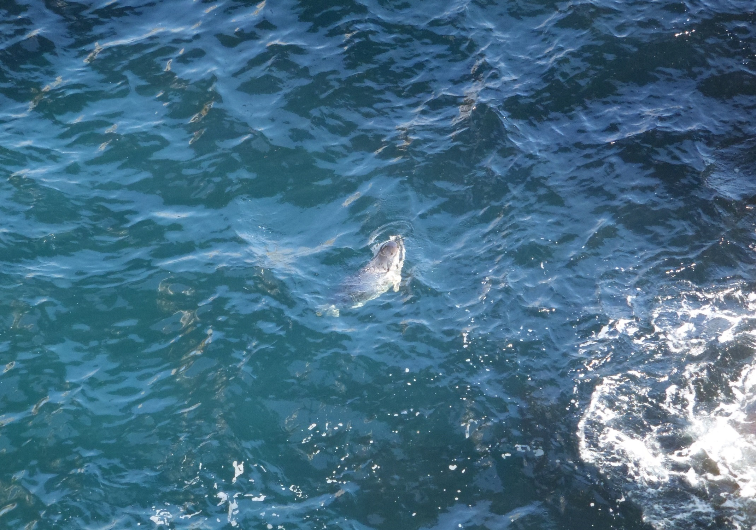
Tyra E
Grey seal
16th May 2013
Photo: S. Hansen

Slide 6
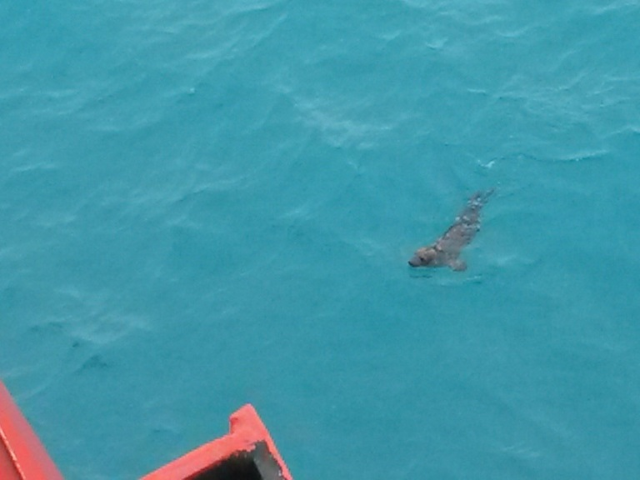
Valdemar AA
Grey Seal
3rd May 2014
Photo: Esvagt server

Slide 7
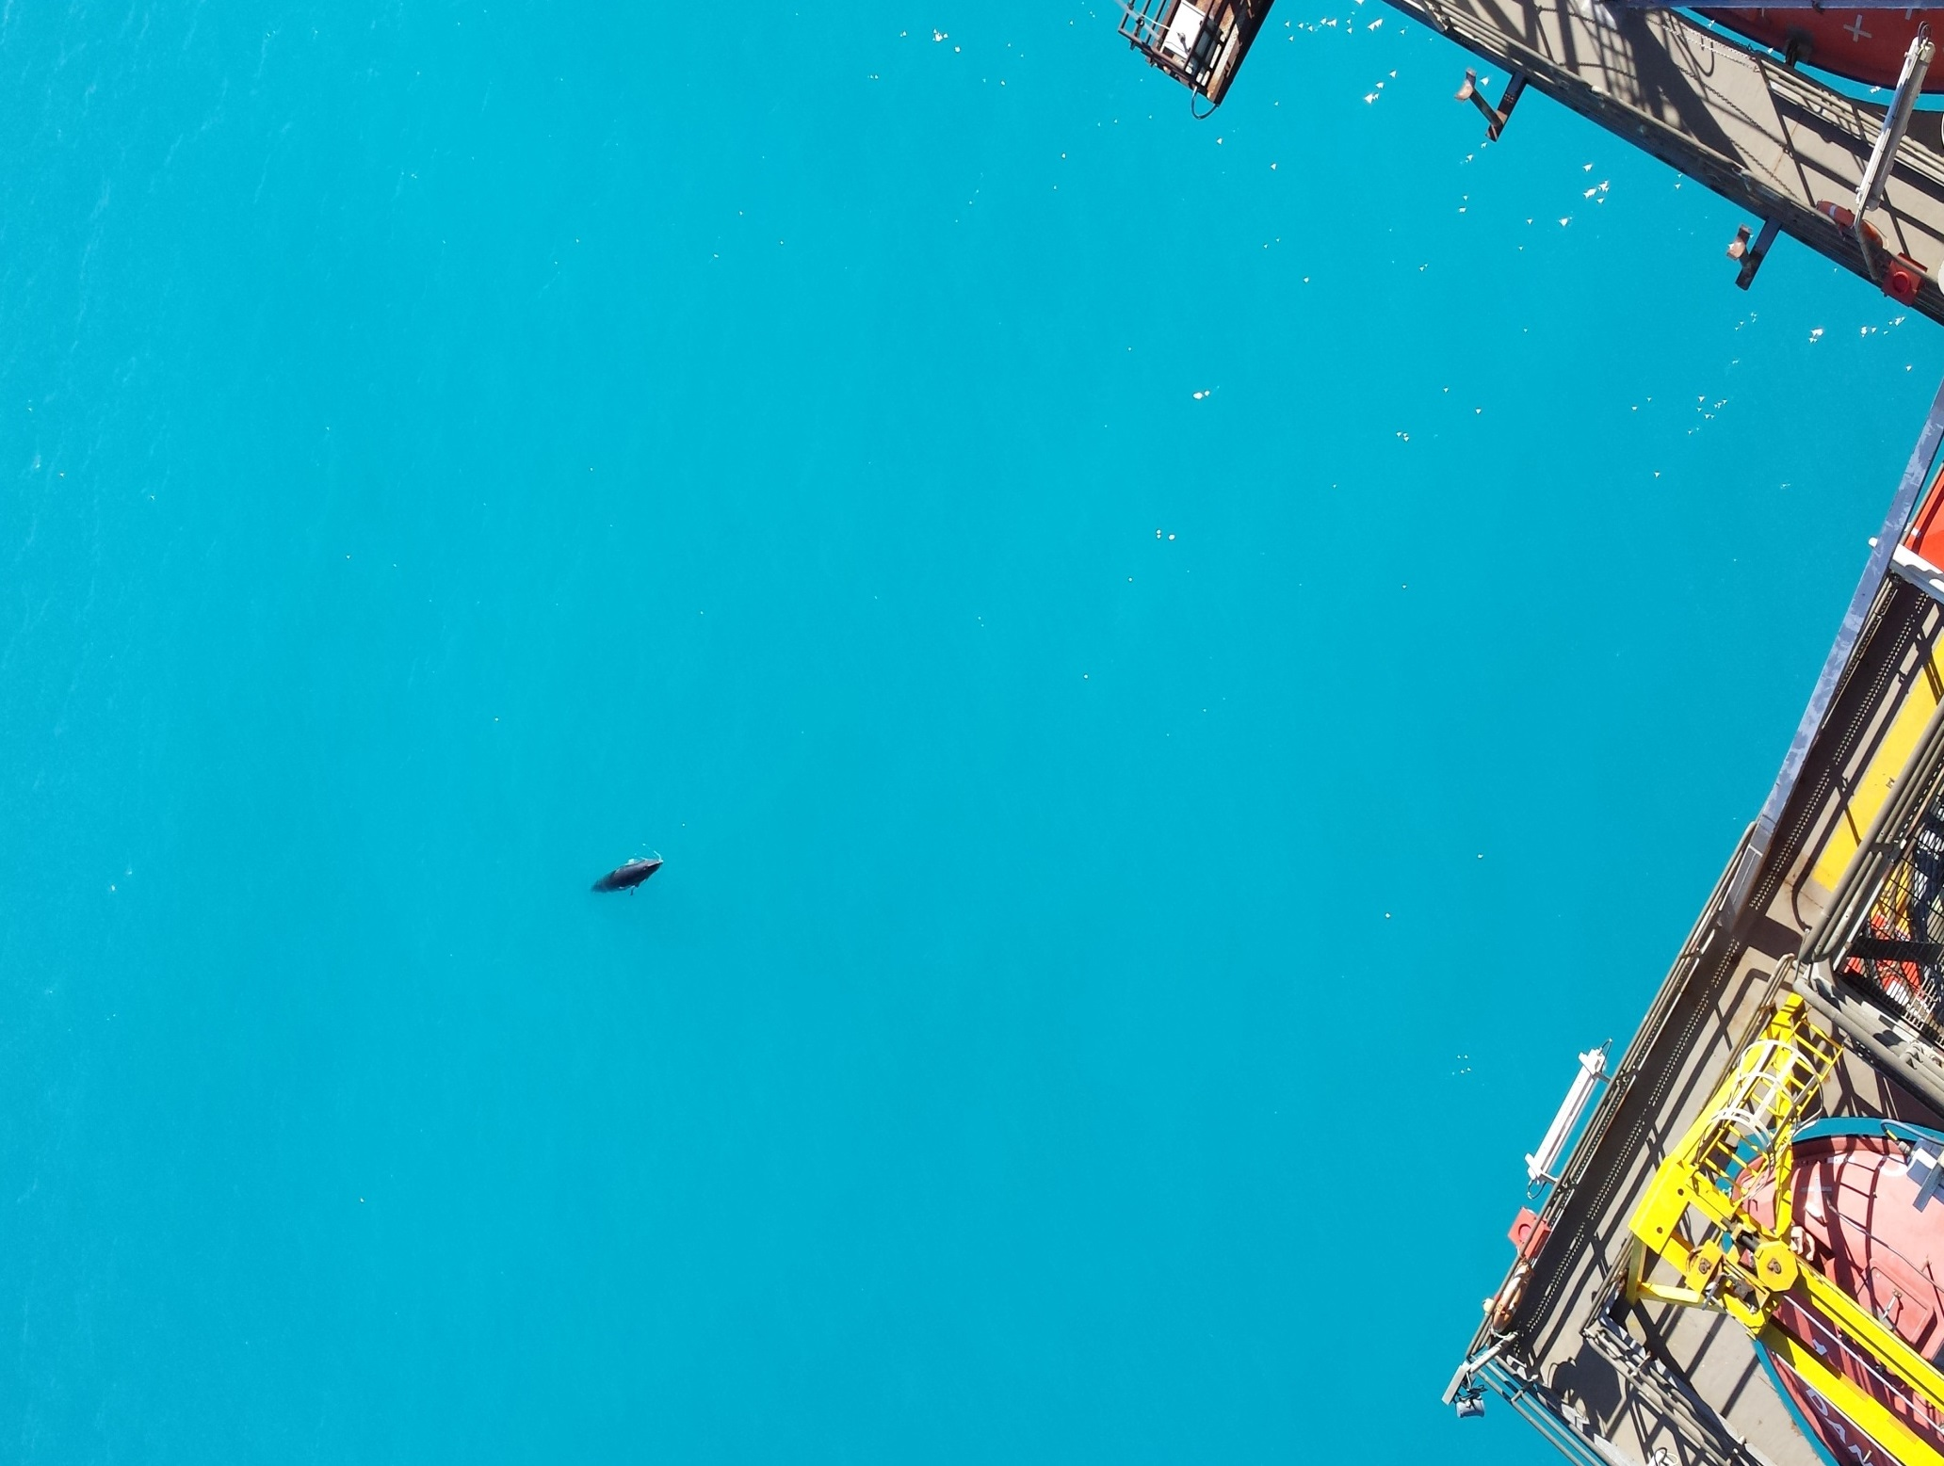
DanF
Minke whale
25th May 2014
Photo: S. Mathiassen

Slide 8
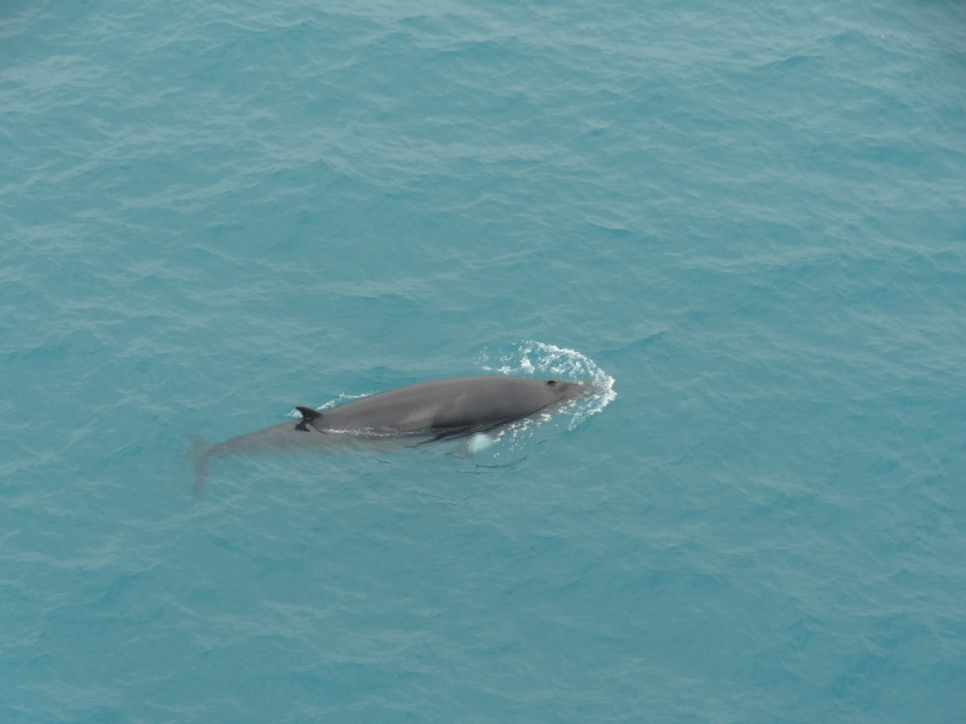
Harald
Minke whale
2nd June 2014
Photo: N. Frederiksen

Slide 9
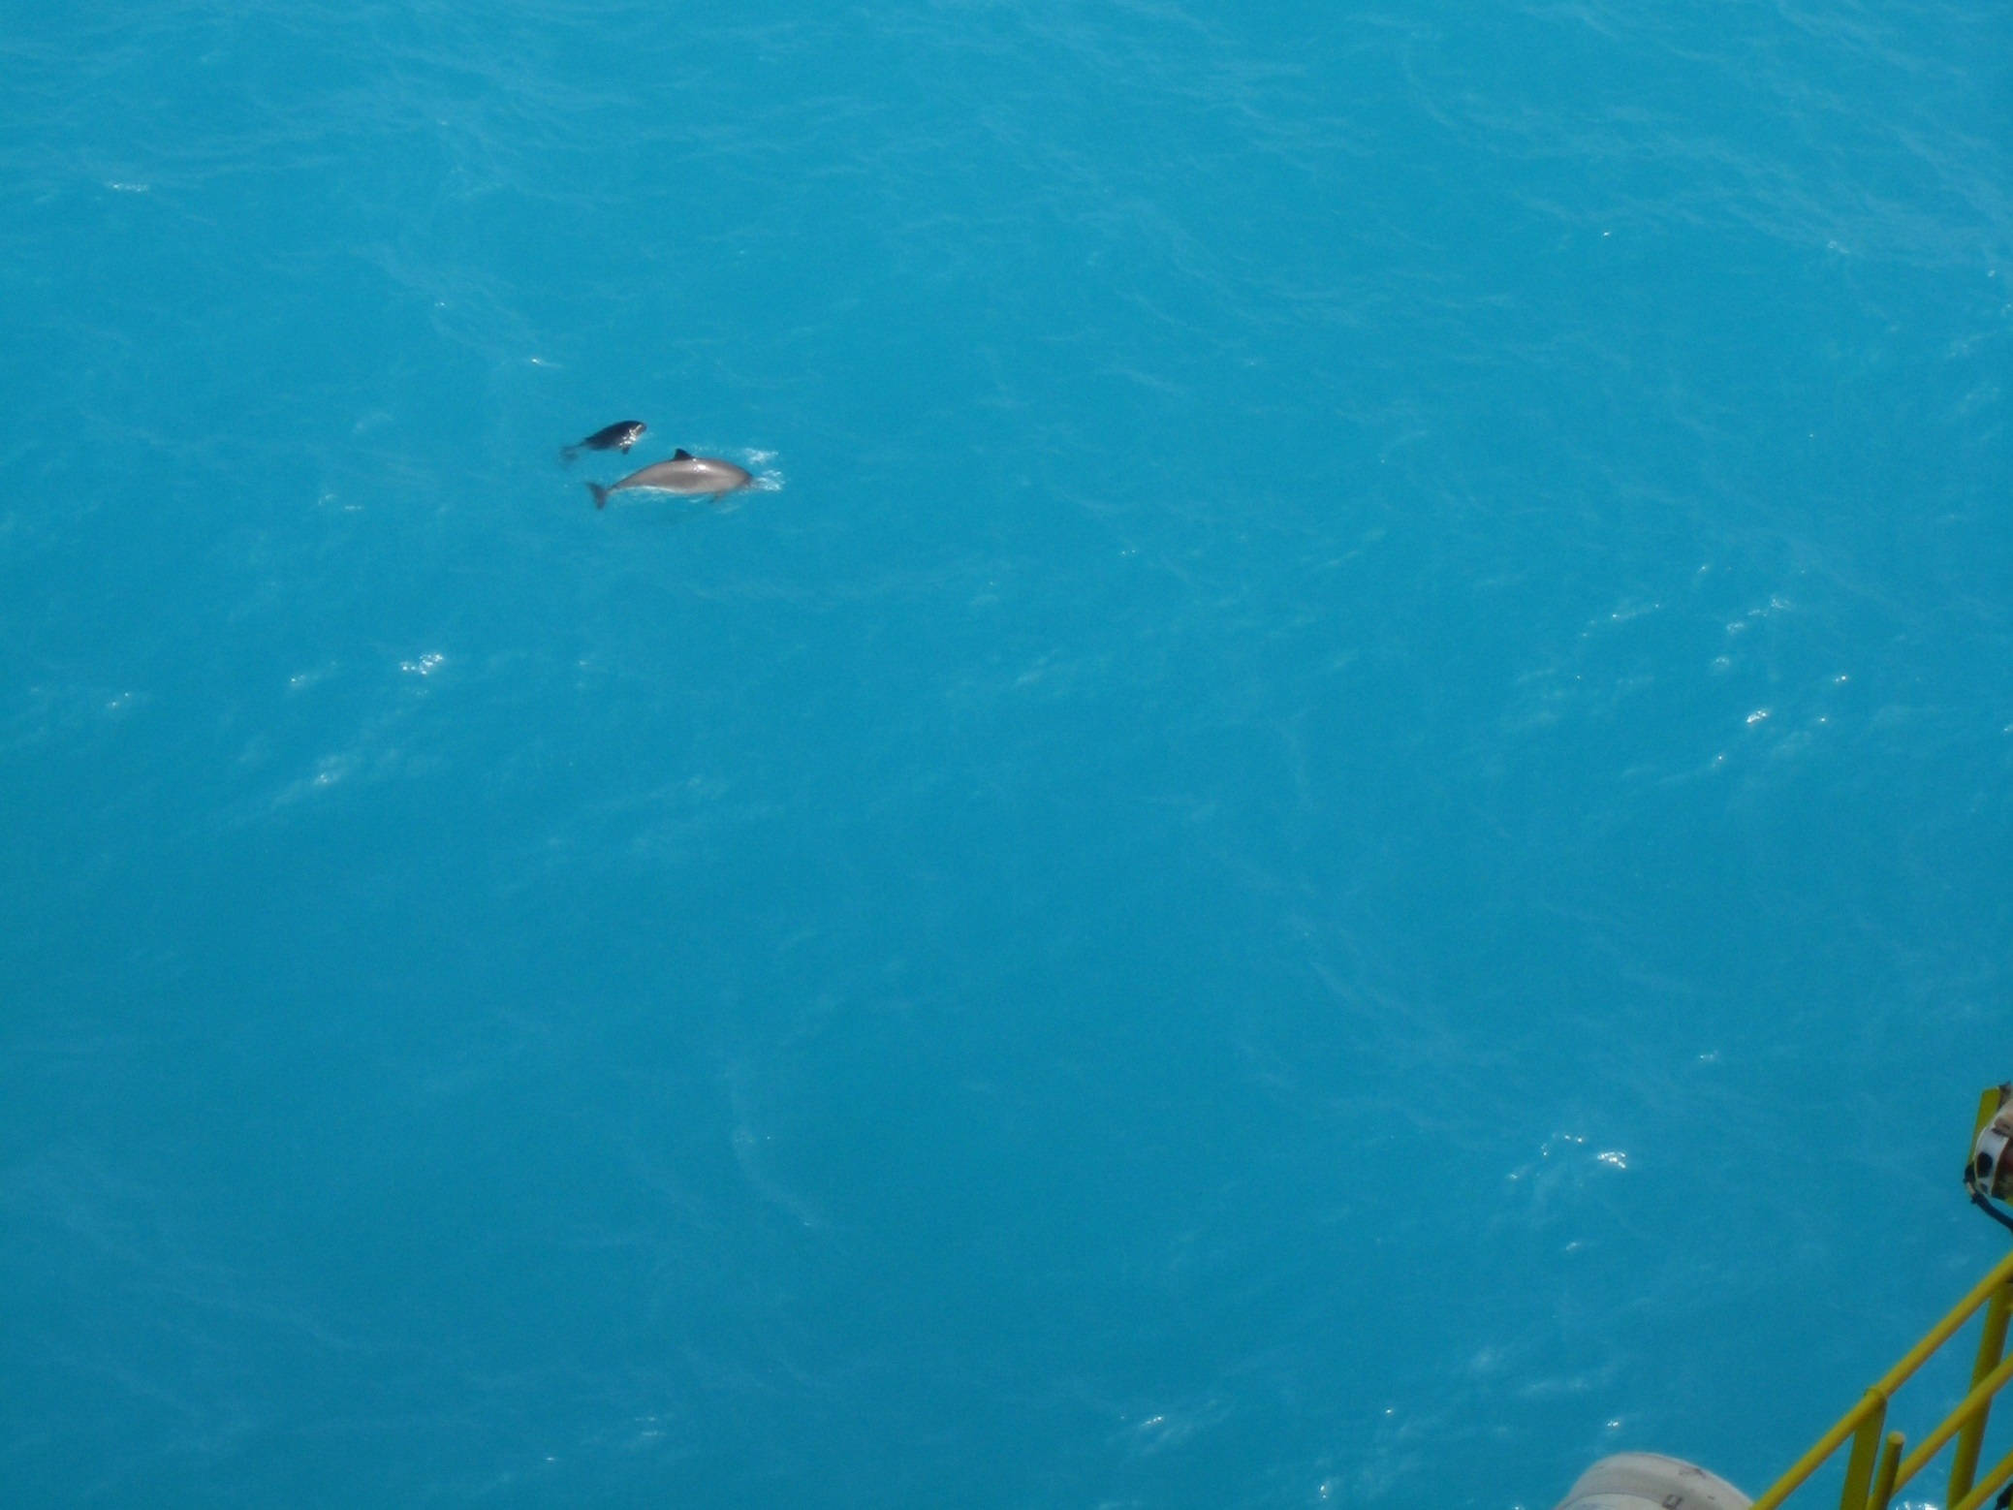
Tyra East
Harbour porpoise
3rd June 2014
Photo: T. Rabjerg

Slide 10
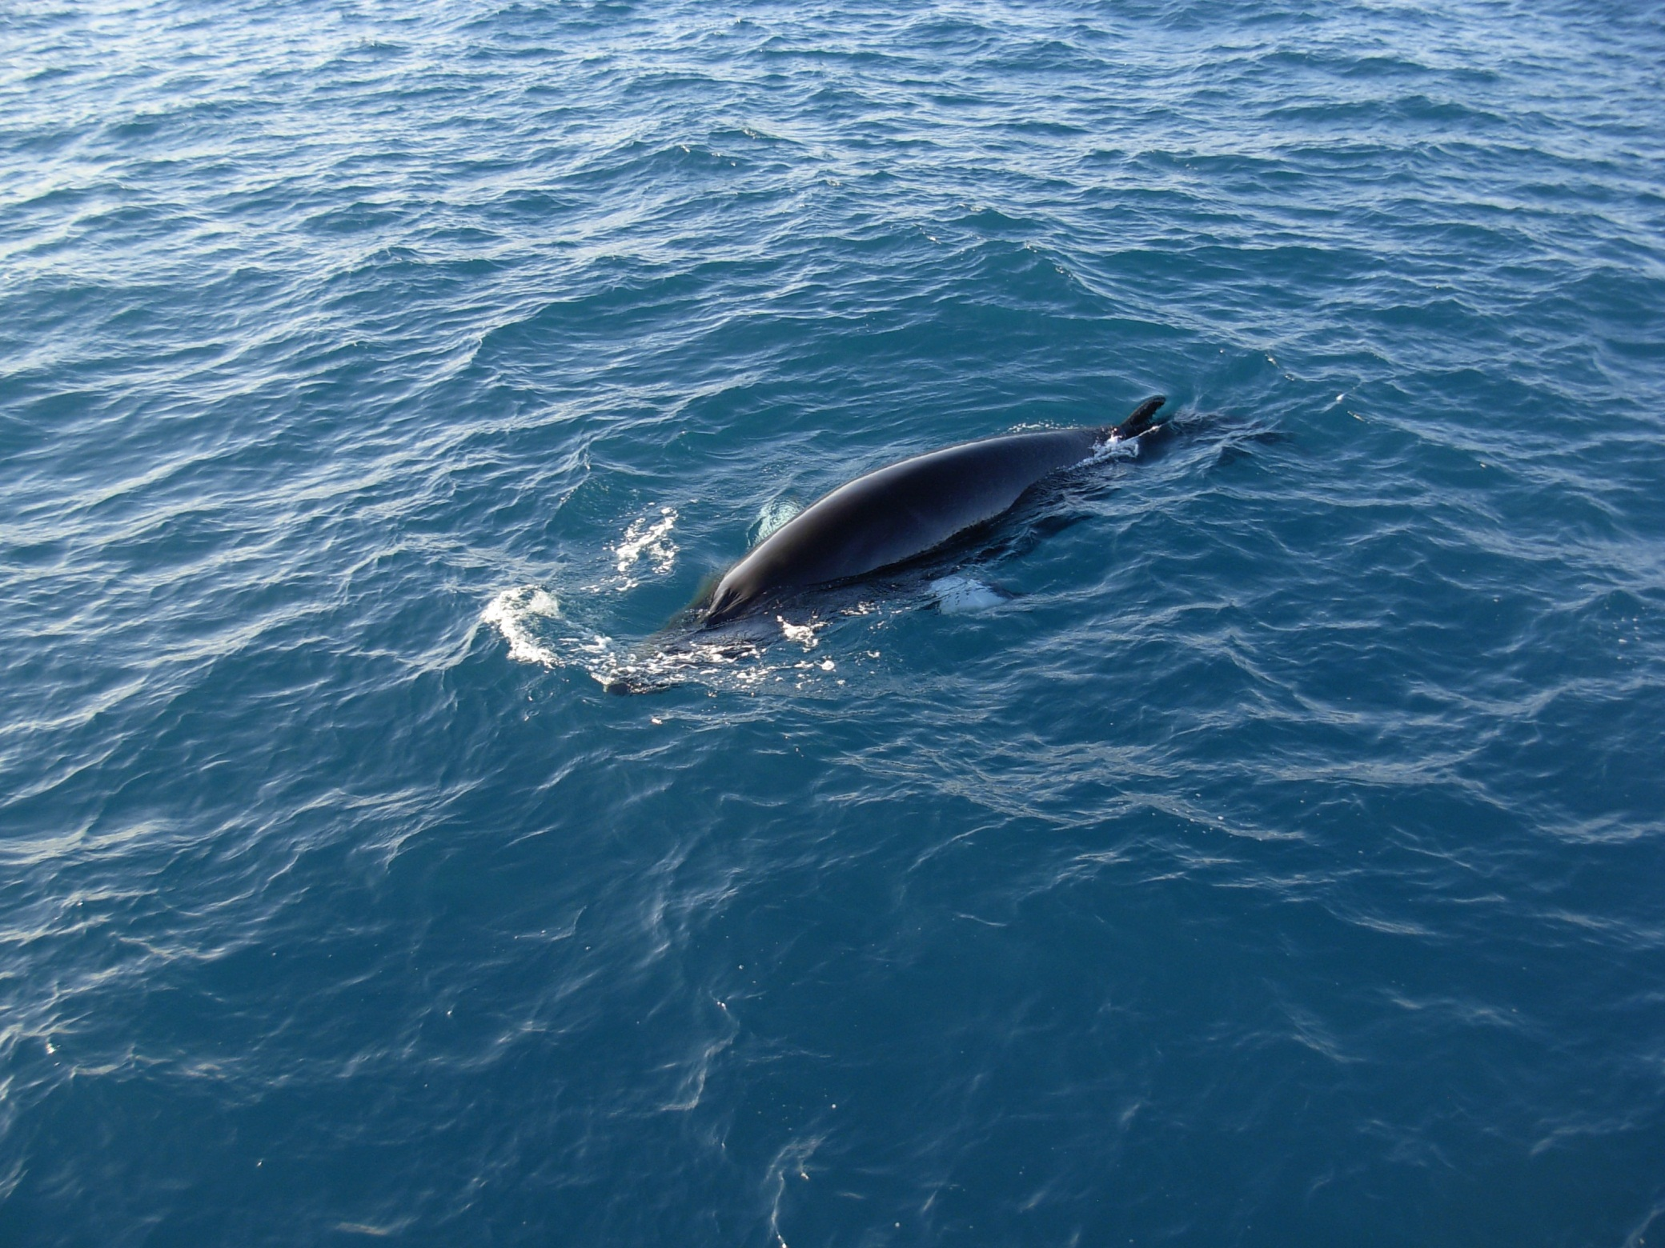
Halfdan B
Minke whale
11th June 2014
Photo: Esvagt Preserver

Slide 11
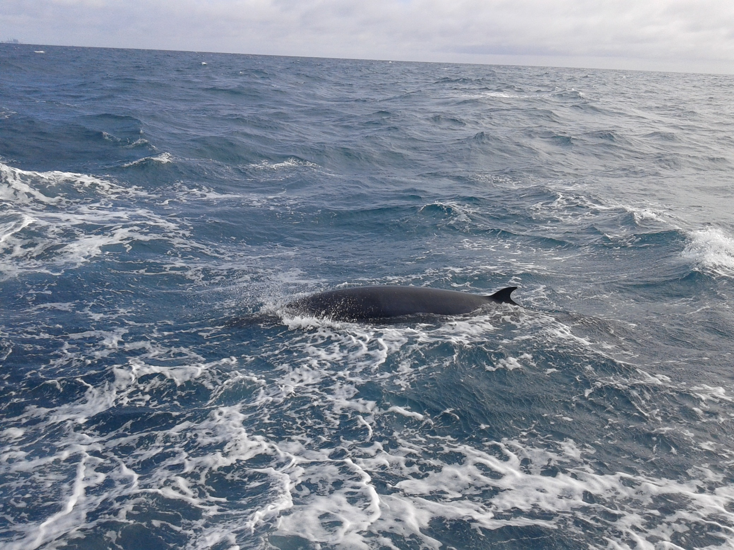
Gorm
Minke whale
22nd June 2014
Photo: M/V Cecilie, Foga ApS.

Slide 12
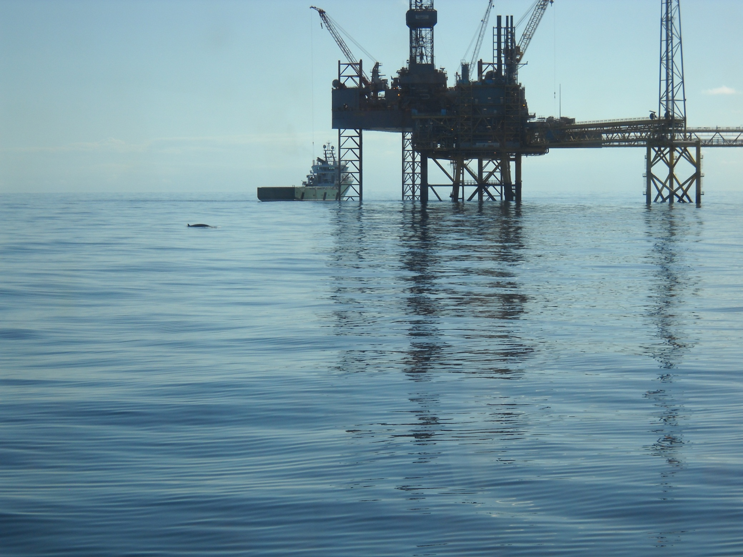
Halfdan A
Minke whale
26th June 2014
Photo: Esvagt Promotor
H. Hersom

Slide 13
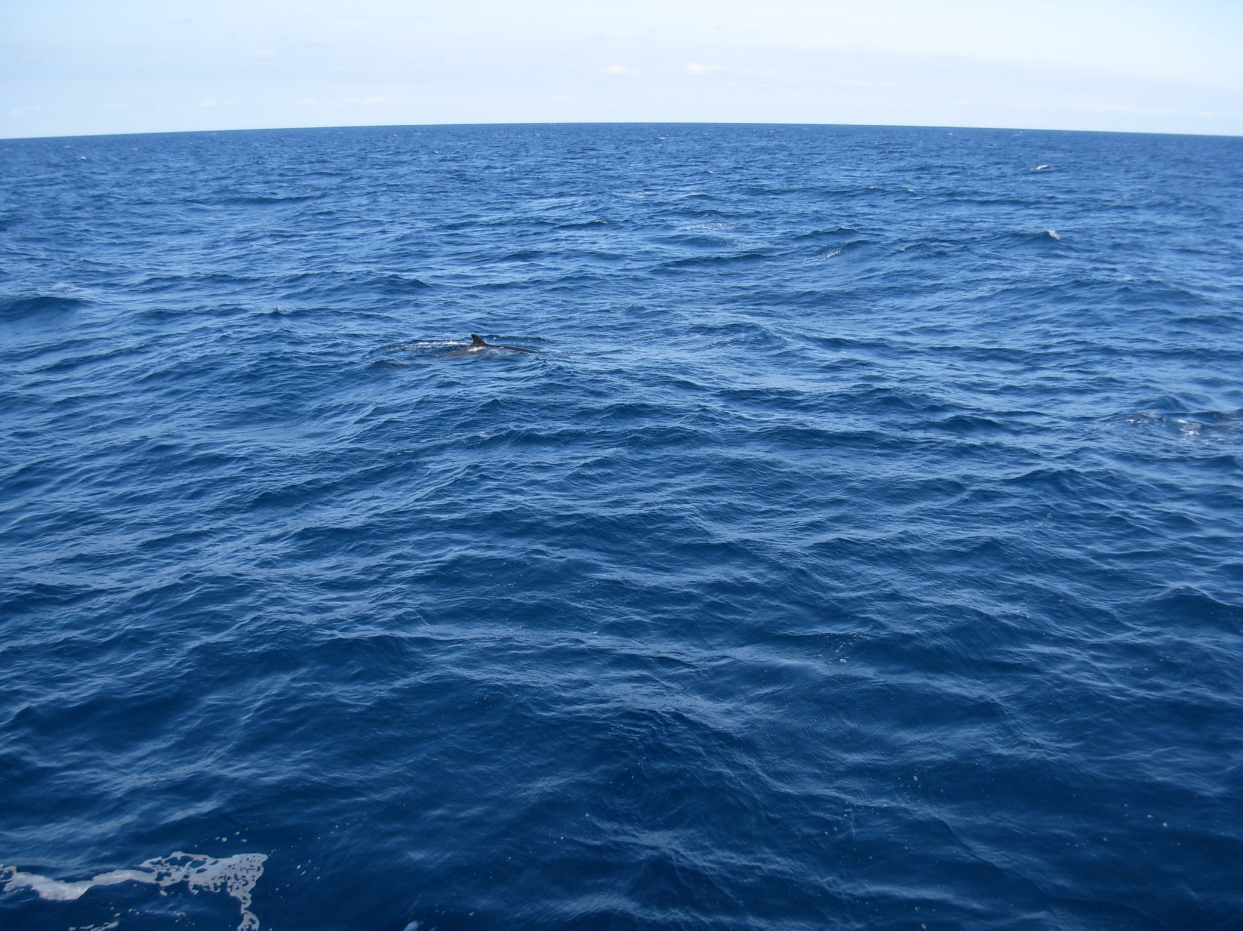
Halfdan B
Minke whale
28th June 2014
Photo: Esvagt Preserver

Slide 14
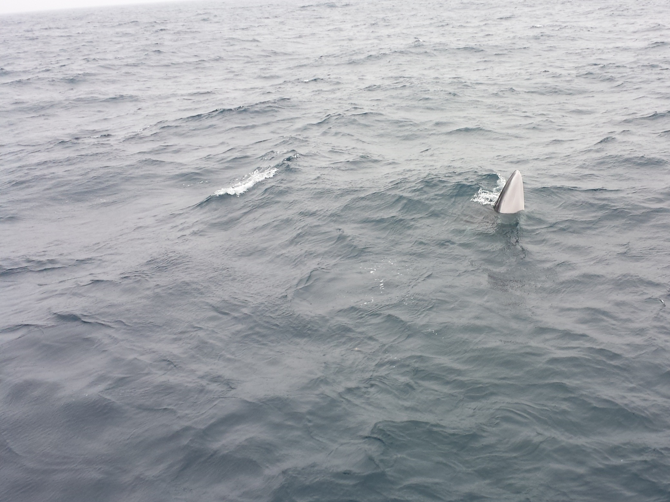
Tyra W
Minke whale
05th July 2014
Photo: M/V ”Anette Christina”, Foga ApS

Slide 15
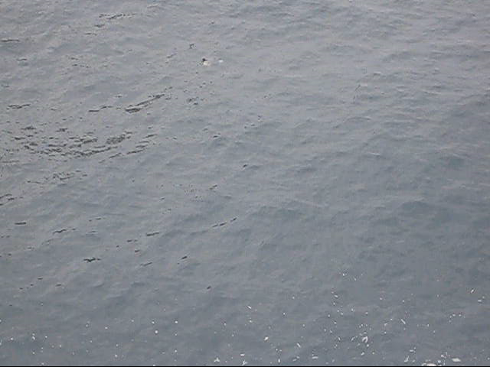
Halfdan B
White-beaked dolphins 06th July 2014
Movie: T. Thorsen.

Slide 16
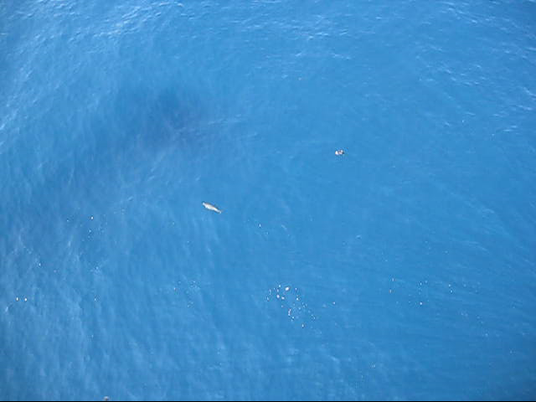
Halfdan B
Harbour porpoise
10th July 2014
Photo: T. Thorsen.

Slide 17
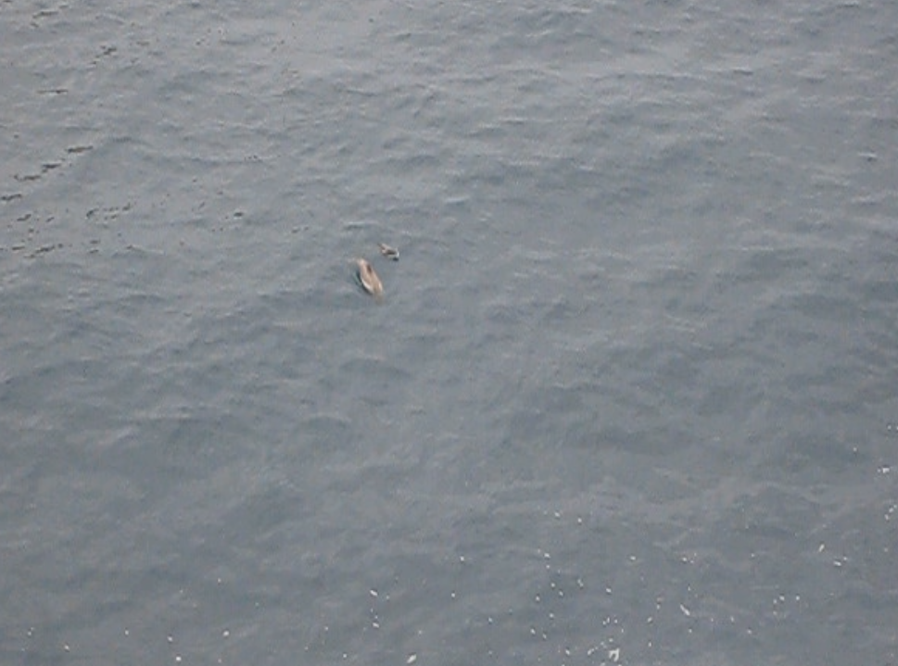
Halfdan B
White beaked dolphins
6th July 2014
Photo: T. Thorsen.

Slide 18
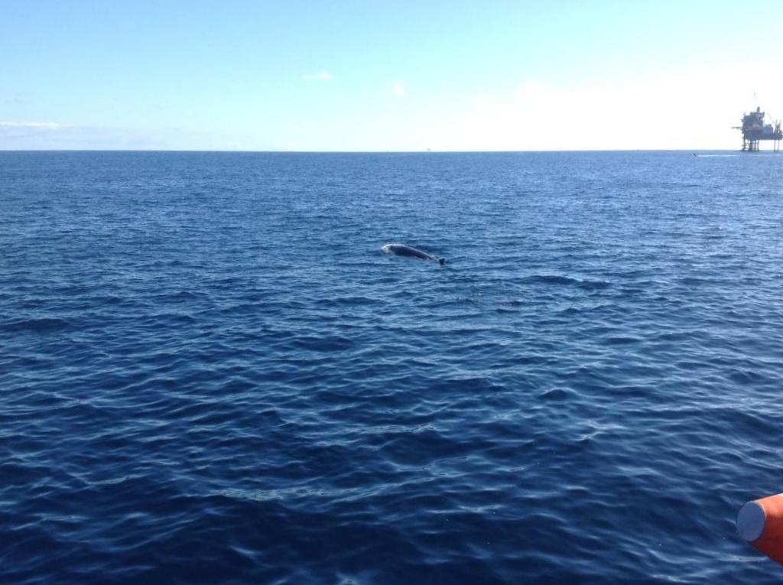
Gorm
Minke whale
18th July 2014
Photo: R. Husted / Esvagt Echo

Slide 19
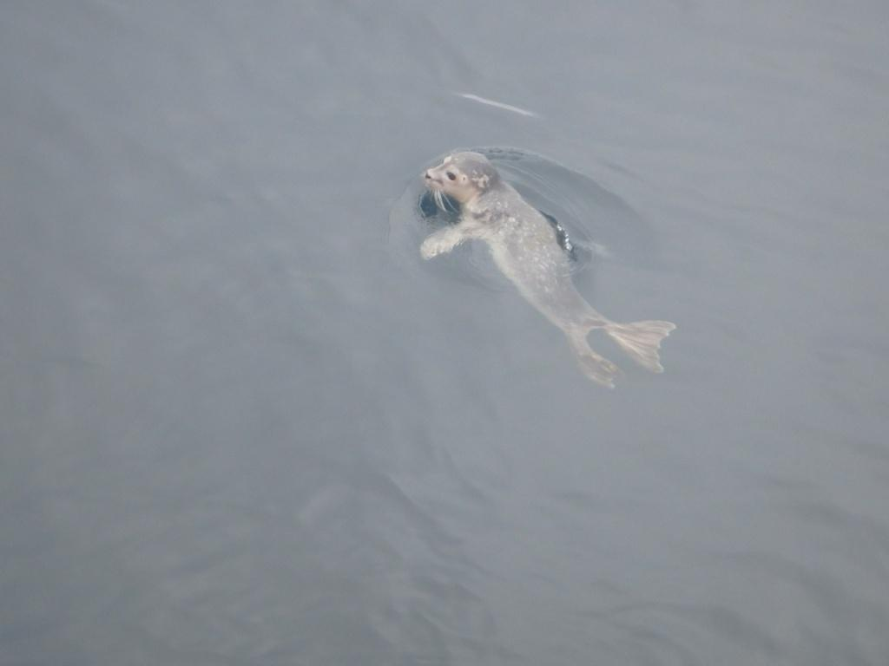
Gorm
Harbour seal
19th Sept. 2014
Photo: M. Bysted / Esvagt Echo

Slide 20
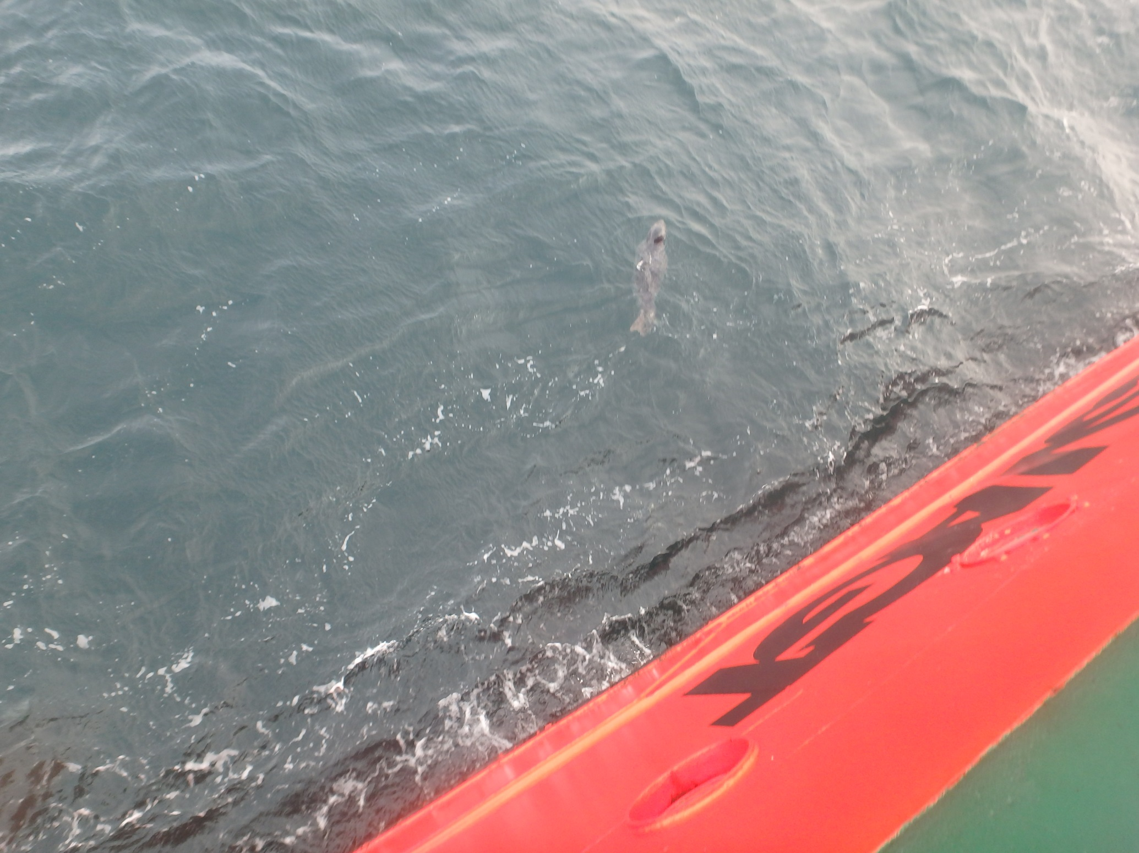
Gorm
Grey seal
5th Mar. 2015
Photo: M. Bysted / Esvagt Echo

Slide 21
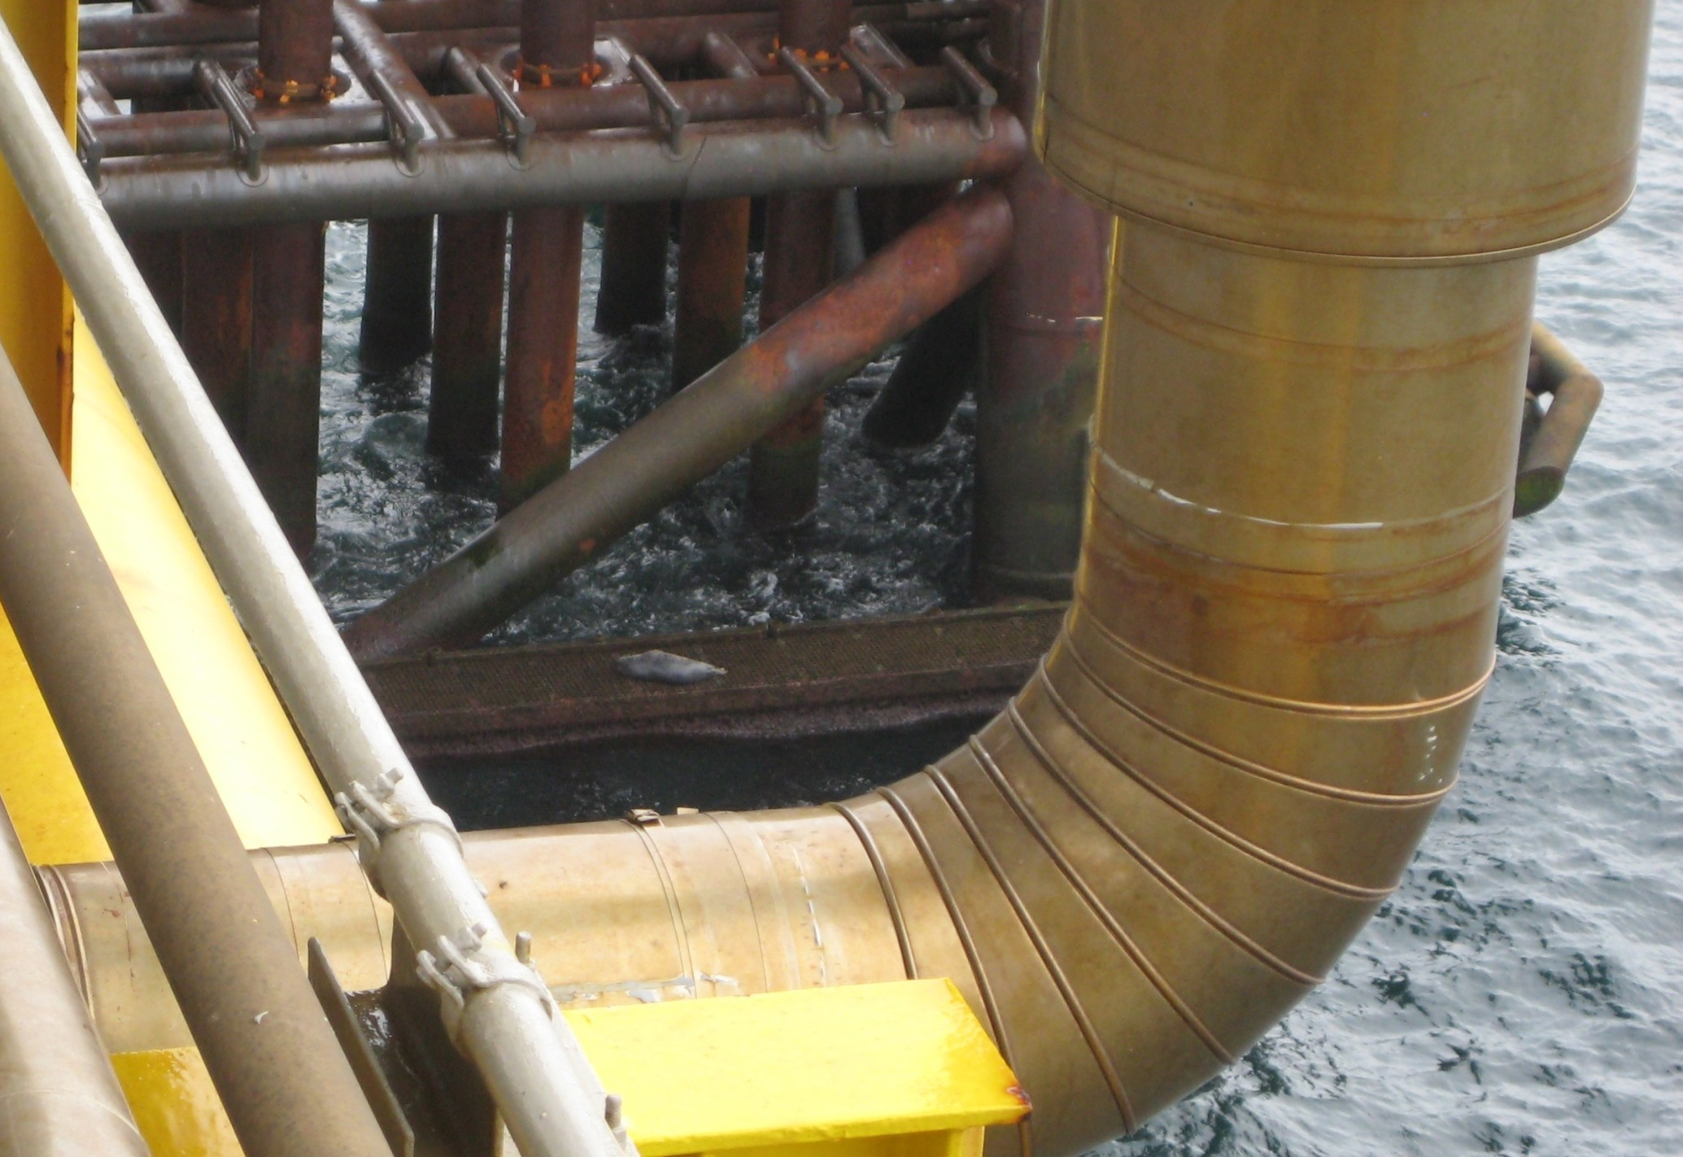
Dan F
Grey seal
20th Apr. 2015
Photo: C. Mortensen

Slide 22
Fish sightings around Oil and Gas installations, offshore Denmark

Slide 23
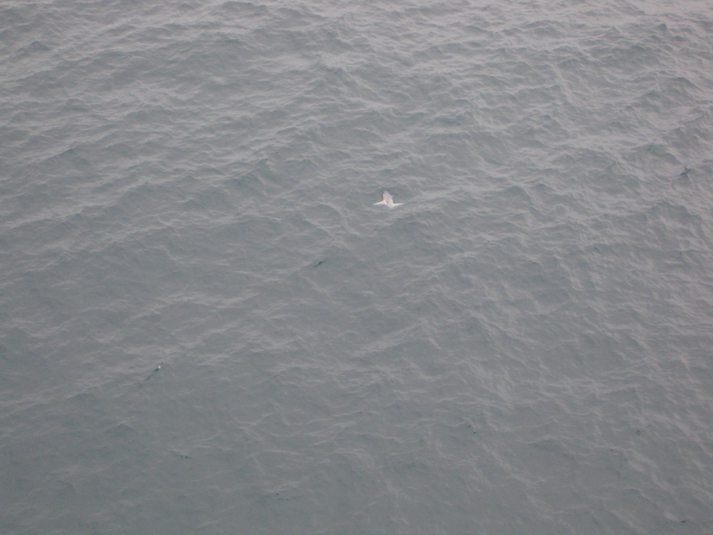
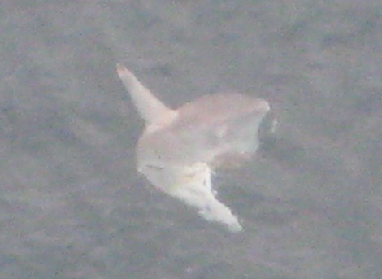
Halfdan B
Sunfish
24th July 2015
Photo: T. Thorsen

Slide 24
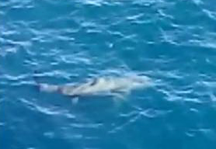
Tyra East
Basking shark
3rd Oct. 2015
Photo: A. Hermann Larsen

