Slide 1
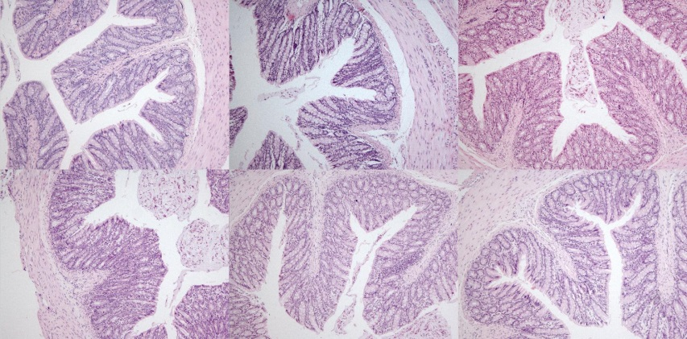
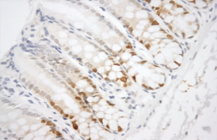
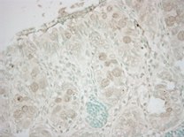
Figure 1
A
C
EWS
ERS
H&E
Proximal colon
H&E
Distal colon
B
C
EWS
ERS
PCNA
Proximal colon
PCNA
Distal colon
C
C
EWS
ERS
TUNEL
Proximal colon
TUNEL
Distal colon
Effects of extruded sorghum diets on crypts depth, cell proliferation and apoptosis in the rat proximal and distal colonic mucosa. (A) Representative haematoxylin and eosin-stained sections and the crypts depth measured as cells number per hemicrypt of the colon of rats fed with the control, WS or RS diet (100x). (B) Representative photographs for immunohistochemical staining of PCNA (darkbrown)-positive cells (400 x magnification) and the PCNA labelling index (%) in colon tissues from rats fed the control, WS or RS diet. (C) Colonic epithelial apoptosis as revealed by terminal deoxynucleotidyl transferase dUTP nick end labelling (TUNEL) assay of control, EWS and ERS- fed rats (light microscope, 400x magnification ) and quantification of apoptotic cells by TUNEL labelling index (%). Values are means from eight rats in each group, with SEM represented by vertical bars. Bars with different letters indicate significant differences (at least p<0.05) between groups.

