Slide 1
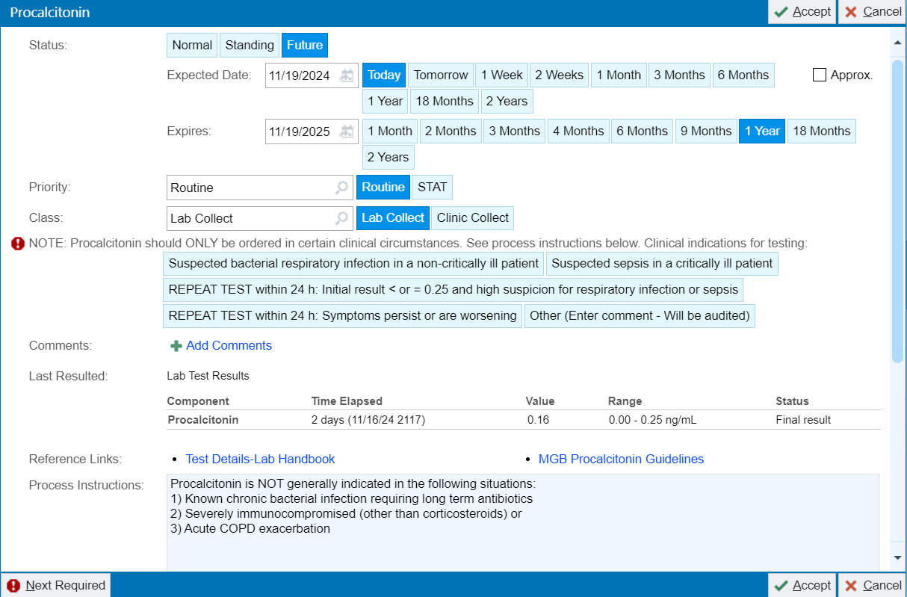
v
1
v
2
3
v
4
Supplemental Figure 1

Slide 2
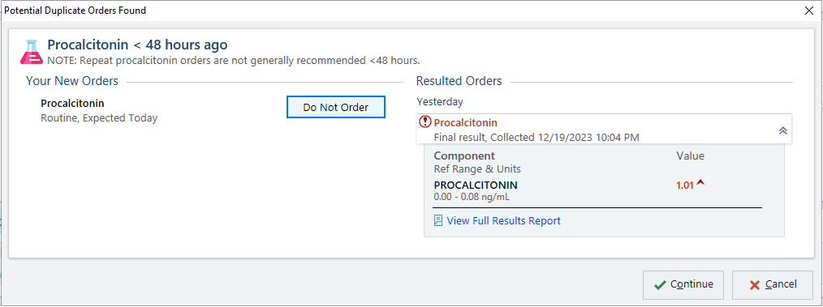
v
Supplemental Figure 2

