Slide 1
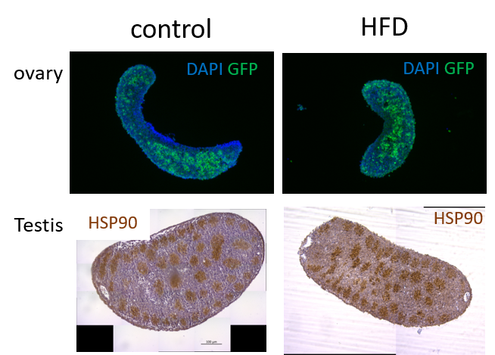
Supplemental figure 1: Representative photos of gonadal sections in each group showing ovaries (top panel) with germ cells labelled in green by an anti-GFP antibody, and testis (bottom panel) with germ cells labelled in brown by an anti-HSP90 antibody.

