Slide 1
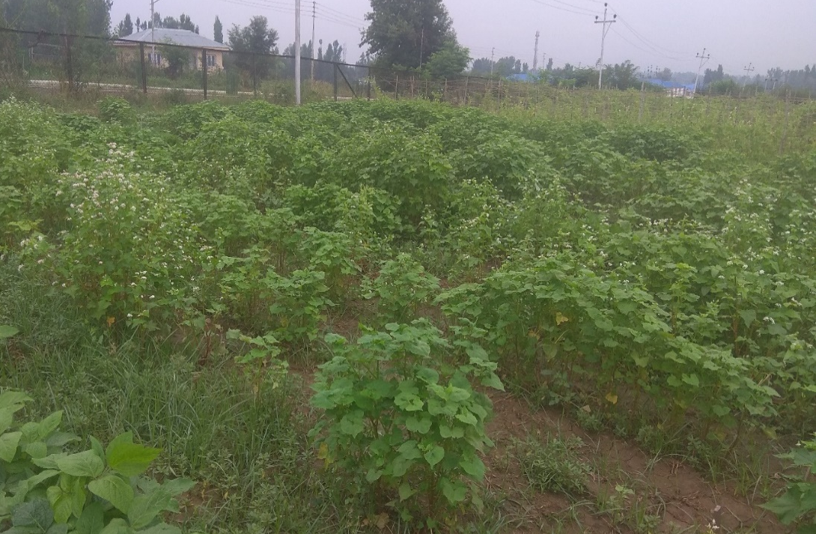
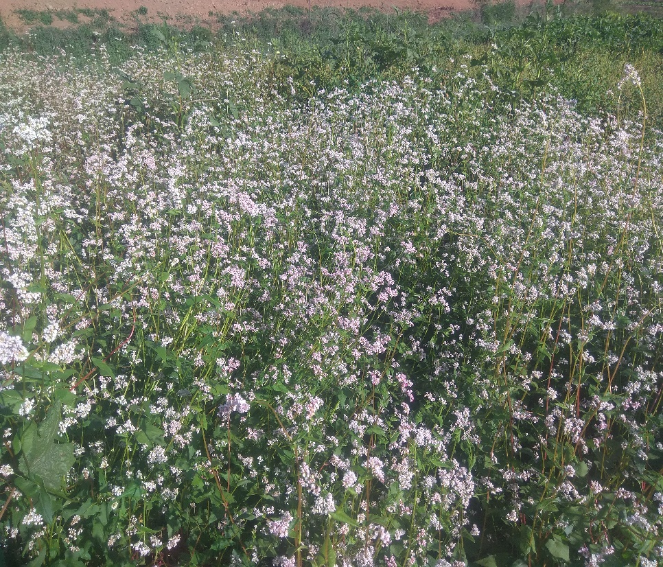
(A) Buckwheat field, Shuhama at vegetative stage
(B) Buckwheat field, Shuhama at flowering time

Slide 2
Leaf Blade Length and Width
Petiole Length
Plant Height (Large, Medium, Small)

Slide 3
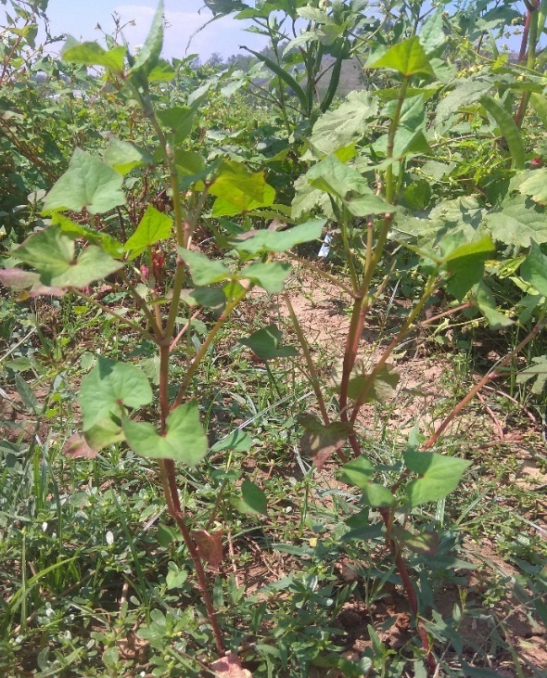
Greenish Yellow
Pink
White
FLOWER COLOR
Leaf Color (Red and Green)
Red
Green
STEM COLOR

Slide 4
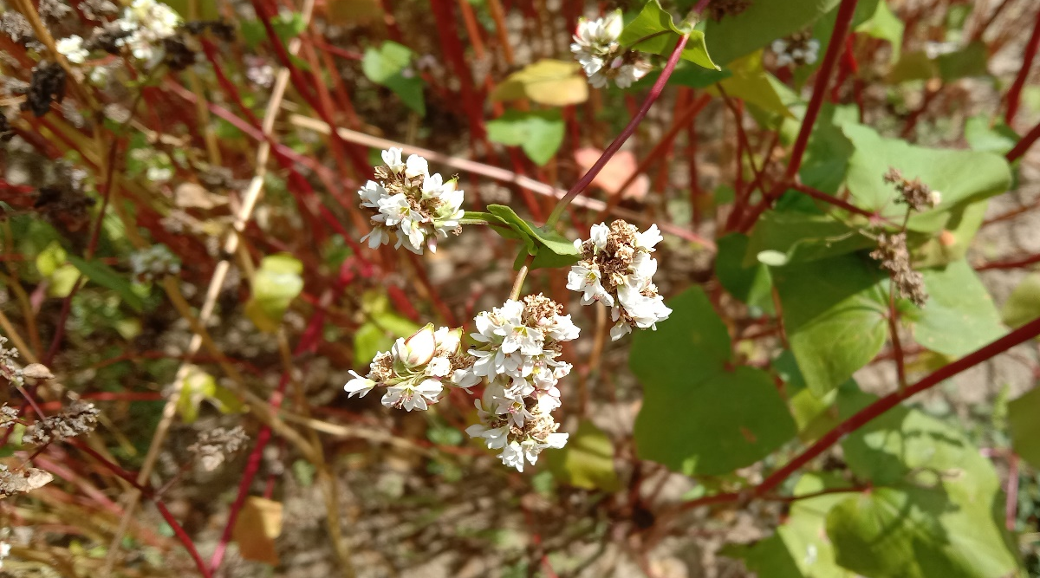
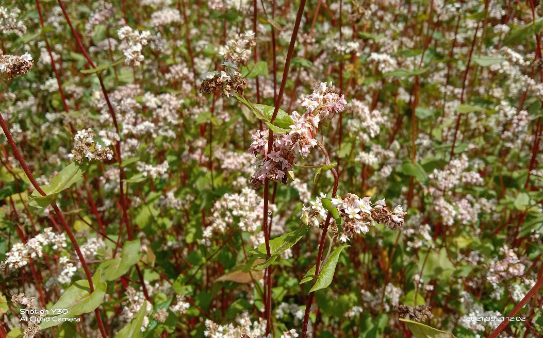
Petiole Color (Pink, Green)
Leaf Margin Color (Pink and Green)
Flower and Immature Seed Colour (White)
Stem colour (Pink)

