Slide 1
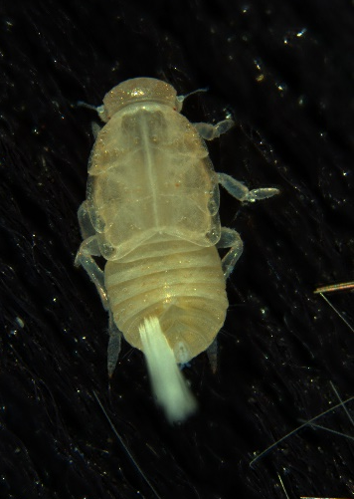
Figure S1 . Morphology of Pentastiridius leporinus adults and nymphs. (A) adult female (B) adult male, (C) third-instar nymph, (D) fourth-instar nymph and (E) fifth-instar nymph.
A B
C D E
2 mm
2 mm
2 mm

Slide 2
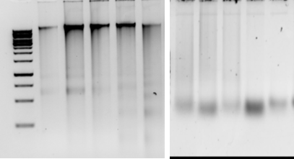
Figure S2 . Agarose gel electrophoretic separation of pure (left side ) and crude (right side) nucleic acid extracts prepared from Pentastiridius leporinus adults (lane 1 and 2) and nymphs (lanes 3-5). The DNA marker is 1 kb ladder (M).
M 1 2 3 4 5
1 2 3 4 5
10 kb

Slide 3
Figure S3. RPA for specific detection of Pentastiridius leporinus. RPA was performed for 5, 10 and 15 minutes at 39°C using DNA samples of H. obsoletus (Lanes 1 to 3) and P. leporinus (lanes 4 to 6) adult samples. RPA products were gel-separated without an additional purification step. The size of amplicons was compared with 100 bp ladder (M).
M 1 2 3 4 5 6 1 2 3 4 5 6 1 2 3 4 5 6
300 bp
__________ __________ __________
5 min 10 min 15 min

